Slide 1

KLAS Users’ Group Meeting
Maureen Dorosinski, President, KLAS Users’ Group
James Burts, Keystone Systems
Mitake Burts, Keystone Systems
Drea Callicutt, Keystone Systems
Growth in Action: Advancing Library Service
through Community Partnerships
NLS National Conference | September 10−12, 2024

Slide 2
Agenda:
Introductions
Keystone Updates
KLAS Development Updates
KLAS Users’ Group Officers’ & Committees
KLAS Users’ Conference
Q&A
Growth in Action: Advancing Library Service
through Community Partnerships
NLS National Conference | September 10−12, 2024

Slide 3
Keystone Updates
Services Update
2024 SSAE Certification Completed
Migrated all hosted customers to private micro VMs
  Addressed KLAS issues exposed when migrating
Ongoing Cataloging Service
  Basic - $250 / month
  Series - $200 / month
  “All-in” - $400 / month
Growth in Action: Advancing Library Service
through Community Partnerships
NLS National Conference | September 10−12, 2024

Slide 4
Keystone Updates
New KLAS Users
Jewish Braille Institute – New York, NY
Alabama Instructional Resource Center – Talladega, AL
Growth in Action: Advancing Library Service
through Community Partnerships
NLS National Conference | September 10−12, 2024

Slide 5
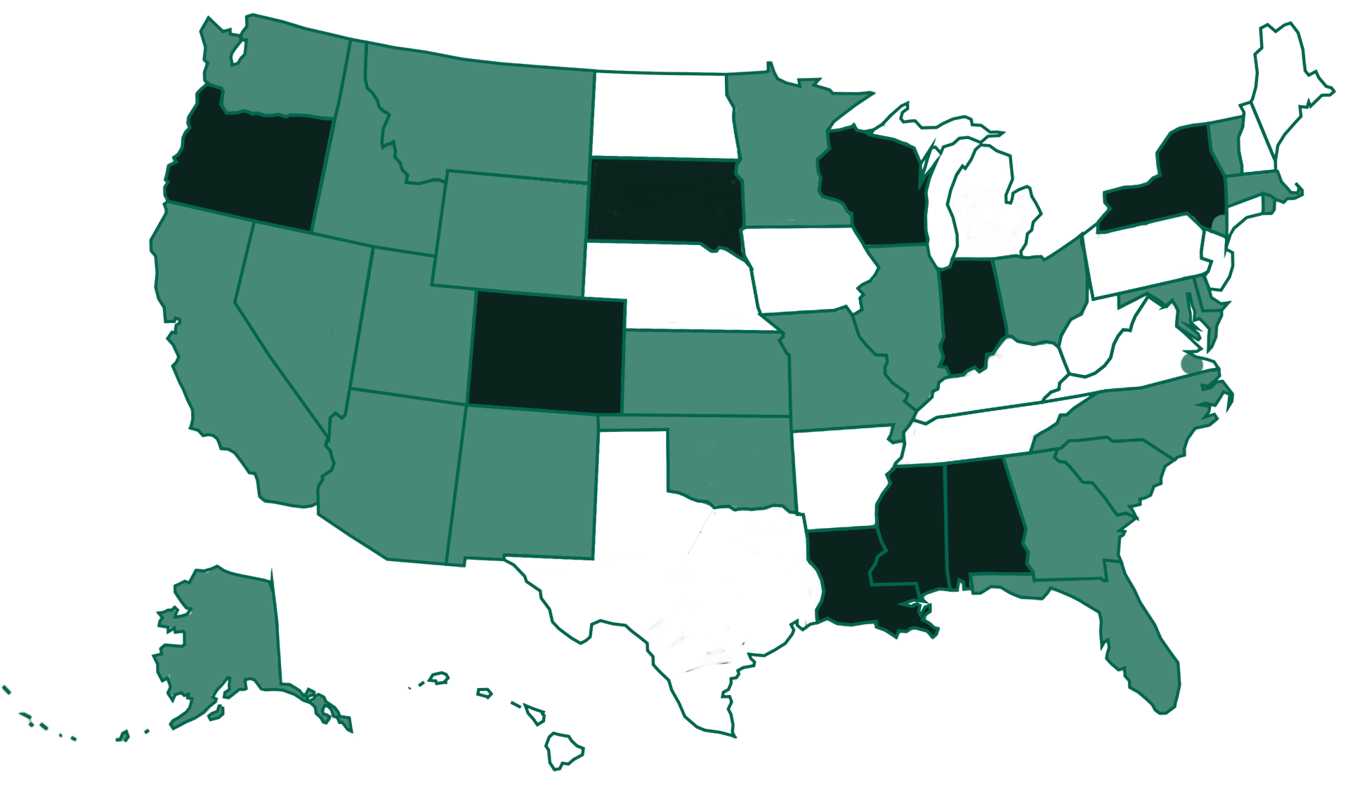
Keystone Updates
Current LBPD Customers
Growth in Action: Advancing Library Service
through Community Partnerships
NLS National Conference | September 10−12, 2024
Notes:
NLS network libraries use KLAS to provide service in 34 states plus the Virginia Beach area. Of these, 9 libraries are self-hosted and 25 are Keystone-hosted (some states have multiple network libraries). Dark green indicates self-hosted installations, while states in light green are Keystone-hosted.

Slide 6
Keystone Updates
KLASusers.com
Forums
Blog Posts
Release Lists
Webinar Recordings
Customer Specific Training Recordings
KLAS Training Manuals
MARC Record Update Files
Upcoming Events & Training Opportunities
Growth in Action: Advancing Library Service
through Community Partnerships
NLS National Conference | September 10−12, 2024

Slide 7
Keystone Updates
Other Communication Channels
KLASUsers listserv
KLASUsers IRC listserv
Weekly Wrap-up
Keystone Social Media
Facebook
Twitter
LinkedIn
Growth in Action: Advancing Library Service
through Community Partnerships
NLS National Conference | September 10−12, 2024

Slide 8
Keystone Updates
Online KLAS Administrator Training
4-day intensive, small group training led by Keystone staff
Deep dive into KLAS Admin features & functions
Growth in Action: Advancing Library Service
through Community Partnerships
NLS National Conference | September 10−12, 2024

Slide 9
KLAS Development Updates
Recent Development Highlights
Switch to micro-servers revealed a major resource inefficiency
The performance fix unfortunately had other consequences, which should now be fully corrected.
Growth in Action: Advancing Library Service
through Community Partnerships
NLS National Conference | September 10−12, 2024

Slide 10
KLAS Development Updates
Recent Development Highlights
Password Security Settings
Serials Updates to support MOC Duplication
  Issues created based on files
  Batch Seed Serial
  Create Dup Order by Medium
PIMMS sync, transfer bug fixes & improvements, incl. AAA server authentication
Growth in Action: Advancing Library Service
through Community Partnerships
NLS National Conference | September 10−12, 2024

Slide 11
KLAS Development Updates
Recent Development Highlights
OpenEdge 12.6.16 security update:
If you are not yet at KLAS v7.8.22 – please update ASAP
Growth in Action: Advancing Library Service
through Community Partnerships
NLS National Conference | September 10−12, 2024

Slide 12
KLAS Development Updates
Upcoming Development Priorities
Parental Acknowledgement handling
  Store Acknowledgement
  Sync with PIMMS
  Block patron if not in place
Keycloak integration for single-sign
Out-of-state emergency Duplication handling
Continued Serials improvements
Growth in Action: Advancing Library Service
through Community Partnerships
NLS National Conference | September 10−12, 2024

Slide 13
KLAS Users’ Group
Officers
Maureen Dorosinski, President
Traci Timmons,
Past President
Josh Easter,
Vice President
Sara Zapotocky, Secretary
Committees
KLAS Development Advisory Committee Chair: Jesse McGarity
Program Committee Chair: Jesse McGarity
Logistics Committee Chair: Maureen Dorosinski
Growth in Action: Advancing Library Service
through Community Partnerships
NLS National Conference | September 10−12, 2024

Slide 14
KLAS Users’ Group Committees
KLAS Development Advisory Committee
Serves as an advisory role to Keystone on new features being developed for future releases of KLAS.
Meets once per month, apply to serve for two years

Slide 15
KLAS Users’ Group Committees
Program Committee
Online programs each month; during years of Mini Conference, once per quarter.
Meets once per month, new members always welcome
Logistics Committee
Accommodations, transportation, gifts, speakers, incentives for conference.
Meets once per month, new members always welcome

Slide 16

KLAS Users’ Conference
March 17-20, 2025
Indianapolis, IN
Early-bird Registration
open now
Call for Proposals
Info & links at
KLASusers.com
Growth in Action: Advancing Library Service
through Community Partnerships
NLS National Conference | September 10−12, 2024

Slide 17
KLAS Users’ Conference
Driving Innovation & Inclusion in Libraries: Start Your Engines!
Growth in Action: Advancing Library Service
through Community Partnerships
NLS National Conference | September 10−12, 2024

Slide 18
KLAS Users’ Conference
Hotel
Embassy Suites by Hilton Indianapolis Downtown
$133/ night + tax (or prevailing gov. rate)
Breakfast
Evening reception
Conference Site
Indiana State Library
Walking distance from hotel

Slide 19
KLAS Users’ Conference
Registration Deadlines and Costs
In-Person Attendee Registration:
In-Person Early-bird (before December 18, 2024) = $200 with Early-bird discount
In-Person (December 18, 2024 - February 16, 2025) = $250 per attendee
In-Person Late (after February 16, 2025) = $300 with late fee

Slide 20
KLAS Users’ Conference
Registration Deadlines and Costs
Virtual Attendee Registration:
Virtual Early-bird (before December 18, 2024) = $85 with Early-bird discount
Virtual Attendee (after December 18, 2024) = $100 per attendee

Slide 21
KLAS Users’ Conference
Sessions Proposals
Open Now!
Close Call Sept. 20
Agenda Timeline
• Oct. 11 Overview Schedule
• Nov. 8 Initial Agenda
• Dec. 6 Final Agenda

Slide 22
Q & A

Slide 23
Thank you!

