Slide 1

New Features for IRC
7.8.15 – 7.8.25
Nancy Honeycutt –
Manager, Customer Support
Keystone Systems

Slide 2
Agenda
Materials Request
Acquisitions
Patron
Circulation / Catalog
WebOrder and other updates

Slide 3

Materials Request
Assign the full quantity of consumables (making sure not to pull from deleted shelves or holdings)
Notes:
Auto assign of full quantity of consumables (making sure not to pull from deleting shelves)
For Equipment Consumable titles set to Assign automatically, KLAS was only Assigning items from the first shelf encountered with any inventory, even if this was below the requested quantity and more items were available on other shelves. This has been corrected, and automatic Assignment of Equipment Consumables will now pull from multiple shelves as needed to Assign the full requested quantity. Issue #KLAS-3322 7.8.21
If the user has not selected specific consumable records to use, the Assign MatRequestLine function finds shelves that have available consumables to Assign. A flaw was causing this program to return more results than it should. Although the flaw was not preventing the Assignment from being completed successfully, it has now been corrected and the program is now functioning as intended. Issue #KLAS-3319 7.8.21
When Assigning an MR Line, KLAS skipped consumables on Home Shelves associated with deleted Holdings, but consumables on Temp Shelves for deleted Holdings could still be selected, resulting in an error. This has been corrected, and Temp Shelves for deleted Holdings will now also be skipped. Issue #KLAS-3352 7.8.22

Slide 4
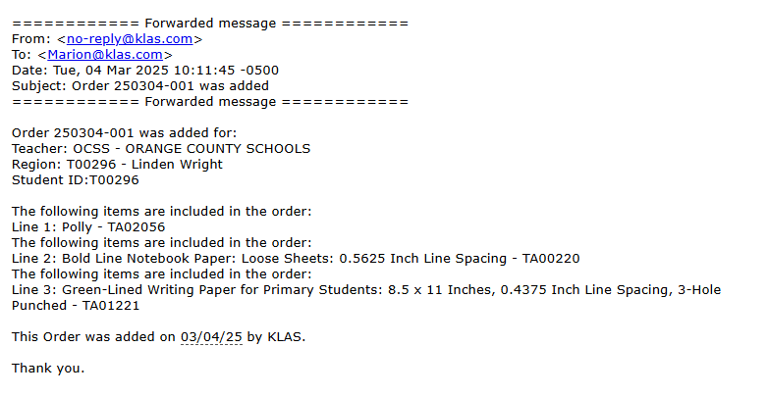
Materials Request - Emails
New Options:
  Tracking number
  Reporting period
Notes:
Emails – add tracking number, Reporting period
Support has been added to the MatRequest Event emails for the following tokens: Report Period ID, Report Period Desc, Report Period Begin Date, and Report Period End Date. Issue #KLAS-3119 7.8.22
When setting an MR Line to an action that should send an email, several errors were recorded to the agent log and the email was not sent. This has been corrected, and Mat Request event emails will be sent as expected again. Issue #KLAS-3355 7.8.22
Added a “TrackingNumList” token for the automatic emails that are sent based on the ShipPost action for Materials Requests. Issue #KLAS-2981 7.8.20

Slide 5
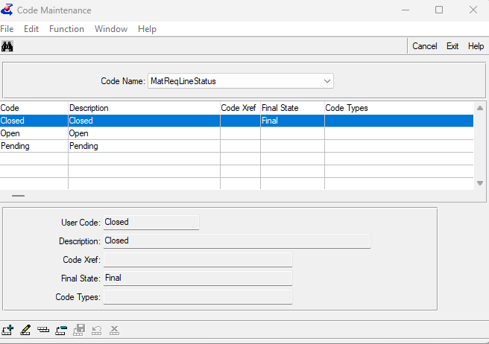
Materials Request
Temp Titles – ISBN corrections
Set MR Header status based on line action
Notes:
When a 13-digit (979) ISBN is entered for a title via Add TempTitle, both the ISBN and Other ISBN fields are now updated and the ISBN will be displayed in the Catalog Window. This was already working as expected for 10-digit (978) ISBNs. Issue #KLAS-3295 7.8.20
Posting a MatRequest Line was previously hard-coded to set the Header status to Closed if all lines were something other than Open or Pending. Now KLAS will use the MatRequest line status settings to determine whether all lines are at a Final status and the request can be Closed, or if it must remain Open. Issue #KLAS-3371 7.8.24

Slide 6
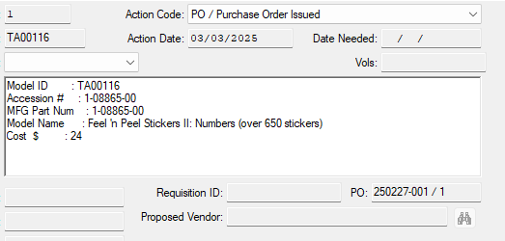
Mat Request / Acquisitions
Stop a MR Line from being added to a second PO
Notes:
Issue Acq Item was not previously checking to see if a MatReq line already had an Order Line issued for it, allowing a duplicate Order Line to be created in certain circumstances. Validation has now been added to prevent this. Issue #KLAS-3345 7.8.22

Slide 7
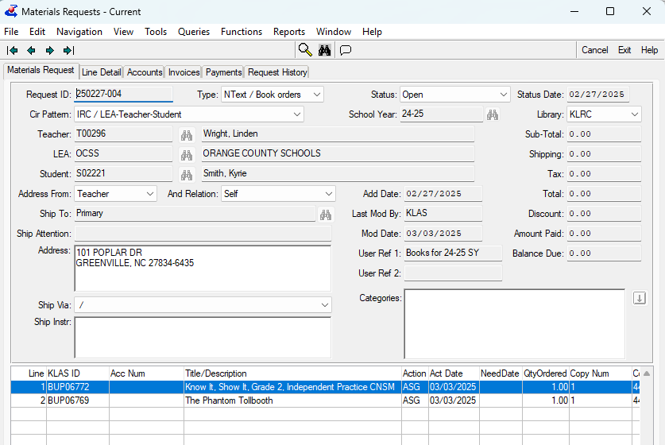
Mat Request - Invoices
New Invoice function for Mat Requests
New Invoice Tab
  make sure F5 refresh works
Notes:
Create Invoice function for Mat Requests
Invoice Tab – make sure F5 refresh works
New screen/function for creating invoices from completed MatRequests. Addresses a number of workflow concerns. Issue #KLAS-2976 7.8.20

Slide 8
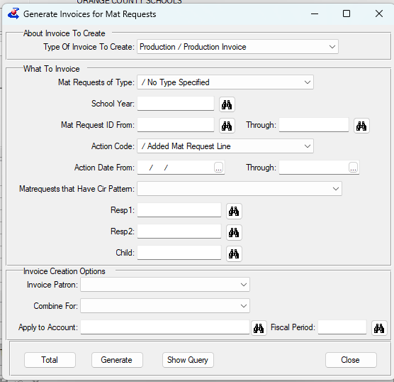
Mat Request - Invoices
New - Generate Invoice function
  On Functions menu
  Based on MR lines
Set up Invoice Linetype crossref for pricing
  Ask Keystone for assistance
Notes:
Generate Invoice function – lots here
Set up Invoice Linetype crossref for pricing
New screen/function for creating invoices from completed MatRequests. Addresses a number of workflow concerns. Issue #KLAS-2976 7.8.20
The MatRequest Generate Invoices function will now create Invoice lines in order by the Line number of the MatRequest. Issue #KLAS-3374 7.8.23
Make sure that all costs applied to an MR line get passed on to the invoice line via the Generate Invoices function -- Including Processing Fees and Shipping Costs. Issue #KLAS-3359 7.8.23
The Generate Invoices screen includes Patron ID fields used to designate a patron whose MatRequests should be combined into one invoice. Now, the entered Patron ID will also be used as part of the criteria to determine which results are displayed. Issue #KLAS-3376 7.8.23
If the user leaves the “Invoice Patron” or “Combine For” fields blank (i.e. does not select a relationship in either field) an error message will now be displayed, and the generate will not proceed. Previously, the function would attempt to run before eventually reporting 0 invoices selected. Issue #KLAS-3383 7.8.23
The Generate Invoices screen now has the following improvements/corrections: the Type of Invoice combo-box now includes the description as well as the code, the Reporting Period lookup now returns the list of periods with an appropriate type, and the Apply to Account lookup no longer drops the populated Fiscal Period when the user leaves the field. Issue #KLAS-3348 7.8.23
On the Generate Invoices window, the Fiscal Period ID was not being displayed once the Account Balance was selected. This has been corrected and the Fiscal Period field will now be filled in as expected. Issue #KLAS-3400 7.8.25
There are some cases where Invoice Lines' unit price and sub-detail totals need to be independent of each other, so a setting has been added to the InvoiceLineType cross reference to control whether the sub-detail totals are used to set the unit price. Issue #KLAS-2992 7.8.23

Slide 9
Materials Request
COMING SOON:
  query on line type
  key in Student IDs on the MR Header (instead of selecting from the Find)
Notes:
The LineType field on has been added to the Query options under MatRequestLine. Issue #KLAS-3411 7.8.26
The Update Material Request screen previously did not look up a manually entered Patron ID in the Student ID field as it does for the Responsible 1 and 2 fields, requiring use of the Look-up button instead. This has been corrected, and now either the Look-up button can be used or the desired Patron ID can be entered directly. Issue #KLAS-3079 7.8.26

Slide 10
Acquisitions
Print invoice – include all fields on title record
COMING SOON
Print order – tokens for Adding user, bibliographic info
Notes:
The Print Invoice function has been modified so that all fields in the Catalog record are now available to be used in the detail form. Issue #KLAS-3257 7.8.18
A new token “PaymentListUserName” is added to the Print Invoice function. This will display the same information as the existing "PaymentList" token, but with the user’s Full Name (as entered in Security Control) instead of the User ID for the user that entered each payment. The layout as follows: <Payment Date> <Amount Paid> <Payment Type> <(Check Number OR Reference Number)> <UserFullName> Issue #KLAS-3272 7.8.26

Slide 11
Acquisitions / Mat Request
Fixed issue with processing fee and how it gets put on the associated MR line
Update order – prorate tax on completed MR lines
or create newline with tax.
Notes:
Solely for PNDB

Slide 12
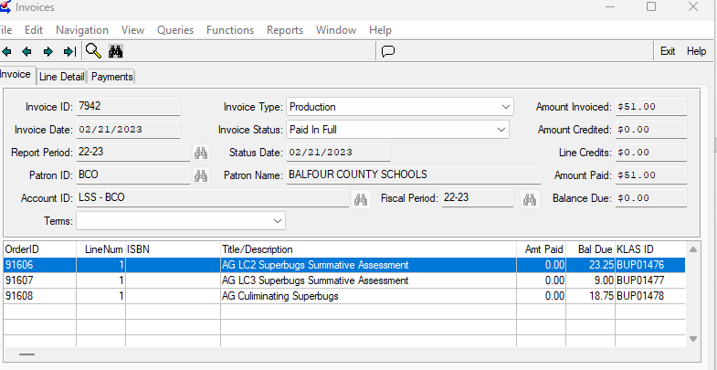
Acquisitions - Invoices
Added Terms
Corrected Tab order
Notes:
Invoice – add Terms Code to screen
Invoice – correct tab order
The TermsCode is used in the computation of whether or not Invoices are past due, but it was not previously displayed on the Invoices screen. It has now been added to the Invoice header as a combo-box, allowing the user to select from any available codes during an update. Issue #KLAS-3409 7.8.25
The tab order of the Credit Invoice function has been corrected to properly reflect the intended order of the fields. Issue #KLAS-3313 7.8.21

Slide 13
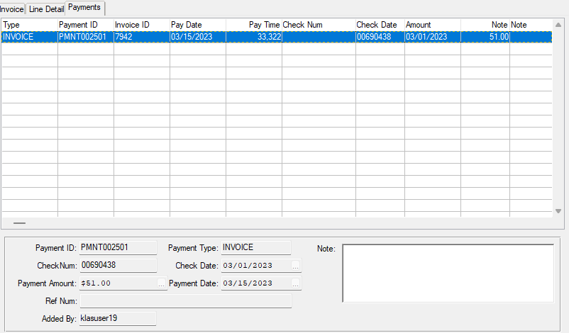
Acquisitions - Invoices
Ability to Add / Modify/ Delete payments
Payments get displayed
Notes:
Invoice – ability to Add / Modify/ Delete payments
Invoice – make sure payments get displayed
The Add/Modify/Delete Panel on the Payments Tab in Invoices has been adjusted to ensure that it activates the proper viewer. Additionally only Modify and Delete payment are allowed. To create a payment, the user needs to use the Pay or Credit functions. Issue #KLAS-3289 7.8.20
Changes made in 7.8.20 inadvertently caused Payments and Credits to no longer display. This has been corrected and all Payments and Credits made for an invoice will be shown as expected. Issue #KLAS-3316 7.8.21

Slide 14
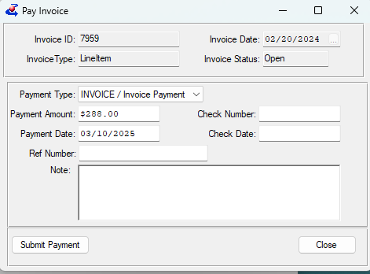
Acquisitions – Invoice Payments
pay/credit invoice with various types
validate payment dates
Notes:
Invoice – pay/credit invoice with various types
Invoice – validate payment dates
In previous releases, a Credit Type field was added to the credit invoice screen, and Payment Type was added to the payment screen. This release adjusts the business logic such that adding or adjusting a payment or credit will now affect the balance due, amount paid, and account balance as expected. Issue #KLAS-3300 7.8.20
If the user attempts to submit a payment with an invalid date - a message will be returned about the date. Issue #KLAS-3292 7.8.20

Slide 15
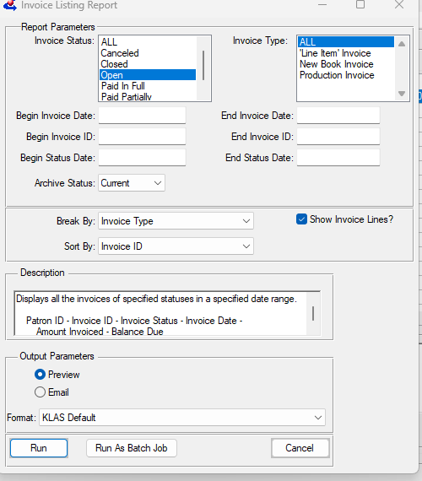
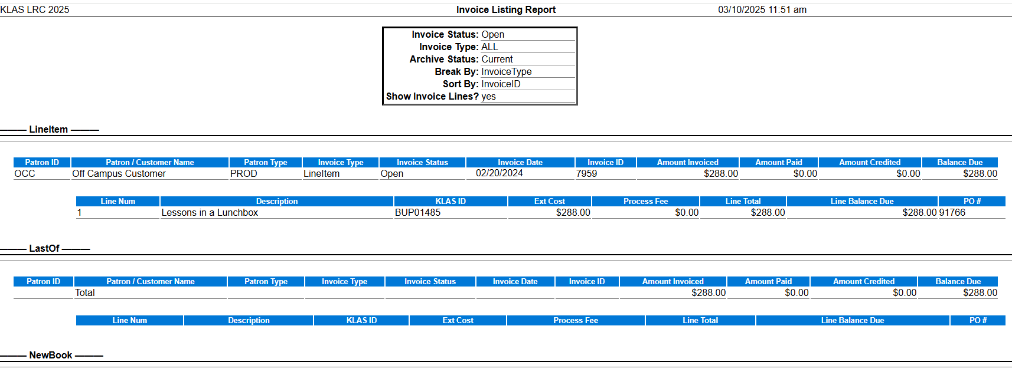
Acquisitions – Invoice Listing Report
Includes:
  Amt Paid
  Amt Credit
  Subtotal
  Total row
  Name formatting
Notes:
The Invoice Listing Report has been updated to include: Amount Paid, Amount Credited, SubTotal rows, and a Total row. Additionally, the formatting of the Name for non-individuals has been corrected. Issue #KLAS-3364 7.8.24
The Sort by Invoice ID option for the Invoice Listing report now functions as expected. Issue #KLAS-3340

Slide 16
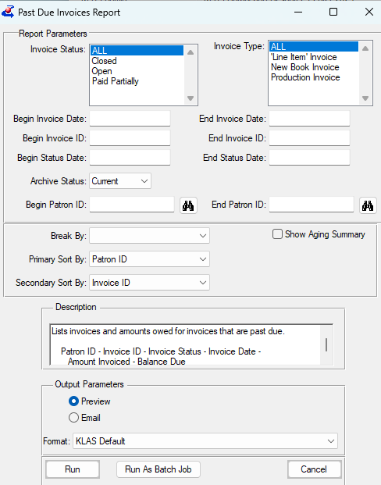
Acquisitions - Past Due Invoices Report
Include the ability to select a patron
aging summary
output changes
Notes:
The ability to specify a Patron or range of PatronIDs has been added to the parameters for the Past Due Invoices report. Issue #KLAS-2758 7.8.24
A number of changes have been made to the Past Due Invoice report. The report output now includes the age of the invoice in days, the Amount Paid, Subtotal for each group, Total, and Summary by Patron. Additionally, a code file has been added to allow libraries to set the desired term before an Invoice is considered Past Due. Issue #KLAS-3350 7.8.24

Slide 17
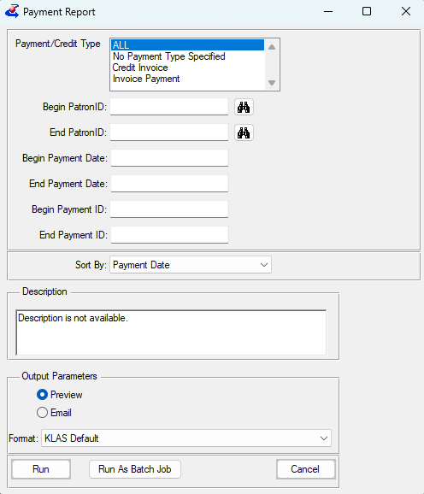
Acquisitions - Payment Report
Improvements
  fixing labels
  sort options
Notes:
Various improvements have been made to the Acquisitions Payment Report, including new parameters (Filter by Payment / Credit type, Patron ID range; Sort by options), the addition of the Account ID to the output Sub Total rows, and a Total row added to the report output. Issue #KLAS-3365 7.8.24
Several corrections have been made to the Payment report: the Payment Type parameter is now labelled, the Patron ID sort option now works as expected, the Payment ID is now included in the report output, and the label for the Report Total is now displayed. Issue #KLAS-3413 7.8.25
Several corrections have been made to the Payment report: the Payment Type parameter is now labelled, the Patron ID sort option now works as expected, the Payment ID is now included in the report output, and the label for the Report Total is now displayed. Issue #KLAS-3413 7.8.25

Slide 18
Patron Maintenance
Add Date bug fix
Merge Patron fixes:
  Was not setting desired new status
  Service Queue titles going into wrong queue
Restore Deleted patrons bug fix & improvement
Notes:
Add Date: KLAS-3286
Merged Patron Status: KLAS-3250
Merging Service Queues: KLAS-3208
Cancel pending dup orders: KLAS-3214
KLAS Deleted: Barcode search now “begins” not “equals” - KLAS-3255
Tool was briefly not returning any results, fixed in KLAS-3218

Slide 19
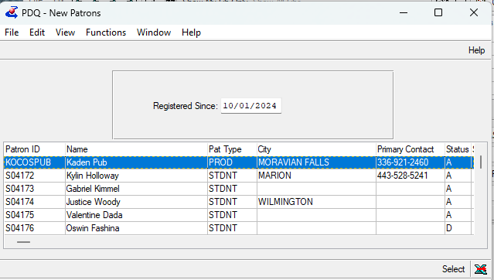
Patron Queries
Import Query sorts by Patron ID again
PDQ bug fixes:
  New Patrons
Merge Queries performance fix
Notes:
New Patrons PDQ: was displaying all patrons, not just new - KLAS-3241
AutoSelect PDQ: was displaying all patrons, not just those without subjects - KLAS-3243
Not Using BARD PDQ: was displaying NO patrons - KLAS-3242
and cutoff date was hard-coded, now only looks at past year for downloads - KLAS-3245
Assigned Orders PDQ: displaying all patrons - KLAS-3244
Merge queries: KLAS-3393

Slide 20
Patron Export
Patron Query Results fields for Export:
  Primary Language, Primary Reading Level, Disability, Referral Source, Service Code, Last Served Date
  Export All Fields, or request customization of Visible
Notes:
Query Results Export: in “All Fields” export; can be added to Visible Fields upon request - KLAS-2807
Find Export - KLAS-3237

Slide 21
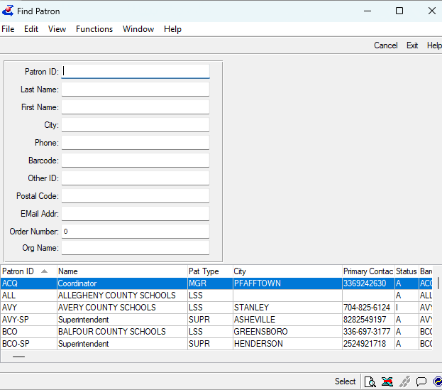
Patron Find
Export fixed to only Export currently listed patrons
Notes:
When exporting results from Patron Find to Excel, the output was including all patron records instead of only the records that matched the Find criteria and were displayed in the browse. This has been corrected, and the Patron Find screen's Export will function as expected again. Issue #KLAS-3237 7.8.17

Slide 22
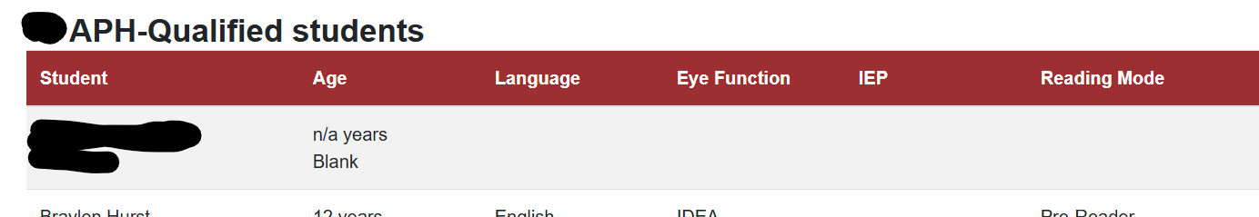
Census / Weborder
Fixed columns so they don’t overwrite each other
Notes:
The WebOrder Census Status screen has a table that shows all the related patrons for the district. On narrow screens, the second column was displaying on top of the first. This has been corrected, and all columns in the table will now react appropriately in narrow windows and on mobile devices. Issue #KLAS-3372 7.8.23

Slide 23
WebOrder / WebOPAC
Set language tag in html for screen readers
COMING SOON:
  Ability to mark literacy modes to keep from being displayed online
Notes:
The xHTML metadata in the WebOrder templates now specifies the language attribute "en" for English. Issue #KLAS-3414 7.8.25

Slide 24
Patron – Empty module bug
Where did my patrons go?!
  KLAS needs 1 blank PatSearchResults record to display and move between records in the module
  A minor change unexpectedly caused adding or deleting a patron to also add/delete this record
  KLAS now auto-restores this record if needed
  Logging added to catch anything that removes it
Notes:
F5 or Ctrl-F to restore PatSearchResults record

Slide 25
Catalog
Chasing performance issues at certain libraries
  Bad SDO configurations are resolved
  Is your catalog crashing? Slower than molasses? Please tell us!
Notes:
SDO Config - KLAS-3394

Slide 26
Catalog
Undo Merge Title
  We now have the ability to undo an erroneous merge, moving the copies/items back to their original titles. Just let us know ASAP!
Notes:
A utility has been created to allow Customer Support to un-merge recently merged catalog records based on a backup of the parts of the record most commonly used by IRCs. A future update will allow the rest of the merged record to be restored. Issue #KLAS-3382 7.8.23

Slide 27
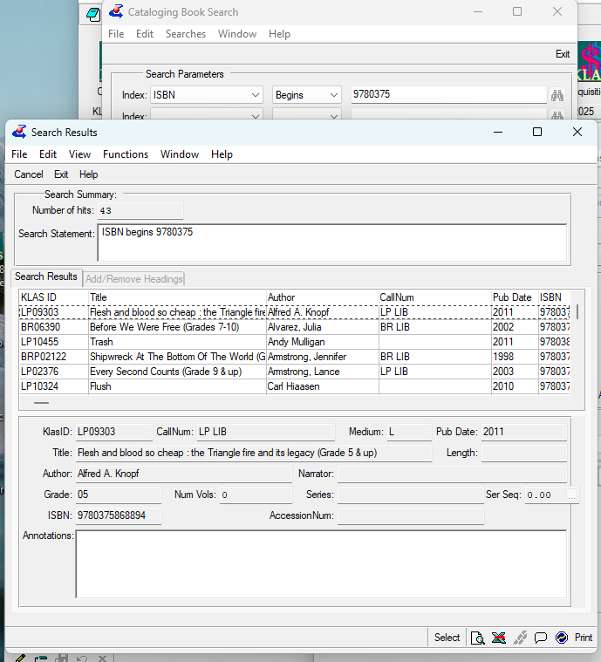
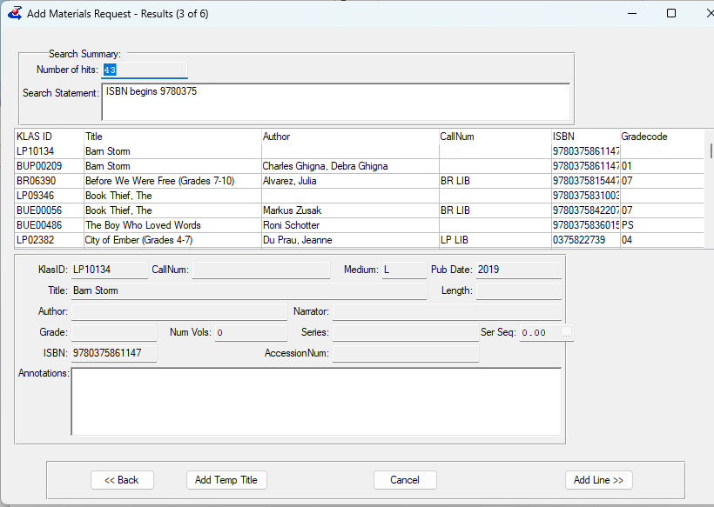
Catalog / Mat Request
Make search results consistent between Catalog search and the Add Line search
Notes:
The Add Material Request Wizard's search results screen has been modified to use the same browse customizations as the Catalog search results screen. Issue #KLAS-3128 7.8.24

Slide 28
Catalog / Aquisitions
Add a Part Number when adding items, if the Collation Final is not checked
Notes:
When adding a copy through Add Items, if the Collation is not marked Finalized the name of the volume, supplement, or preliminary being added will now include a part number. When the Copy is updated to Collation Finalized, that part number will automatically be removed from the Item Name. Issue #KLAS-3417 7.8.25

Slide 29
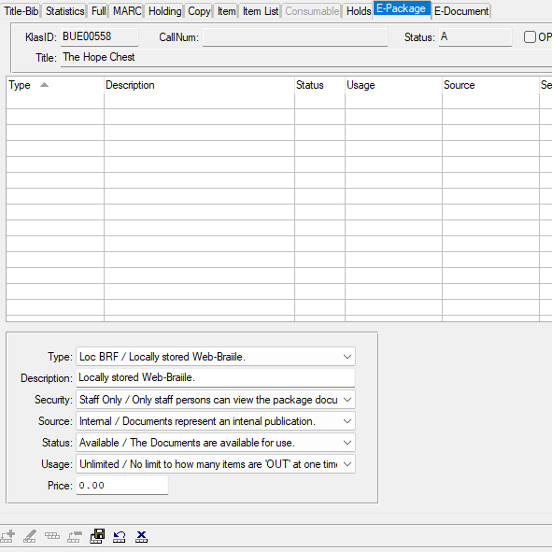
Catalog / Weborder / Webopac
Suppress download links for epackages that are designated “Staff only”
Notes:
The WebOpac will no longer show links for eDocs for which the Security Level on the ePackage is set to “Staff Only.” All other Security Levels will continue to be displayed so long as the filters are set up to show download links for eDocs. Issue #KLAS-3387 7.8.24

Slide 30
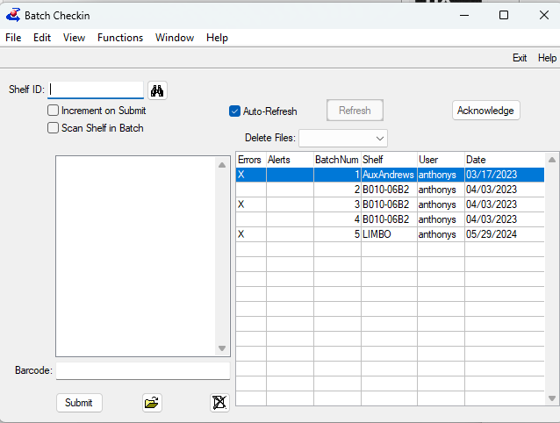
Circulation
Batch Check-in directory fix
Notes:
Batch Check-in - KLAS-3246
The Batch CheckIn function was still attempting to save configuration information in the C:\klas7 directory, which was used in 7.6 and prior versions. Customers may not have noticed this problem as they had remnants of 7.6 installations left on their workstations, but new users were not able to save as expected. This has been corrected, and the program will now write to the appropriate directory for the KLAS instance type. Issue #KLAS-3246 7.8.17

Slide 31
KLAS Core
Full System Backup temp storage improvement
Code File Maintenance
  Character limit for Codes increased to 15
Blocks Maintenance
  Blocks now sort by Block ID Number
  System Blocks can no longer be Copied
  IDs lower than 1000 can no longer be manually entered
Notes:
Backup – The weekly full system backup temp location can now be mounted to a separate drive, allowing just that drive’s storage space to be increased if needed to allow for the backup without affecting the full system. Once backup is complete, the temp file is compressed and saved to backup location. - KLAS-3390
Codes – new limit supports ParentalAck codes from NLS - KLAS-3362
Blocks – System Blocks cannot be deleted by users; changes ensure they cannot be created by users - KLAS-3329

Slide 32
Questions & Answers

