Slide 1

New Features for LBPD
7.8.15 – 7.8.26
Katy Patrick –
Technical Writer, Keystone Systems

Slide 2
Agenda
KLAS Core
Patron
Serials
Circ & Catalog
Scribe
Coming Soon

Slide 3
KLAS Core
Full System Backup temp storage improvement
Code File Maintenance
  Character limit for Codes increased to 15
Blocks Maintenance
  Blocks now sort by Block ID Number
  System Blocks can no longer be Copied
  IDs lower than 1000 can no longer be manually entered
Notes:
Backup – The weekly full system backup temp location can now be mounted to a separate drive, allowing just that drive’s storage space to be increased if needed to allow for the backup without affecting the full system. Once backup is complete, the temp file is compressed and saved to backup location. - KLAS-3390
Codes – new limit supports ParentalAck codes from NLS - KLAS-3362
Blocks – System Blocks cannot be deleted by users; changes ensure they cannot be created by users - KLAS-3329

Slide 4
Patron Acknowledgements
NLS Parental / Legal Acknowledgement
  Main tab Prompt for Juvenile patrons
  New ParentalAck, LegalAck Properties
  Parent/Guardian, Legal Alt Contact Types, Contact Preferences
  PIMMS sync updates, PIMMS Transfer update
  Blank birth dates synced as 01/01/1900
  System blocks based on AltContact & Property
Notes:
Parental Acknowledgement: https://klasusers.com/klas-news/parental-acknowledgement-support
Parental Acknowledgement FAQ: https://klasusers.com/knowledgebase/nls-parental-acknowledgement-faq
Institutional Acknowledgement: https://klasusers.com/klas-news/nls-institutional-acknowledgement
Not blocking relevant accounts without the Acknowledgement yet? Get in touch!

Slide 5
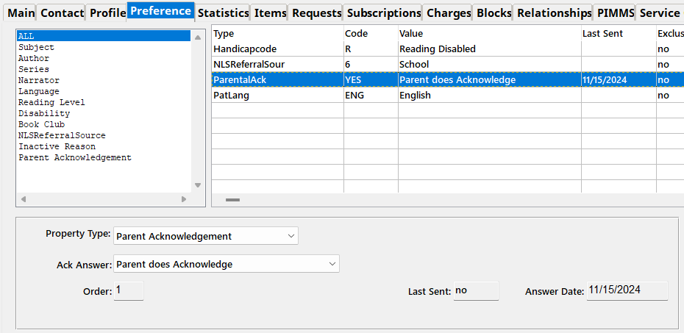
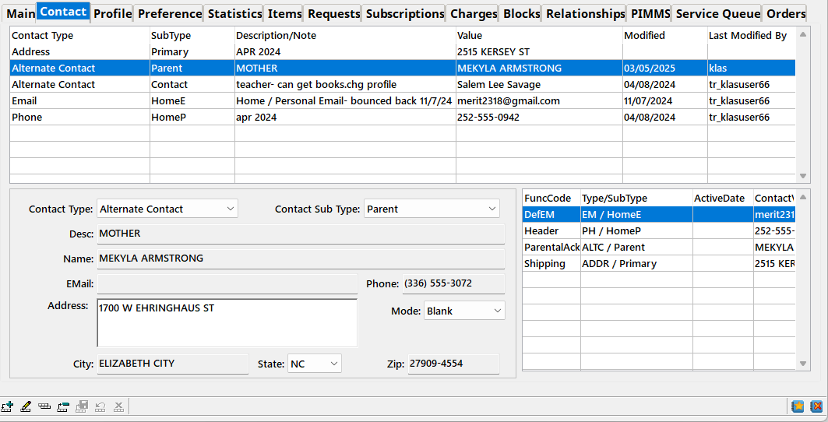
NLS Acknowledgements

Slide 6
Patron Maintenance
Add Date bug fix
Merge Patron fixes:
  Was not setting desired new status
  Service Queue titles going into wrong queue
Patrons with pending Dup Orders can’t be deleted
  Pending Dup Orders are now cancelled when the patron is made inactive
Restore Deleted patrons bug fix & improvement
Notes:
Add Date: KLAS-3286
Merged Patron Status: KLAS-3250
Merging Service Queues: KLAS-3208
Cancel pending dup orders: KLAS-3214
KLAS Deleted: Barcode search now “begins” not “equals” - KLAS-3255
Tool was briefly not returning any results, fixed in KLAS-3218

Slide 7
Patron Service
Support for Addresses outside of USA
Keyboard Shortcut for Add To Service Queue from Book Search Results (Alt-s)
Various Series Fixes
  Restart – HasNow check fix, Medium check fix
  Next Title logic excludes Withdrawn titles
  HasHad check for linked titles
  Shuffle Queue fix for titles in multiple series
Notes:
Keyboard shortcut: KLAS-3258
Series: restart tries to reserve title in wrong medium - KLAS-3343; error in HasNow check for restart - KLAS-3405; Next title logic now excludes Withdrawn titles - KLAS-3302; HasHad problem with compilations linked to single-sequence titles - KLAS-3403; Shuffle queue now correctly handles titles in multiple series - KLAS-3304

Slide 8
Patron Queries
Import Query sorts by Patron ID again
PDQ bug fixes:
  New Patrons
  AutoSelect w/ No Subjects
  Patrons Not Using BARD
  Patrons w/ Assigned Orders
Merge Queries performance fix
Notes:
New Patrons PDQ: was displaying all patrons, not just new - KLAS-3241
AutoSelect PDQ: was displaying all patrons, not just those without subjects - KLAS-3243
Not Using BARD PDQ: was displaying NO patrons - KLAS-3242
and cutoff date was hard-coded, now only looks at past year for downloads - KLAS-3245
Assigned Orders PDQ: displaying all patrons - KLAS-3244
Merge queries: KLAS-3393

Slide 9
Patron Export
New Patron Query Results fields for Export:
  Primary Language, Primary Reading Level, Disability, Referral Source, Service Code, Last Served Date
  Export All Fields, or request customization of Visible
Patron Find Exports fixed to only Export currently listed patrons
Notes:
Query Results Export: in “All Fields” export; can be added to Visible Fields upon request - KLAS-2807
Find Export - KLAS-3237

Slide 10
Patron – Empty module bug
Where did my patrons go?!
  KLAS needs 1 blank PatSearchResults record to display and move between records in the module
  A minor change unexpectedly caused adding or deleting a patron to also add/delete this record
  KLAS now auto-restores this record if needed
  Logging added to catch anything that removes it
Notes:
F5 or Ctrl-F to restore PatSearchResults record

Slide 11
PIMMS
PIMMS now uses an authentication token
Properties’ Notes now transfer
Institution accounts with an Email now sync First & Last Name from the contact note
When looking up the PIMMS Circ ID to transfer a patron, KLAS now compares the statuses
The re-sync now checks whether a patron is a Repair Agency
Notes:
Auth token - KLAS-3294
Property Note transfer - KLAS-3256
Institution names – for BARD access; last word of the contact note is interpreted as Last Name, the rest is sent as the First Name. OR if a comma is present, everything before the comma is the Last Name, and everything after it is the First Name - KLAS-3210
PIMMS Circ ID lookup - The PIMMS CircID Lookup now only returns records that are consistent with the Merge/Delete status of the KLAS Patron. ex. if adding or accepting a transfer for a Patron with an ID or Barcode that has been recycled, treat this record as an active record and do not accept matches from PIMMS that are Deleted or Merged. - KLAS-3216
Resync – For machine transactions, regular patrons and Repair Agencies are treated differently; the re-sync now handles this appropriately - KLAS-3366

Slide 12
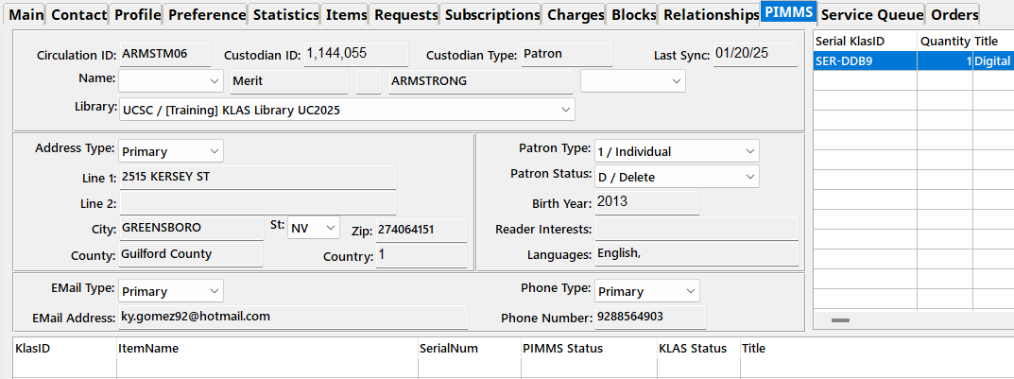
PIMMS Status
PIMMS Deleted status can now be updated!
Notes:
PIMMS Deleted: sync no longer ignores patrons with a PIMMS status of Deleted; if the KLAS status does not map to Deleted, they will now be updated accordingly - KLAS-3406 (Note – if their PIMMS ID has been reused in the meantime, this will return an error; contact Customer Support for the fix.)
Should your PIMMS status mapping be updating accordingly? Just want to know what your PIMMS status mapping is? Get in touch!

Slide 13
Serials – MoC Duplication effects
NLS Circ Statistics Report updated accordingly
MoC eDoc Sync now ignores deleted Serials
MoC Sync no longer re-creates deleted Issues
CallNum character limit & display expanded
Notes:
Circ Stats - KLAS-3357
eDoc Sync - KLAS-3248
Issue Sync - KLAS-3269
CallNum - KLAS-3249

Slide 14
Serials – Improvements
Pub / Publication Serial Type excluded from updating Last Served date
Service Subscription/Seed Serial no longer delete manually-added Reserves
Batch Cancel/Substitute Subscription program
When a Subscription is deleted, Reserves for issues of that serial are deleted with it
Notes:
Pub Serials – NLS serials should be updating the patrons’ Last Served dates, but prevents your Newsletter or similar local serials from making a patron look like they are being served when they really aren’t. - KLAS-3281
Manual Reserves - KLAS-3263
Batch Cancel – Cancels all subscriptions for a given serial, with option of adding a new substitute for all subscribers; contact us if this is needed - KLAS-3228
Delete Reserves – Seed Serial doesn’t clean up reserves for a patron once they are no longer a subscriber, so this prevents orphaned reserves - KLAS-3268

Slide 15
Serials – Bug Fixes
Batch Seed Serials fixes
Service Subscription uses Serving library’s limits
eDocs tab can display more than 50 rows
No longer Reserves all Issues if KLAS can’t calculate Retention
Fill Queue fixes
Notes:
Batch Seed - No longer skips whole serial if 1 Subscriber has an error - KLAS-3285; No longer crashes if there are too many errors - KLAS-3240; Only runs for subscribers served by the Run As Branch – KLAS-3284
Service Subscription - KLAS-2779
eDocs tab - KLAS-3342
Retention – Usually, this would be due to the patron not having a Service Queue - KLAS-3261
Fill Queue – was ignoring Issue on Reserves and just pulling the first eDoc - KLAS-3317; HasHad and Medium checking descrepencies addressed later.

Slide 16

Serials Maintenance
Medium cannot change if title is already in Orders and/or Service Queues
Notes:
No medium change – This was causing too many problems with cutoffs etc; better to just create a new title/serial record when switching medium KLAS-3315 (Also applies to Catalog / monograph records)

Slide 17
Catalog
Chasing performance issues at certain libraries
  Some small adjustments behind-the-screen have already been made, more in progress.
  Is your catalog crashing? Slower than molasses? Please tell us!
Notes:
SDO Config - KLAS-3394

Slide 18
Circulation
Batch Check-in directory fix
Mail Card improvements
  support for addresses outside of USA
  Issue Name prints appropriately
Notes:
Batch Check-in - KLAS-3246
International Mailcards – Country Code previously only USA - KLAS-3252
Issue Name – Serial name is repeated in the MOC Issue Name format; KLAS will now print only the part of the Issue Name after a dash - KLAS-3227

Slide 19
Patron Service Queues & Orders
HasNow/HasHad checking
  Fixed a HasNow check against Pending Orders
  Completed Orders excluded from HasNow check
  Checks are now all Issue-level, not Serial-level
Order Medium checks fixed to ignore Initial Titles
  At Assignment, Checkout
Notes:
Pending Orders - KLAS-3358
Completed Orders - KLAS-3346
Issue-level checks - KLAS-3389
Order medium check – Assign: KLAS-3305; Checkout: KLAS-3314

Slide 20
Scribe
New Cache
  Will recognize and refresh updated files
New Advanced Barcodes
  Reset Service, Fix Ports, Firmware Start/Stop
  Reboot / Shut Down
  (Note: Please leave Scribes ON as much as possible!)

Slide 21
Coming Now
7.8.26 – in Early Release
  Accessibility fixes – Mail Cards screen, Show Item History in the Catalog
  Send Again will Pause when needed
  Add Item on the Catalog Items tab defaults to selected Holding & Copy
Notes:
AT Fixes – Tab order of Mail Cards screen - KLAS-3327; Show Item History added to Catalog Functions menu - KLAS-3184
Send Again - KLAS-3337
Add Item - KLAS-3415

Slide 22
7.8.26
Alt Length added to catalog Find export
Deleted Acquisition Method codes no longer added back by updates
Fix for cartridge SN barcode swapping error
More corner-case Series fixes
Notes:
Alt Length – in All Fields export; can be added to Find screen’s visible fields on request - #KLAS-3429
Acq Method codes - #KLAS-3401
Cartridge serial number – cartridge SNs are used as their Item Barcode in KLAS, and barcodes must be unique. When a cartridge changes medium, the old item record gets a prefix on the barcode to free it up for use in the new medium. Now, if the new item record still can’t be added, KLAS will append a suffix to the barcode to ensure the cartridge can check out - KLAS-3198
Series fixes – Add Series HasHad message no longer repeats info when that sequence is linked to multiple titles - KLAS-3421; HasHad messaging fix for titles with a manual HasHad - KLAS-3422; Series processing will no longer pick a ‘next’ title in a language the patron can’t receive - KLAS-3423

Slide 23

Coming Soon
Better handling of missing files for Duplication
Automatic creation of SQs for select Media
Keycloak SSO integration
New Scribe WebMonitor
Notes:
Missing files handling: updates will allow for disappearing/reappearing files. details coming soon to KLASusers.com. First changes will be in 7.8.27, handling the Mono side; Serial changes will follow if they don’t make that release.
Automatic SQs: A setting will be added to the AddNewPatMedium xRef to define which Media should automatically create a Service Queue when added to a Patron record. The medium profile needs to be added as ‘Active’ for the queue to be created. Setting will also apply to Transfer-In patrons. Will be in 7.8.27
Keycloak: Will allow for Single Sign-on and two-factor authentication. High priority development. This will also allow release of the new WebMonitor, as that requires user authentication.

Slide 24
Questions & Answers

