Slide 1

KLAS-APH Integration
Kyle Honeycutt
Manager of Software Development
Keystone Systems
Marion Campbell
IRC Customer Support
Keystone Systems

Slide 2
Agenda
Overview of APH Order Integration
How Do you Enable this in KLAS
  Steps
  Who to contact when
What Development is left to be done
Looking ahead: Product Integration

Slide 3
What Is APH Order Integration?
A way to copy a KLAS order to the APH site
A KLAS user starts the process
The order is added at APH using an Application Programming Interface (API)
Data is in Javascript Object Notation (JSON) format
The data is transferred over Secure Hyper-text transfer protocol (HTTPS)

Slide 4
Who Can use it?
A person that meets the following
Must be a KLAS user
Must have permission to the “Set As OnOrder” function in Orders
Must be an EOT or EOT Assistant
Must have a login on the APH site
Must have had APH enable API access

Slide 5
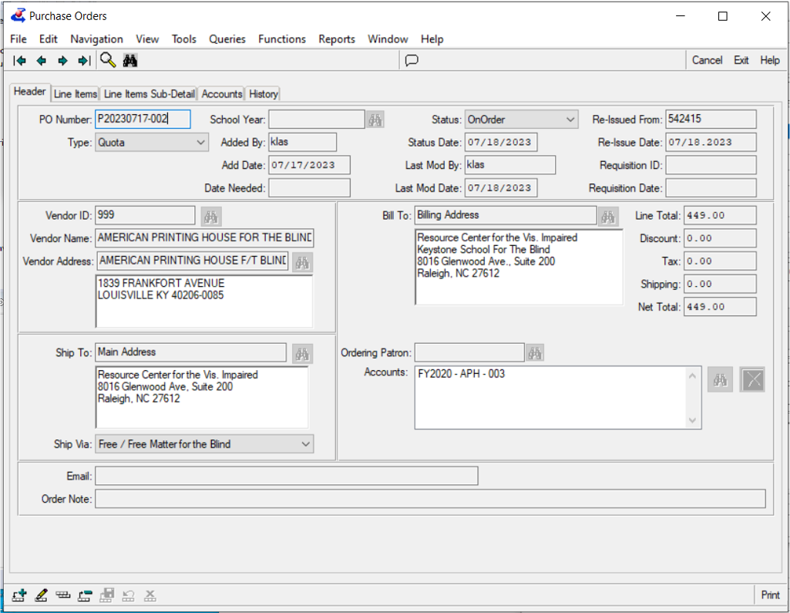
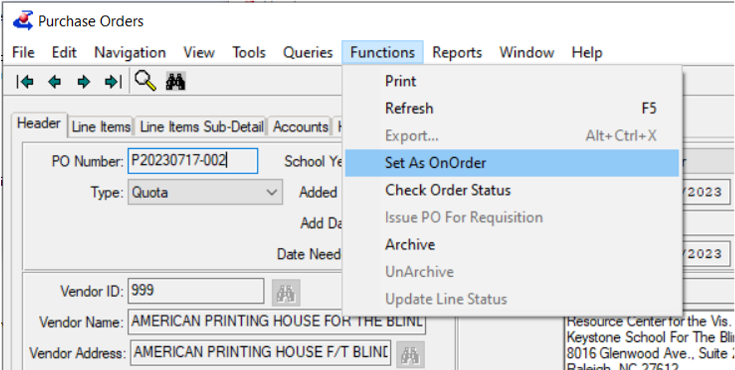
How does It Work?
Order is created in KLAS
The order is “Set As OnOrder” Selected from the function menu

Slide 6

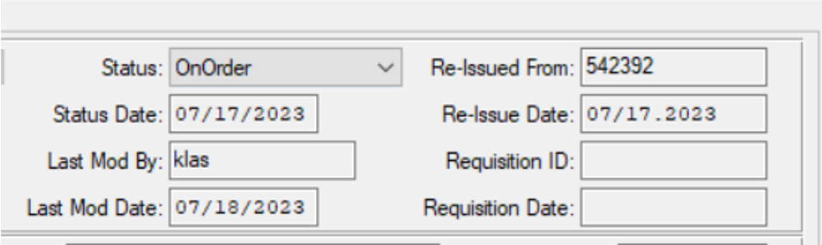
How does It Work? Cont.
The KLAS order is sent to APH (lots of steps are covered)
KLAS receives order information back from APH , Including
The APH Order ID
Notes:
Step 3 KLAS Validates the products
Uses the SKU, stored in vendor catalog number
Checks Availability of product
Blocks order if not available
Updates Vendor catalog status
Checks the price
Updates Vendor Catalog
Updates OrderLine and encumbrance
KLAS POSTS the order to the ordering endpoint
Ex.: https://staging.aph.org/wp-json/wc/v2/orders
This is done server to server
Users will see the windows wait state

Slide 7
How Do you Enable this in klas?
Make sure your EOT or EOT Assistant has a KLAS login, They are the ones doing the ordering.
Contact APH to let them know. The APH contact on this project is Anthony Phillips at japhillips@aph.org
Notes:
KLAS Formats the Order as JSON

Slide 8
How Do you Enable this in klas? Cont.
APH Will enable the account for API Access
APH will notify Keystone of the customer ID (please ask them to do this step)
Keystone will complete the setup, given the customer ID from APH
Klas will let you know to test it with a small order.

Slide 9
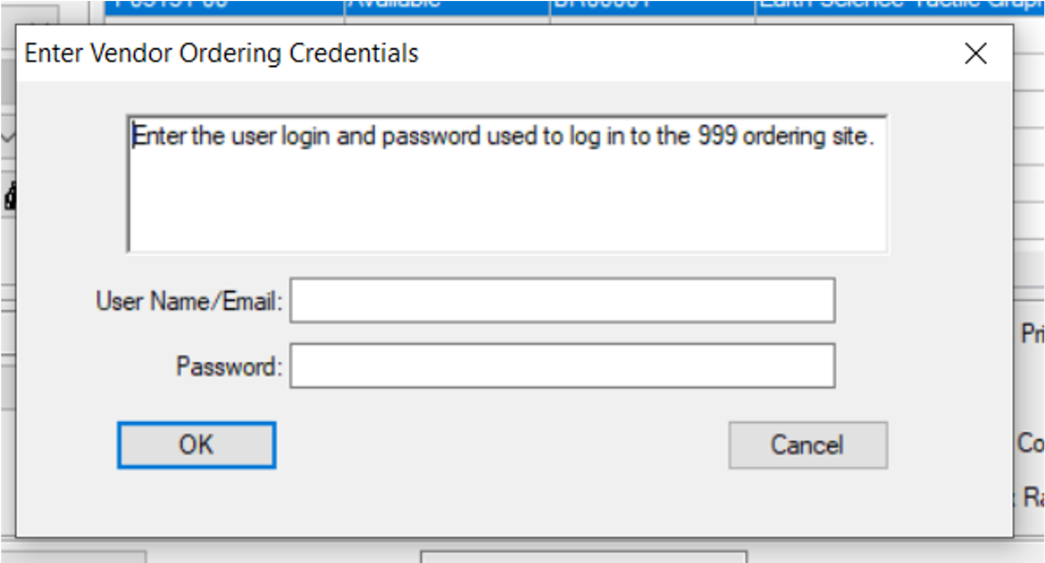
What Development is left to be done?
Remove the password anti-pattern
  We should no longer store credentials
  Expired tokens will require you to log in again

Slide 10

What Development is left to be done?
Add several new setup screens
  Keystone currently have to execute CURL commands
    Ex. To Find the Account ID:
    curl --location "https://staging.aph.org/wp-json/wp/v2/users/29332" --header "Authorization: Bearer g8vpvv19mwotyolb1jm9m2ypbgy2dv7ousgsatxl"
  Keystone staff currently run batch programs
    To set Federal quota account ID

Slide 11
Looking ahead: product integration
APH is producing the catalog in a JSON format file
Keystone will add a function in KLAS to load the data
  Create Bibrecs for new titles
  Create VendorCatalog records
  Update existing title statuses and costs

Slide 12

APH Integration STATUS for new users.
New sign-ups not Available for now.
APH has had some issues with their new eCommerce site that has stopped the ability to set up new users

Slide 13
APH Integration STATUS Catalog
The site hosting the catalog updates for this integration is down
APH is determining if it will be restored

Slide 14
Questions & Answers

