Slide 1

New Features for IRC / IMC
Katy Patrick – Technical Writer,
Keystone Systems

Slide 2
Agenda
KLAS Core
Material Requests
Patron
WebOrder
Coming Soon

Slide 3
KLAS Core
KeyCloak Integration for SSO and/or MFA support
User Security & Permissions update

Slide 4
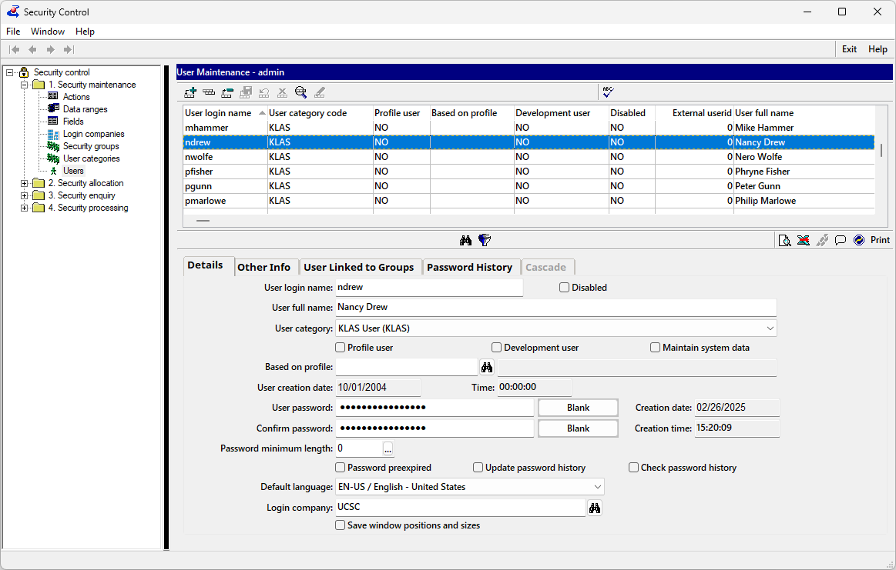
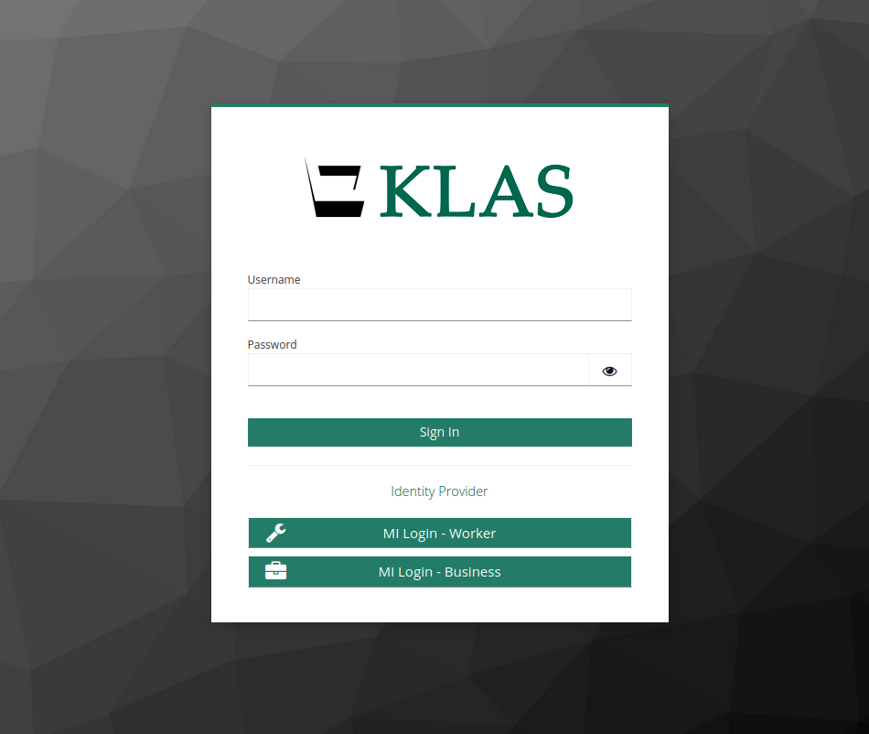

KeyCloak Integration
Built-in KLAS user management
Will continue to be available for now
Basic security options available
If using KeyCloak, users will still be listed
Opening KLAS will launch the browser log-in page:
the KLAS Login Portal (KLASport)
or your SSO (JumpCloud, Microsoft Entra ID, Google Workspace, etc)
KeyCloak provides browser-based login with new options:
More secure login to KLAS, support for MFA
Or connect with your SSO
identity provider
Notes:
Built-in KLAS user management
Will continue to be available for now
Basic security options available
If using KeyCloak, users will still be listed
KeyCloak provides browser-based login with new options:
More secure login to KLAS, support for MFA
Or connect with your SSO
identity provider
Opening KLAS will launch the browser log-in page:
the KLAS Login Portal (KLASport)
or your SSO (JumpCloud, Microsoft Entra ID, Google Workspace, etc)

Slide 5
KeyCloak Integration
Built-in KLAS user management
Will continue to be available
(for now)
Basic security options available
If using KeyCloak, users will still be listed
Opening KLAS will launch the browser log-in page:
the KLAS Login Portal (KLASport)
or your SSO (JumpCloud, Microsoft Entra ID, Google Workspace, etc)
KeyCloak provides browser-based login with new options:
More secure login to KLAS, support for MFA
Or connect with your SSO
identity provider
Notes:
MFA = Multi-factor Authentication
SSO = Single Sign-on
https://klasusers.com/klas-news/klas-single-sign-on-support

Slide 6

KeyCloak Integration : What to Know
Limited release, gradual rollout
  Some functions still in development
  Field testing will result in improvements
Know your Identity Provider
  For SSO, ask your IT
  No SSO? Use KLASport for MFA or other advanced security features
More info at KLASusers.com
Notes:
https://klasusers.com/klas-news/klas-single-sign-on-support

Slide 7
User Security & Permissions
Change Password loophole closed
Newer functions added to the Security Structure
  k7-ct Load External Titles File
  k7-pa Add Service Queue function
  k7-pa Batch Add Comment tool
  k7-pa Reading History Opt-Out tool
  k7-eq Restore Deleted Model tool
Notes:
KS - Change Password - Password change induced by expired password allowing login on cancel - Issue #KLAS-3544
KS - Security Structure - Create Security Structure for Several Functions - Issue #KLAS-3539

Slide 8
Material Requests
Lines by Patron Role Report

Slide 9
MR - Lines by Patron Role Report
Improvement on Students Served report
Select which columns to include in output
  Set preferred columns as default
Examples…
More info at KLASusers.com
Notes:
https://klasusers.com/knowledge-base/lines-by-patron-role-report

Slide 10
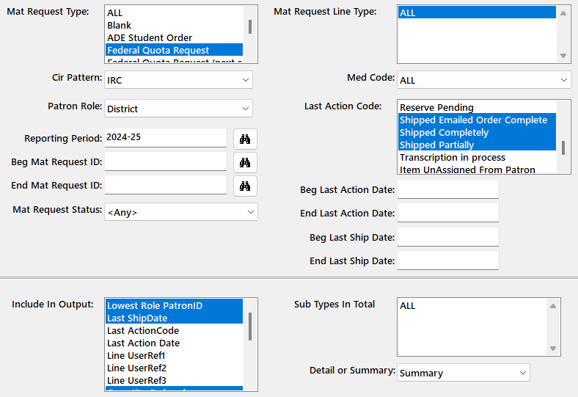
Students Served by District
Mat Request Type:
Federal Quota Request
Cir Pattern: IRC
Patron Role: District
Reporting Period: 2024-25
Last Action Code:
Emailed Order Complete
Shipped Completely
Shipped Partially
Include In Output:
Lowest Role PatronID
Last Ship Date
Quantity Shipped
Net Cost
Detail or Summary: Summary
Notes:
Students Served summary by District
Report to the districts how many students were served, with what dollar value

Slide 11
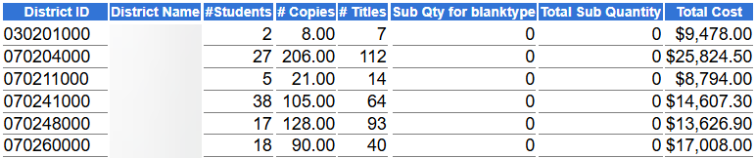
Students by District Output
Patron Role: District = each District is a row (or section of Detail view)
Lowest Role PatronID for the IRC cir pattern = Students
  Student IDs + Summary = count of unique Student Patron IDs

Slide 12
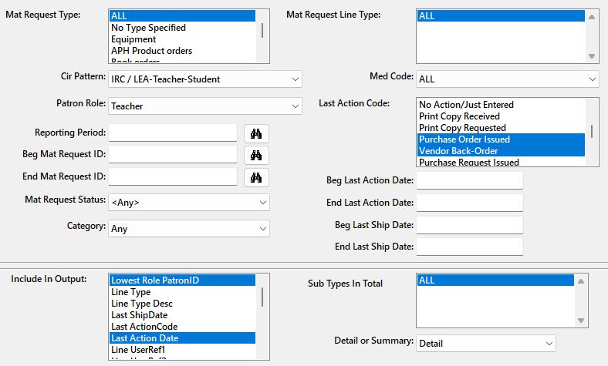
Items on Order by Teacher
Mat Request Type: All
Cir Pattern: IRC
Patron Role: Teacher
Last Action Code:
PO Issued
Vendor Back-Order
Include In Output:
Lowest Role PatronID
Last Action Date
Quantity Ordered / Shipped
KLAS ID, ISBN
Detail or Summary: Detail
Notes:
Students Served summary by District
Report to the districts how many students were served, with what dollar value

Slide 13
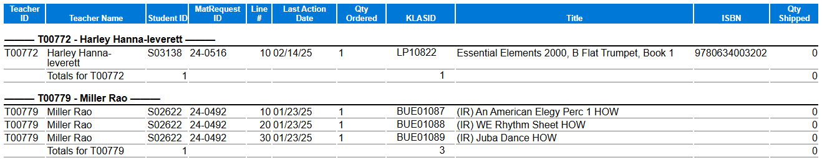
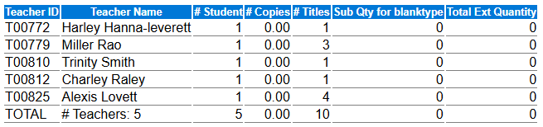
Items on Order output
Patron Role: Teacher = each Teacher is a section (and row in Summary)

Slide 14
Patron
Census Notice

Slide 15
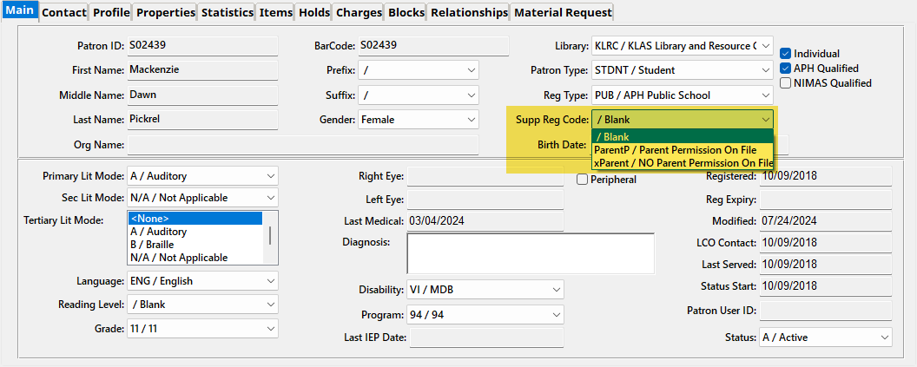
Patron Census Notice
Supplemental Registration Code & Description
can now be included in the notice output:

Slide 16
WebOrder
Security Fixes / Improvements

Slide 17
WebOrder Security Improvements
Cannot be embedded in an iFrame without custom setting to allow an approved “ancestor”
New Session ID set for each log-in to prevent session fixation
Notes:
7.8.32

Slide 18

Coming Soon…

Slide 19
In-process
Consumable Inventory Counters
  Investigation into inaccuracy is ongoing
“On Order” count in Equipment & Catalog
Shortcuts from MR to connected records:
  PO, Requisition
  Title (Catalog / Equipment)
  Patron

Slide 20
In-process cont.
Distinct “Billing Address” on Invoices
APH Census Export screen; straight to xlsx
Ongoing APH Integration
Audit Data report (who changed what, when)

Slide 21
Additional KeyCloak improvements
Track “last active” time (not just “last ping”)
Automatically log out users after a period of inactivity
Ability to terminate a user session from the authentication server
Keystone staff SSO
Notes:
Authentication and session management improvements

Slide 22
Questions & Answers

