Slide 1

New Features for LBPD
Katy Patrick – Technical Writer,
Keystone Systems

Slide 2
Agenda
KLAS Core
Patron
WebOPAC
Coming Soon

Slide 3
KLAS Core
KeyCloak Integration for SSO and/or MFA support
User Security & Permissions update

Slide 4
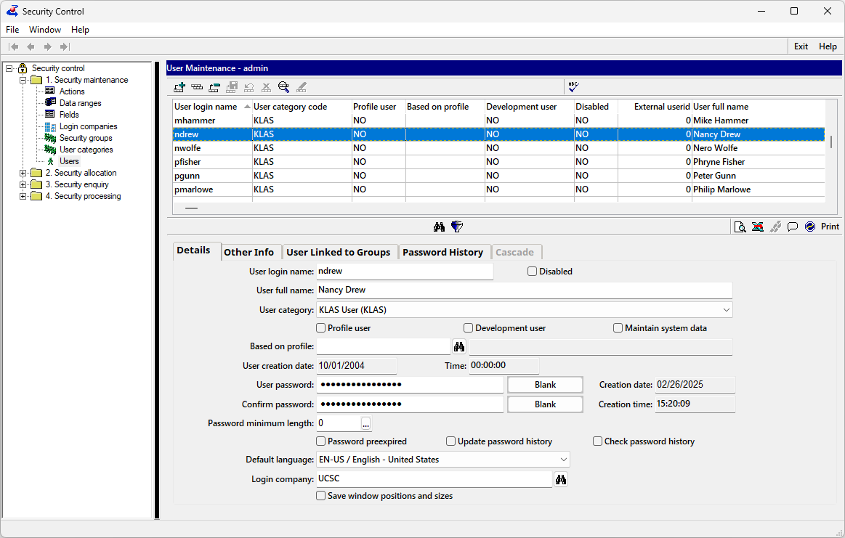
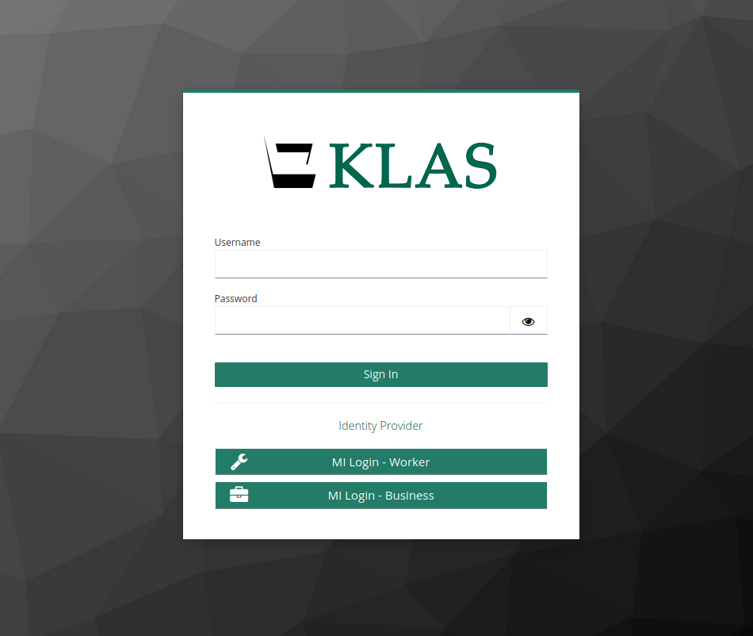

KeyCloak Integration
Built-in KLAS user management
Will continue to be available for now
Basic security options available
If using KeyCloak, users will still be listed
Opening KLAS will launch the browser log-in page:
the KLAS Login Portal (KLASport)
or your SSO (JumpCloud, Microsoft Entra ID, Google Workspace, etc)
KeyCloak provides browser-based login with new options:
More secure login to KLAS, support for MFA
Or connect with your SSO
identity provider
Notes:
Built-in KLAS user management
Will continue to be available for now
Basic security options available
If using KeyCloak, users will still be listed
KeyCloak provides browser-based login with new options:
More secure login to KLAS, support for MFA
Or connect with your SSO
identity provider
Opening KLAS will launch the browser log-in page:
the KLAS Login Portal (KLASport)
or your SSO (JumpCloud, Microsoft Entra ID, Google Workspace, etc)

Slide 5
KeyCloak Integration
Built-in KLAS user management
Will continue to be available
(for now)
Basic security options available
If using KeyCloak, users will still be listed
Opening KLAS will launch the browser log-in page:
the KLAS Login Portal (KLASport)
or your SSO (JumpCloud, Microsoft Entra ID, Google Workspace, etc)
KeyCloak provides browser-based login with new options:
More secure login to KLAS, support for MFA
Or connect with your SSO
identity provider
Notes:
MFA = Multi-factor Authentication
SSO = Single Sign-on
https://klasusers.com/klas-news/klas-single-sign-on-support

Slide 6

KeyCloak Integration : What to Know
Limited release, gradual rollout
  Some functions still in development
  Field testing will result in improvements
Know your Identity Provider
  For SSO, ask your IT
  No SSO? Use KLASport for MFA or other advanced security features
More info at KLASusers.com
Notes:
https://klasusers.com/klas-news/klas-single-sign-on-support

Slide 7
User Security & Permissions
Change Password loophole closed
Newer functions added to the Security Structure
  k7-ct Load External Titles File
  k7-pa Add Service Queue function
  k7-pa Batch Add Comment tool
  k7-pa Reading History Opt-Out tool
  k7-eq Restore Deleted Model tool
Notes:
KS - Change Password - Password change induced by expired password allowing login on cancel - Issue #KLAS-3544
KS - Security Structure - Create Security Structure for Several Functions - Issue #KLAS-3539

Slide 8
Patron
Auto-Add Service Queues

Slide 9
Auto-Add Service Queues
Set by Medium (your choice of DB, DS, etc)
  Use default values or enter custom
Reminder : new Medium profiles can also trigger subscriptions and/or Reserves
  TBT medium, TBT Service Queue, TBT4 subscription
  DS medium, DS Service Queue… Newsletter?

Slide 10
WebOPAC
Security & Accessibility Fixes, Improvements

Slide 11
WebOPAC Security Improvements
Cannot be embedded in an iFrame without custom setting to allow an approved “ancestor”
New Session ID set for each log-in to prevent session fixation
Notes:
7.8.32

Slide 12
WebOPAC Accessiblity Improvements
Updated for WCAG 2.1 compliance
  Filling in missing labels
  Fixing labels which stopped functioning reliably
  Adjusting heading hierarchies
  “Skip to Main Content” link
  Implementation of ARIA regions
  Responsive layout
More info at KLASusers.com
Notes:
https://klasusers.com/klas-news/wcag-2-1-compliance

Slide 13
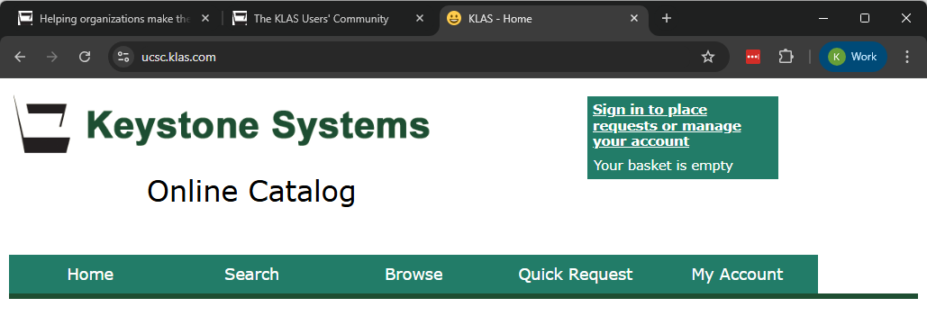
WebOPAC : FavIcon
A favicon helps identify your OPAC’s browser tab
& assures folks that it’s “really you”
?
Notes:
Send a .ico file (or a small icon for us to convert) to ks7@klas.com
Your organization’s web team or whoever is in charge of branding can almost certainly provide you with one!

Slide 14

Coming Soon…

Slide 15
In Partnership with NLS
New NLS Patron Activity Report
USPS intelligent mail barcodes
Online Application integration

Slide 16
Additional KeyCloak improvements
Track “last active” time (not just “last ping”)
Automatically log out users after a period of inactivity
Ability to terminate a user session from the authentication server
Keystone staff SSO
Notes:
Authentication and session management improvements

Slide 17
Other In-process
Audit Data report (who changed what, when)
Continued WebOPAC enhancements
  Library Alert insertion points on log-in screens

Slide 18
Questions & Answers

