Slide 1
State of Keystone:
Updates & Highlights
James Burts, CEO, Keystone Systems
Andrea Ewing Callicutt, Director of Marketing, Sales & Communications, Keystone Systems

Slide 2
Agenda
Keystone Staff
Keystone Customers
Keystone Services Updates
KLAS Development Updates
KLAS Users’ Resources

Slide 3
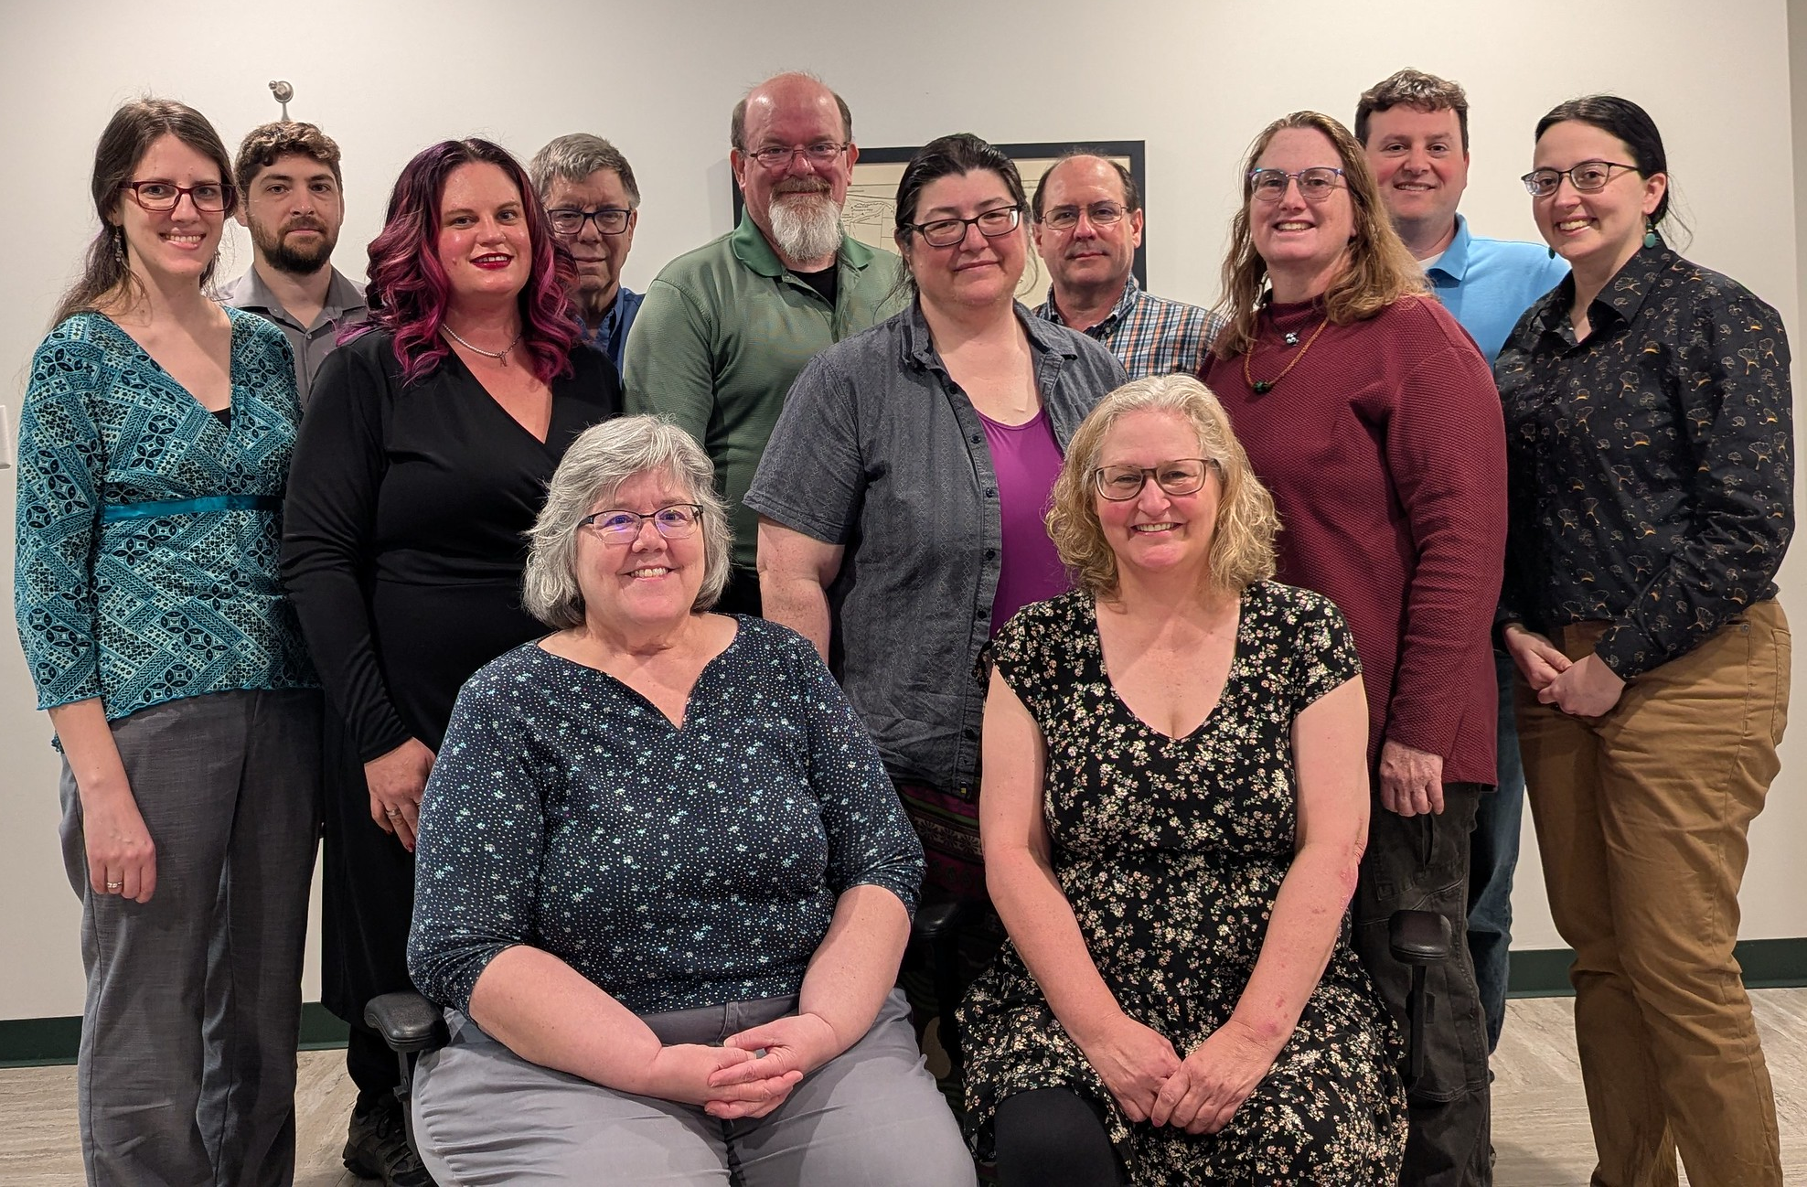
Keystone Staff
Customer Support
Development
Systems Admin / IT
Sales
& Administration

Slide 4
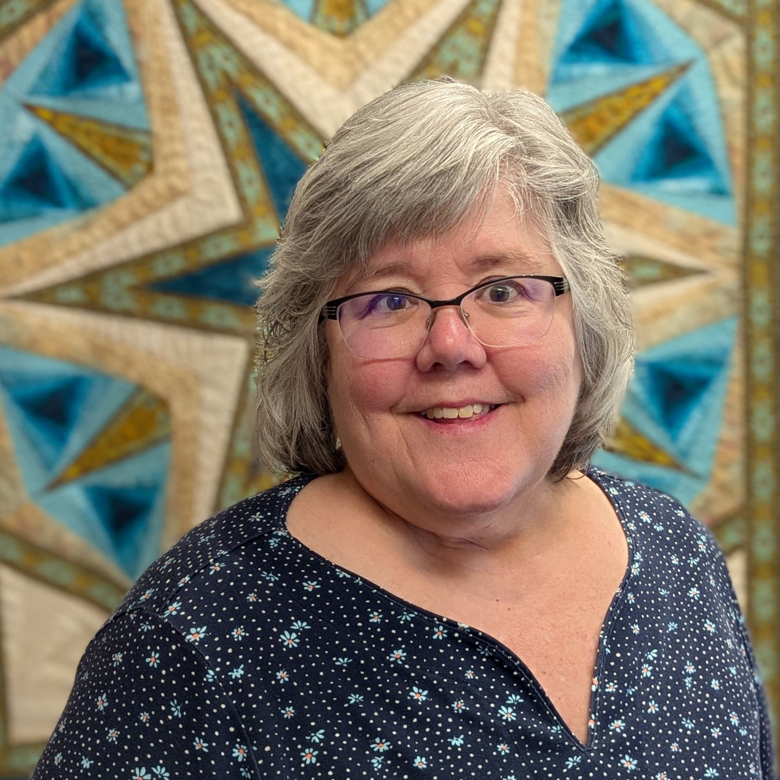
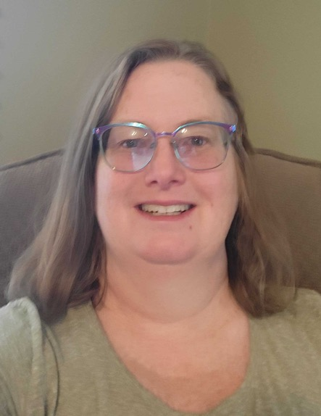
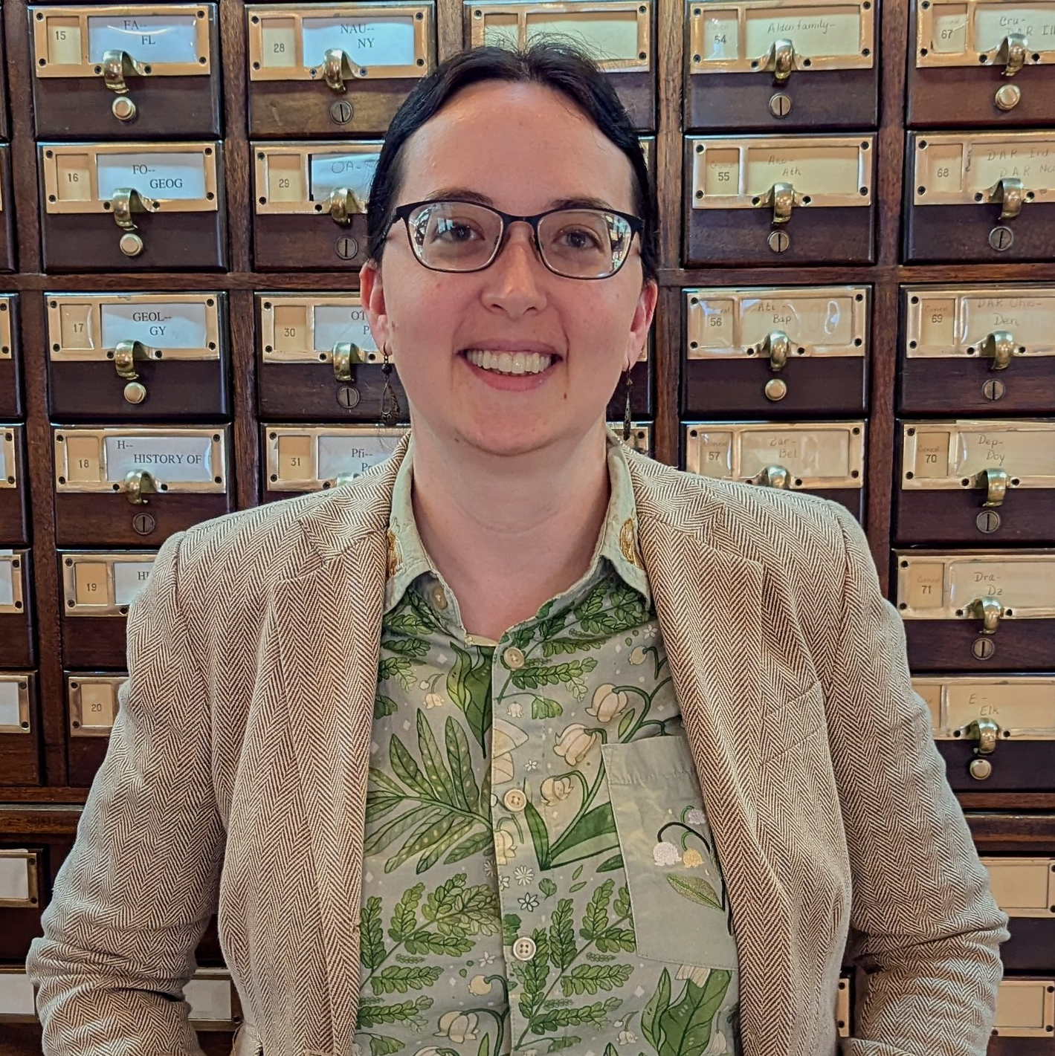
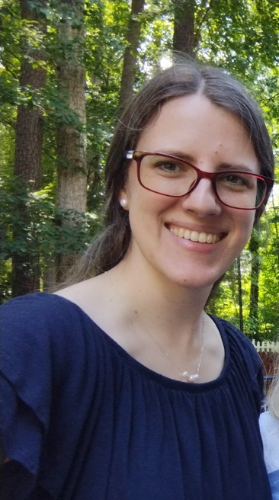
Customer Support
Nancy Honeycutt,
Manager,
Customer Support
Katy Patrick,
Technical Writer
Marion Campbell,
Customer Support Specialist
Katharina Stevens,
Customer Support Specialist

Slide 5
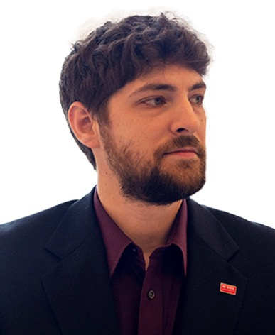

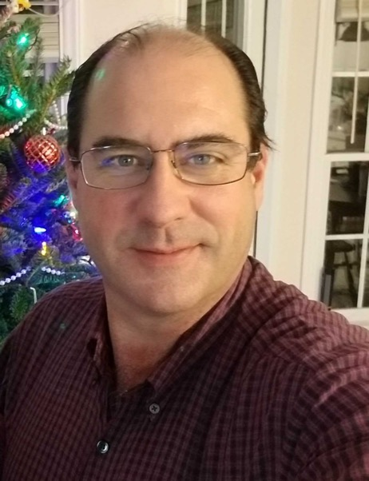

Development
George Martell,
Software Development
Specialist
Mitake Burts,
Chief Product
Development Officer
Kyle Honeycutt,
Manager,
Software Development
John Carpenter,
Software Development
Specialist

Slide 6
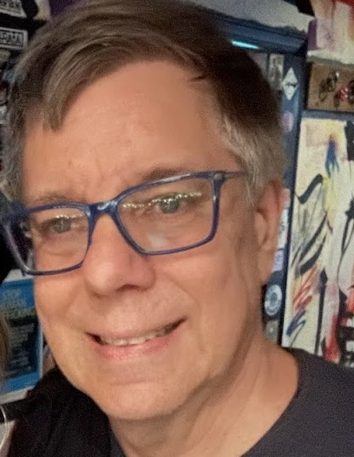
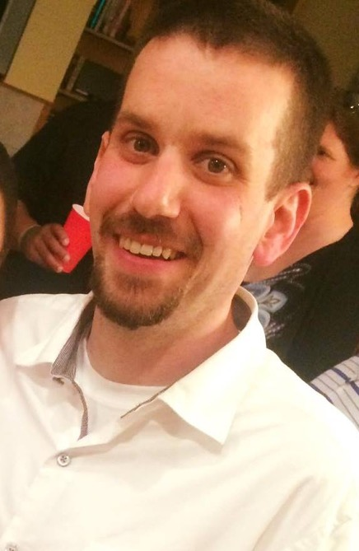
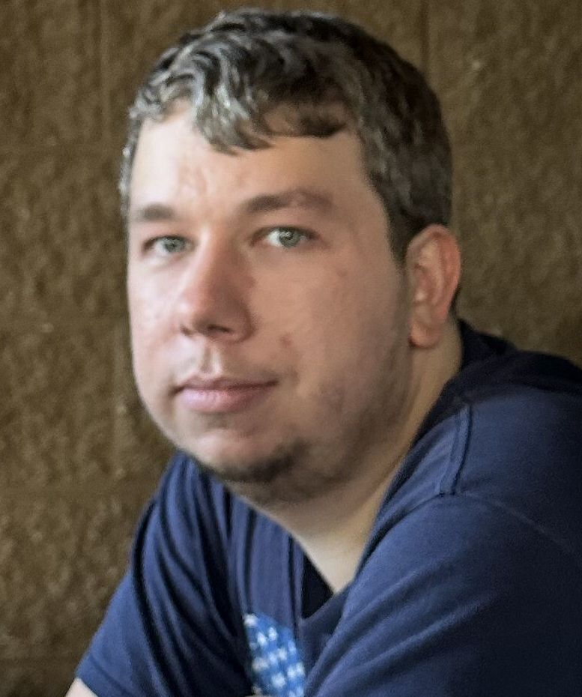
Systems Administration / IT
Mark Gardner, Manger,
Systems & Networking
Lee Higley, Lead Consultant,
Information Technology
Justin Gardner,
Operations Support

Slide 7
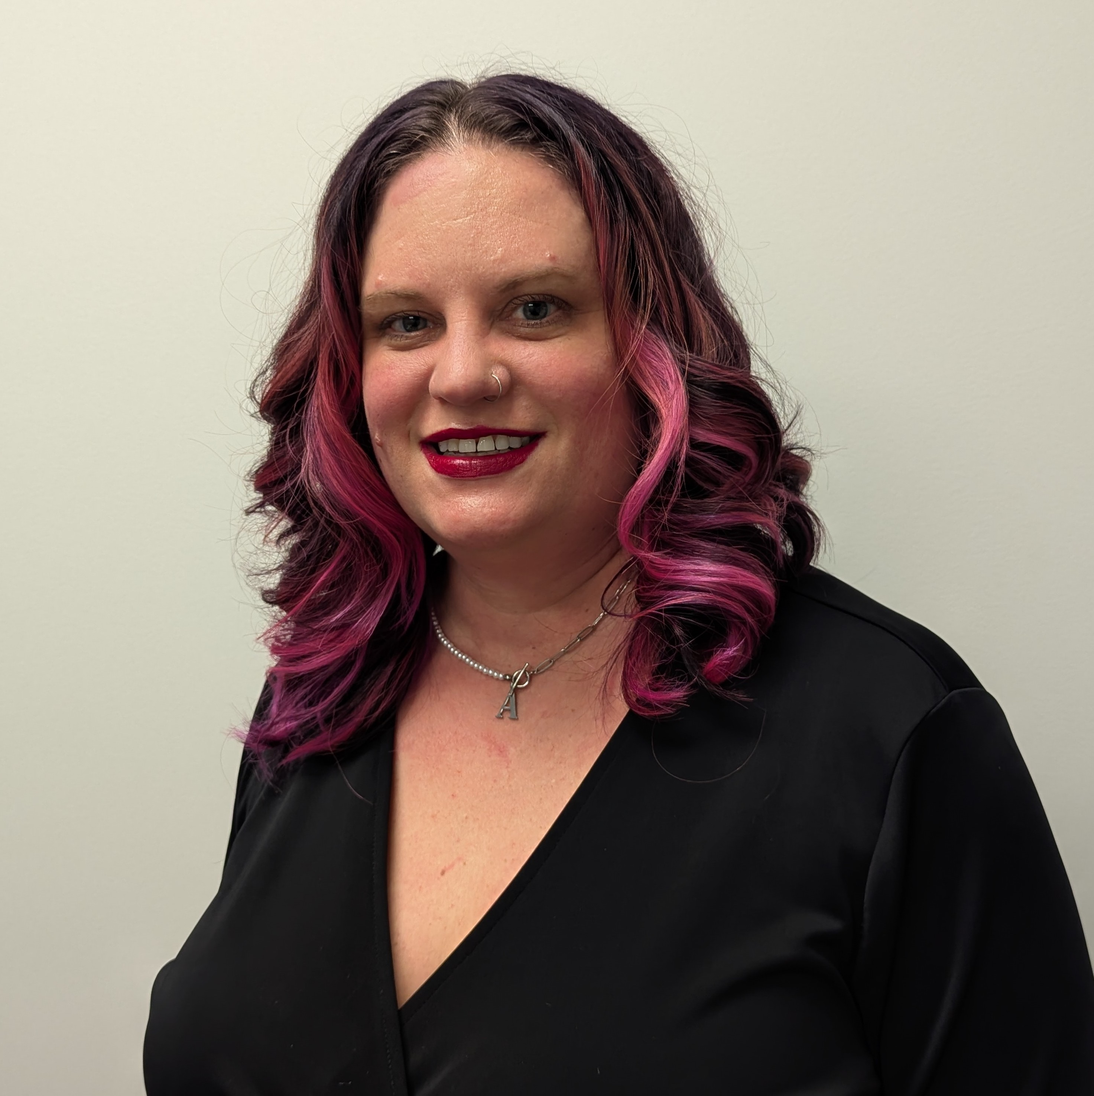
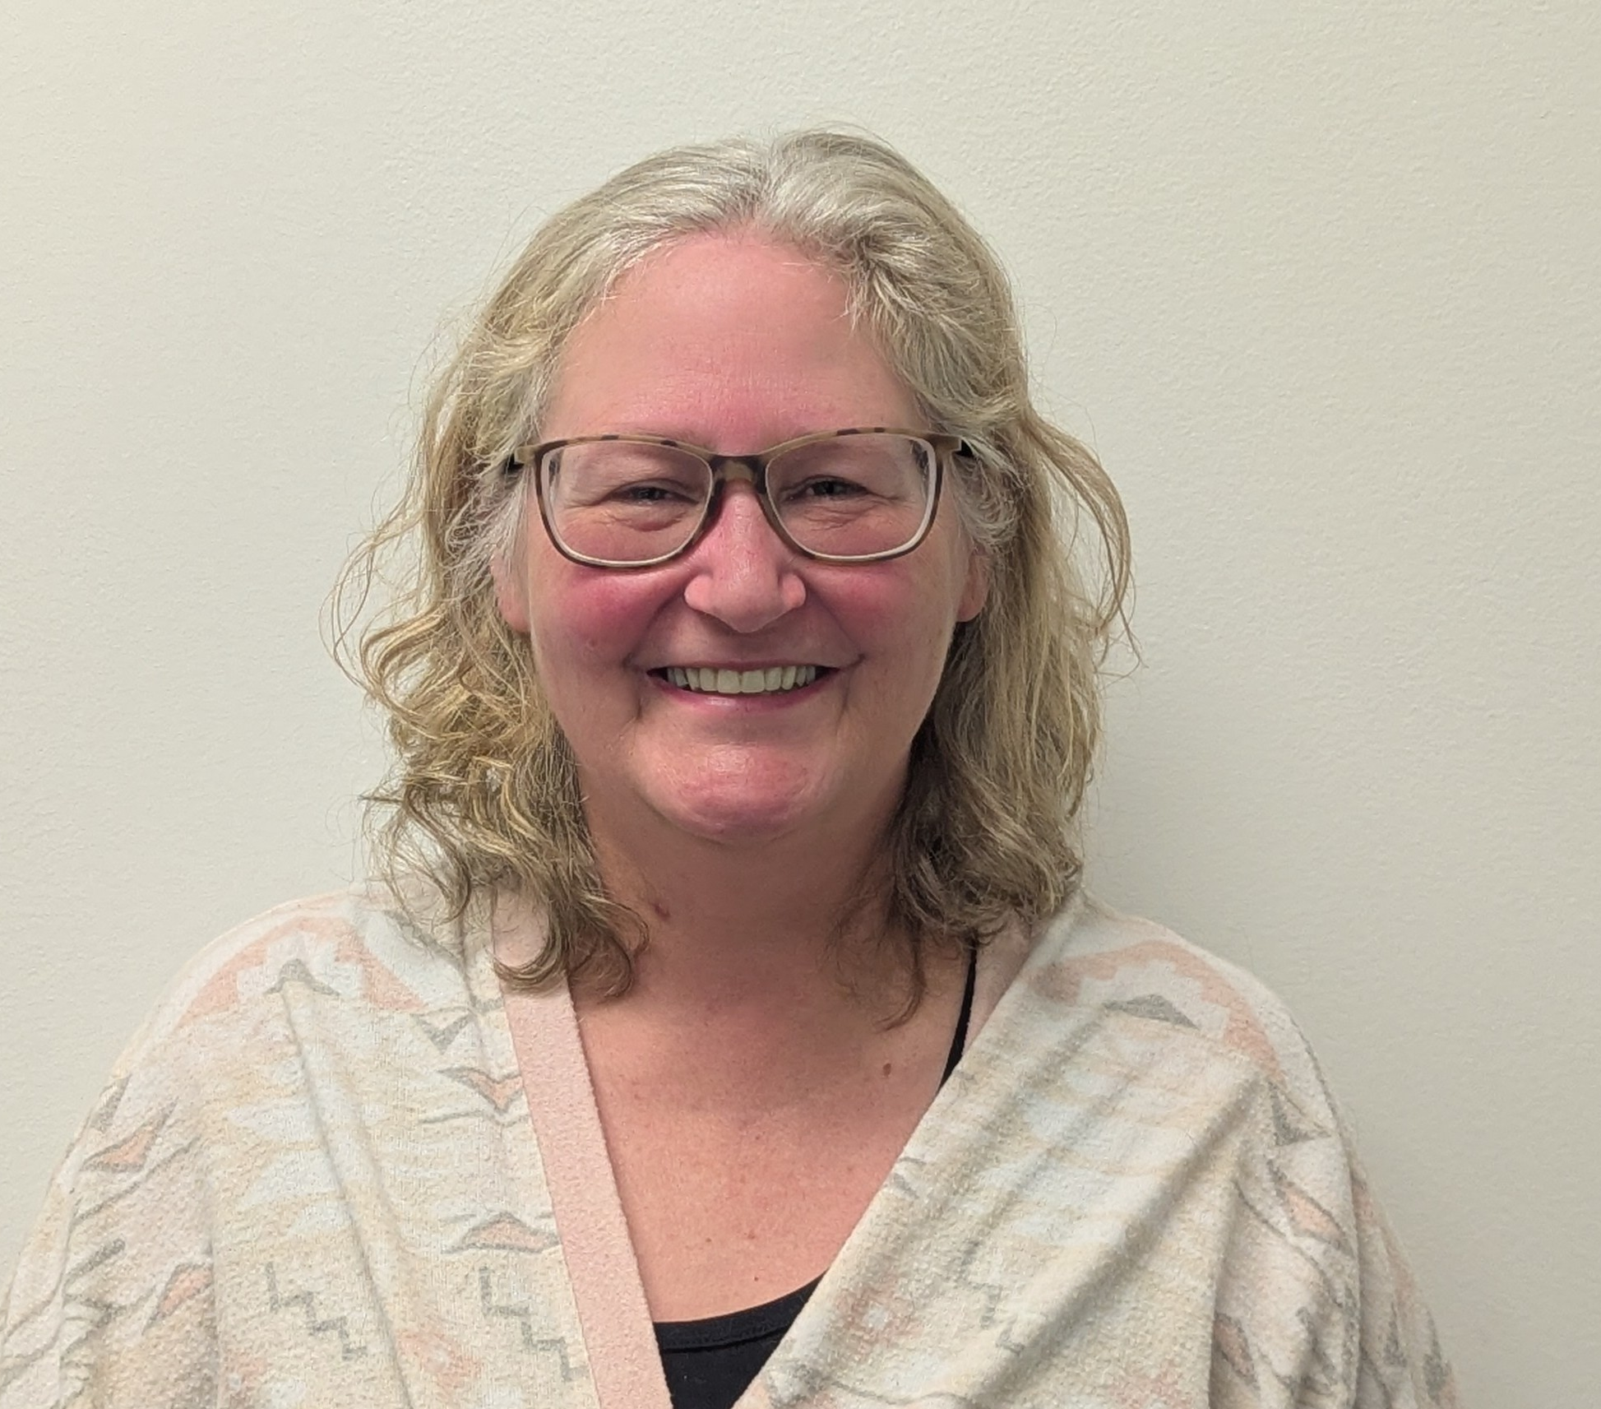
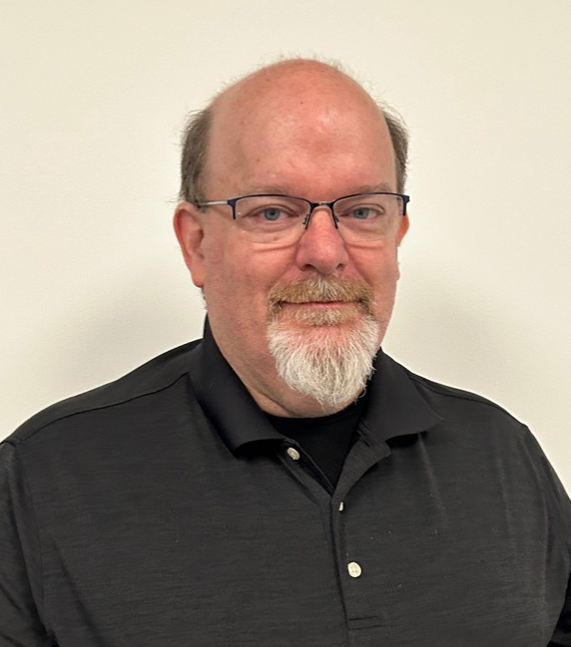
Sales / Administration
Tracey Fye, Office Manager
Drea Callicutt, Director of Marketing, Sales, & Communications
James Burts, CEO

Slide 8
Keystone Customers
New KLAS Users
Current Library for the Blind & Print Disabled Users
Current Instructional Resource / Materials Center Users

Slide 9
New KLAS Users
Michigan Braille and Talking Book Library
New York State School for the Blind
South Carolina Instructional Materials Center

Slide 10
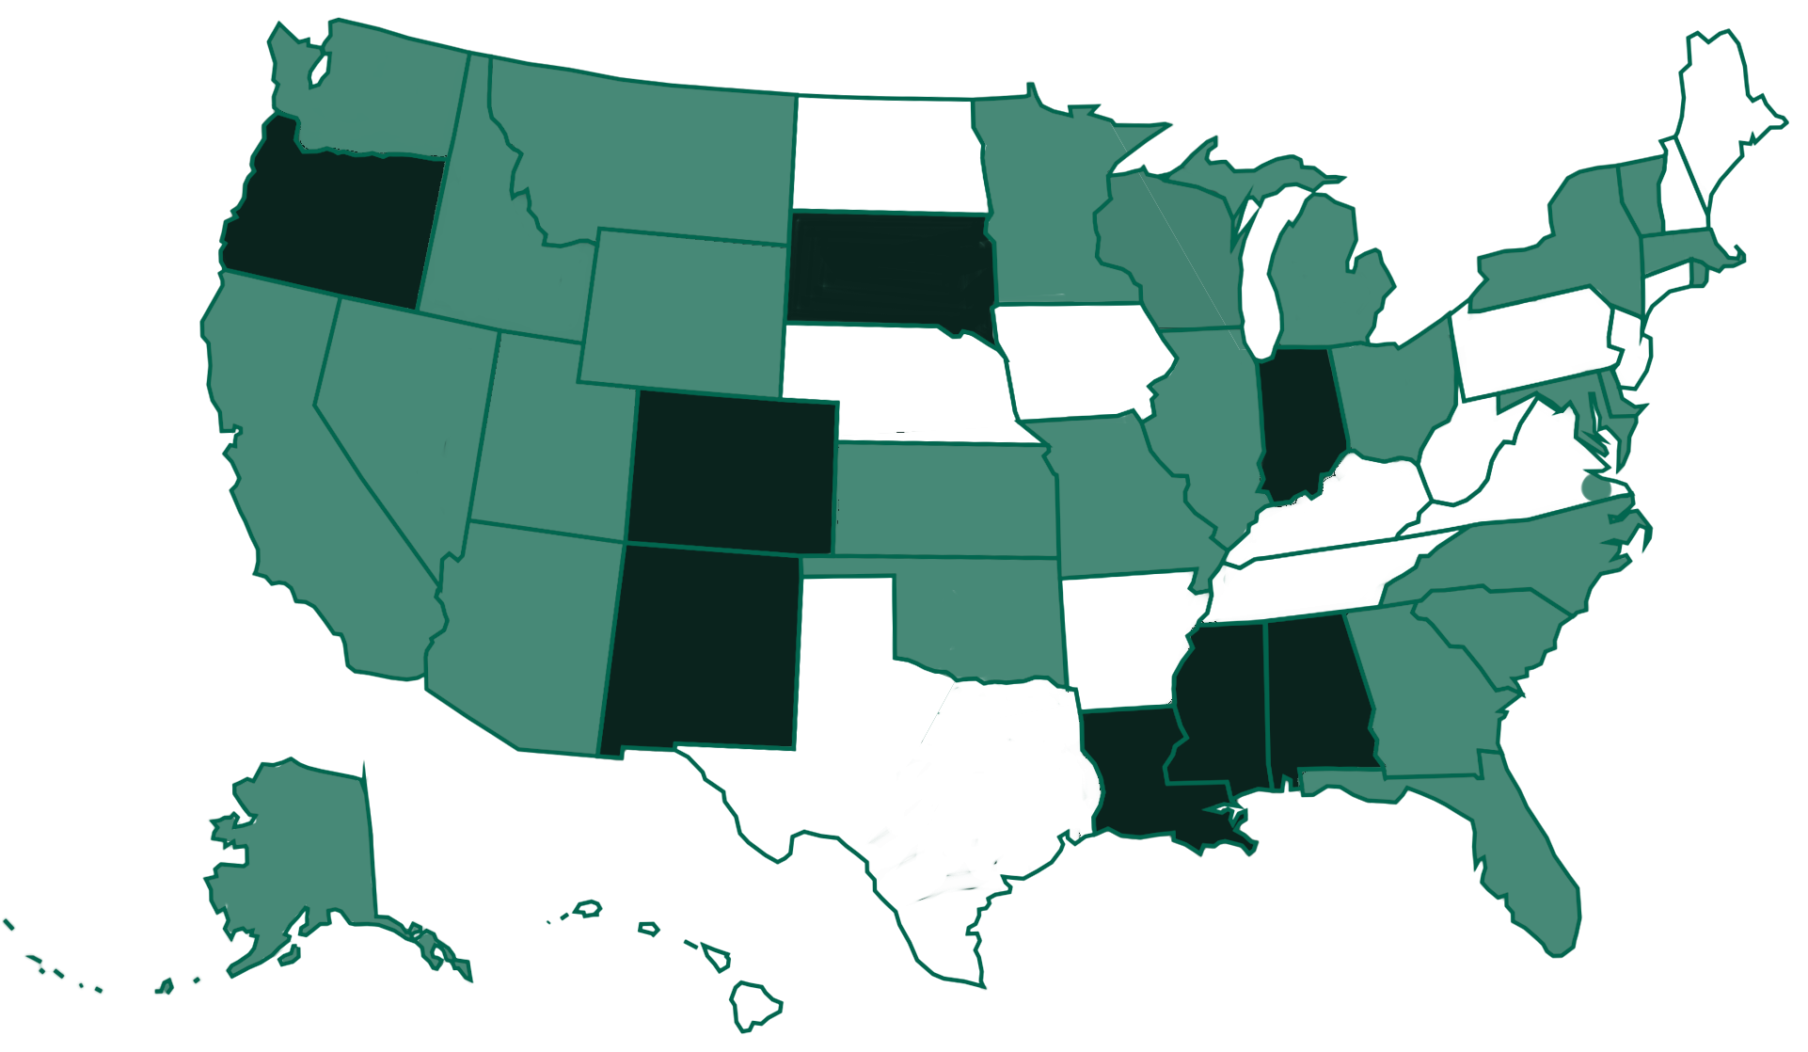
Current KLAS LBPD Installations
Notes:
NLS network libraries use KLAS to provide service in 35 states plus the Virginia Beach area. Of these, 14 libraries are self-hosted and 24 are Keystone-hosted (some states have multiple network libraries). Dark green indicates self-hosted installations, while states in light green are Keystone-hosted.

Slide 11
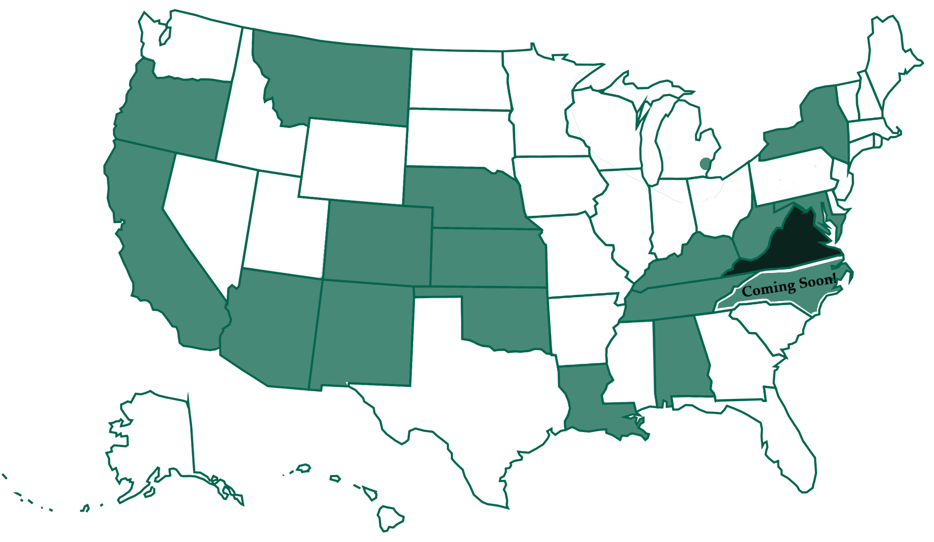
Current KLAS IRC / IMC Installations
Notes:
Instructional Resource and Materials Centers use KLAS to provide service in 18 states. Of these, 1 is self-hosted and 17 are Keystone-hosted. Dark green indicates self-hosted installations, while states in light green are Keystone-hosted. VA IRC is transitioning to Keystone Hosting, and SC IMC is in the process of installing KLAS.

Slide 12
KLAS Developments
Scribe Micro
  Discussed at last (2025) Users’ Conference
  Built in Wifi, camera barcode scanner, speaker
  Intended for outreach, fairs, or taking on-site for Institutions
NLS Intelligent Barcodes
  Item-level tracking by USPS
  2D barcode

Slide 13
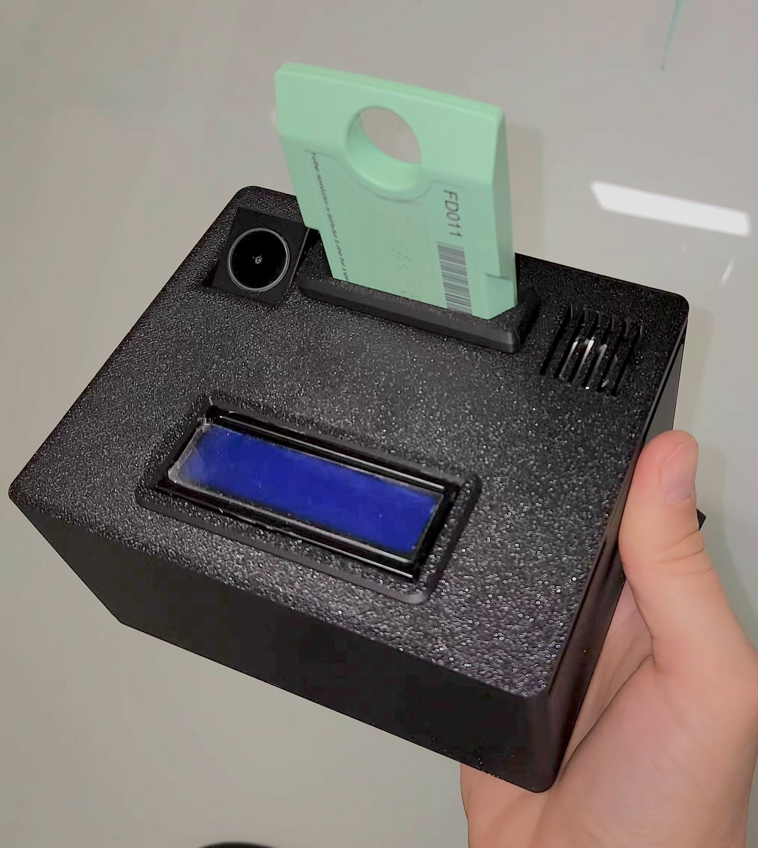
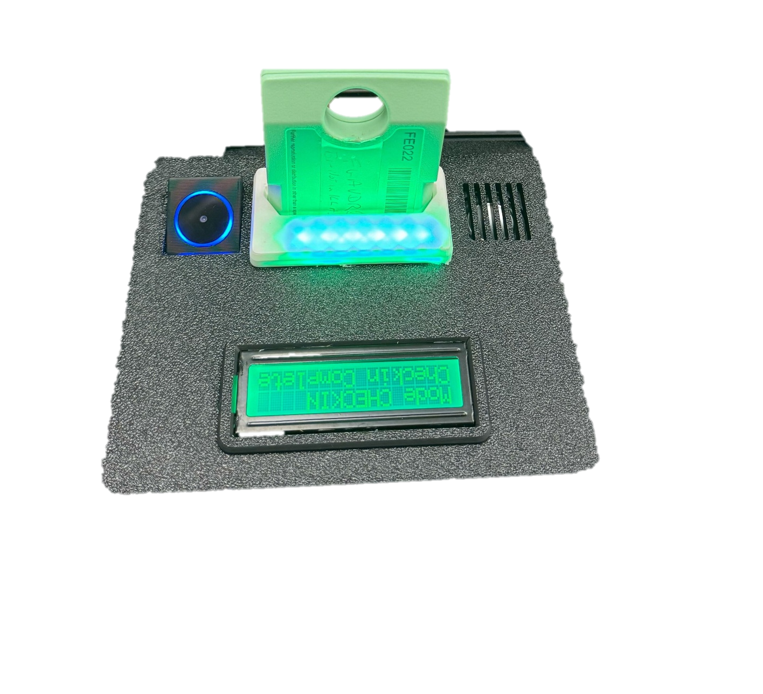
Scribe Micro

Slide 14
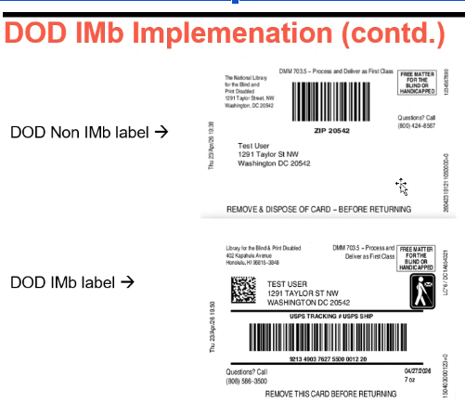
NLS/USPS - Intelligent Mail Barcode
What does NLS intend it to look like?
Questions:
Outgoing information –
  Duplication Barcode
  Equipment Model
  Date/batch/seq # of the card
  Size of cartridge needed
Considerations of
  Reprogramming of existing barcode scanners in the field
  Orientation aids for non-visual staff

Slide 15
Keystone Services Updates
2025 SSAE Certification Completed
  Currently underway for 2026 SSAE audit
WCAG 2.1 Compliance
Working towards FIPS 140-3 compliance by Fall 2026

Slide 16
Services Updates (continued)
WCAG 2.1 Compliance
  Changes to WebOPAC to take advantage of browser improvements
  Some changes required on the Library’s side
    Style sheet. Look and Feel
  We are updating our VPAT accordingly
  We have worked with a number of agencies to meet their WCAG compliance

Slide 17
Services Updates (continued)
FIPS 140-3
  Federal Information Processing Standard Publication 140-3
  Relates to encryption and security of data
  Server side, workstation, and communications link components
  Applies to regulations for both Federal and State agencies
  Keystone will be rolling out support in our Hosting solution in Fall 2026

Slide 18
KLAS Users’ Resources
KLASUsers.com
  Email ks7@klas.com to request an account
  Forums, Release Lists, MARC Records, Training Recordings, How-Tos, User Manuals, etc.
KLAS Users’ & IRC User listserv
  Email ks7@klas.com to be subscribed
KLAS Users’ Conference & MiniConference
  2027 – Hybrid Users’ Conference in Worcester, MA
  2028 – Free, online MiniConference
  2029 – Hybrid Users’ Conference in Jackson, MS

Slide 19
KLAS Users’ Resources
Monthly User-led KLAS Administrator & RA Open Forums
  May 18 - Reader Advisors
  May 19 – KLAS Admins
Keystone Webinars & User-led Roundtables
Keystone’s Social Media
  Facebook & LinkedIn
2026 Online KLAS Administrator Training
  June 8-11 & September 14-17 – LBPD
  November 2-5 – IRC / IMC
KLAS Users’ Group Meetings at NLS & APH

Slide 20
KLAS Users’ Group
New Officers as of 8/1/2025
  Josh Easter, President, South Dakota Braille & Talking Book Library
  James Gleason, Vice President, Perkins Library
  Maureen Dorosinski, Immediate Past President, Florida Braille & Talking Book Libraries
  AnnaMarie Theiss, Secretary, Alabama Instructional Resource Center
Committees
  KLAS Development Advisory Committee (KDAC)
  Logistics Committee
  Program Committee

Slide 21
Questions & Answers

