Slide 1


The Florida Bureau of Braille and Talking Book Library Services
Ambassador Program Training-
Welcome Suwannee River Regional Library System!
Jo Kennon Dowling Park Library and Lee Public Library

Slide 2
Benefits & Outcomes
Answer basic questions about the service.
Become a superstar in filling out the application.
Show people how the equipment works.
Get an account to download books to demo on a mobile device.
Display materials in your libraries, and during outreach events.
Refer them to us or your local DBS district office for more info.

Slide 3
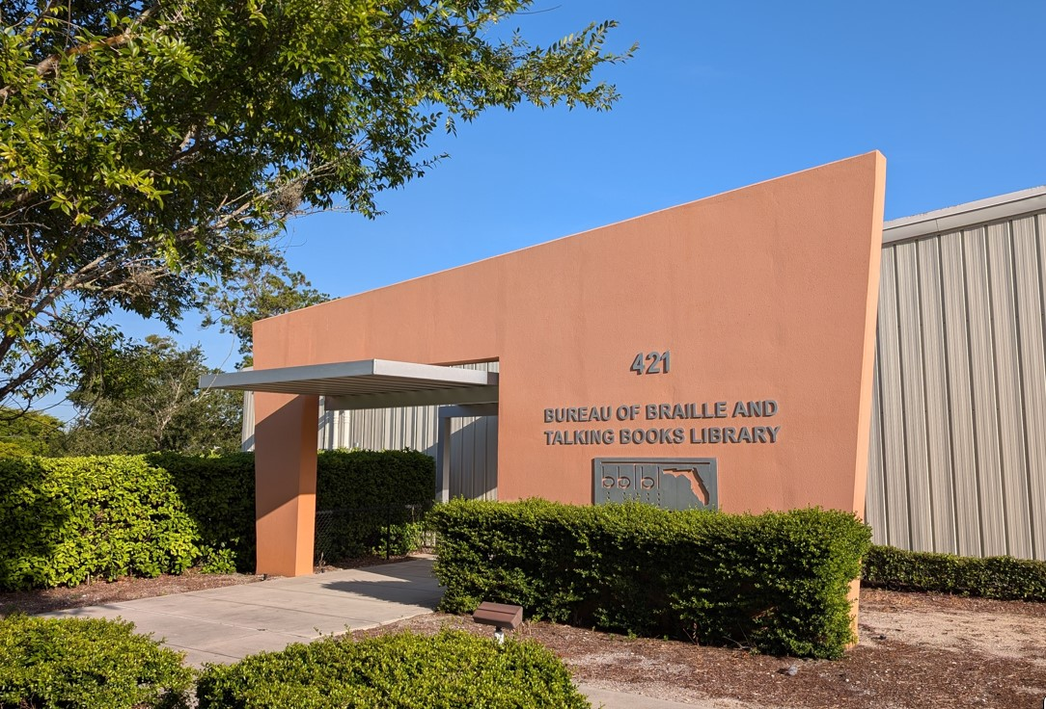
Who We Are:
Department of Education
Division of Blind Services

Slide 4
On the Daytona Beach Campus
Florida Braille and Talking Book Library: Books and magazines for eligible patrons.
Career, Technology, and Training Center for the Blind and Visually Impaired A dormitory where people who are blind can reside temporarily while they learn orientation and mobility, home and personal management, employability skills, receive adaptive equipment, and more.
Vocational Rehabilitation Program: The goal is gainful employment for blind and visually impaired individuals. DBS can provide the education, training, and technology needed.
Business Enterprise Program (BEP) Trains individuals for management of food service facilities and vending machines.

Slide 5
DBS Offices – 15 in Florida!
The Florida Division of Blind Services helps blind and visually impaired individuals achieve their goals and live their lives with as much independence and self-direction as possible.
To apply for services, contact the local DBS district office for Madison and Suwannee Counties:
  Division of Blind Services (District 02 - Tallahassee)
    3900 Commonwealth Boulevard
    Suite 351, Douglas Building
    Tallahassee, FL 32399
  Phone Numbers:
    Main: (850) 245-0370
    Toll Free: (800) 672-7038
    Fax: (850) 487-1436
  Supervisor: Travis Green Travis.Green@dbs.fldoe.org

Slide 6
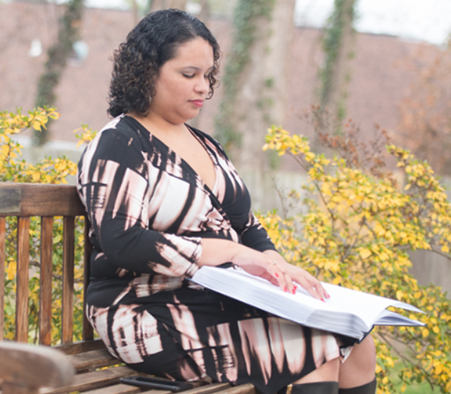
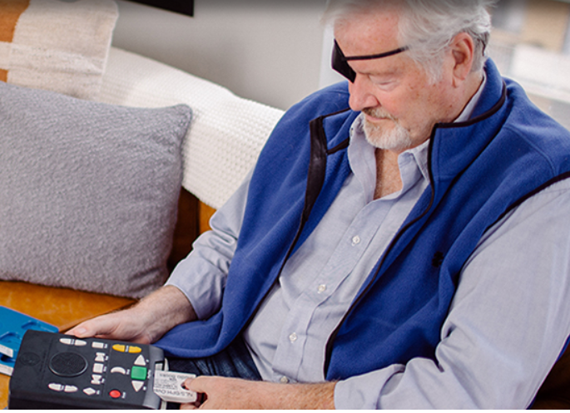
The Library serves:
People of all ages with:
  Blindness or low vision,
  a physical disability, or
  a perceptual or reading disability
which prevents them from using regular print materials, including
  TBI’s, Stroke, Parkinson’s, ALS, MS, spinal cord injuries, Dyslexia and other forms of reading disabilities.

Slide 7
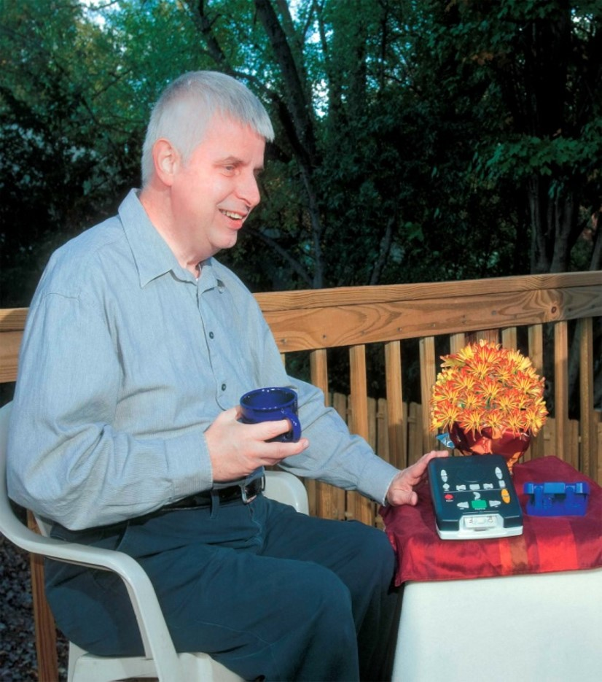
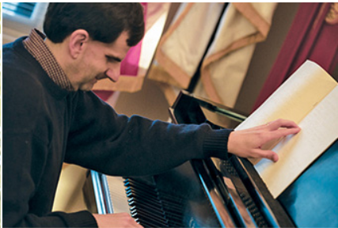
What We Provide:
Multiple languages
Braille
Audio
Descriptive DVDs
Large Print
Music Instructional Materials

Slide 8
What types of books are included?
The National Library Service for the Blind and Print Disabled, Library of Congress (NLS) provides the same types of books that are available through public libraries. Titles are considered for production in braille or audio format when favorably reviewed in reputable nationally distributed publications or included in authoritative bibliographies. NLS strives to provide classics and informational readings, along with popular recreational works that appeal to children, young adults, and older readers. Science fiction, mysteries, romances, and Westerns are represented, as well as bestsellers, standard religious works, and some international-language materials. Books of local or regional interest are generally produced by network libraries.

Slide 9
What about magazines?
Magazines are available in braille and audio formats. Criteria for the selection of periodicals are the same as for books. Selection librarians also consider whether the periodicals reflect a balance of current thinking in the various fields represented, have high interest and demand, are representative in their points of view, and provide recreational as well as informational reading. There are also several locally produced magazines.

Slide 10
Tell me more about music.
NLS does not offer music for listening, but offers musical scores and books in ebraille, braille, and large print (sometimes known as bold note), and recorded instructional materials for learning to play various musical instruments. Music appreciation materials are also available.
Anyone currently registered with an NLS cooperating library qualifies to receive music services and will be able to have materials sent to their address from NLS Music Section directly.
They can also download from the Braille and Audio Reading Download service.

Slide 11
Patron Programming
Call-in monthly meetups:
Calling All Cooks
Wrangling All Writers
Paws to Read: Pet Lovers Book Club
Annual:
Summer Library Activities!
Semi Annual newsletters:
Reading Challenges
Reading Bingo
Future:
Accessible Game Lending Collection
More with gardening, technology, and crafting!

Slide 12
Applications

Slide 13
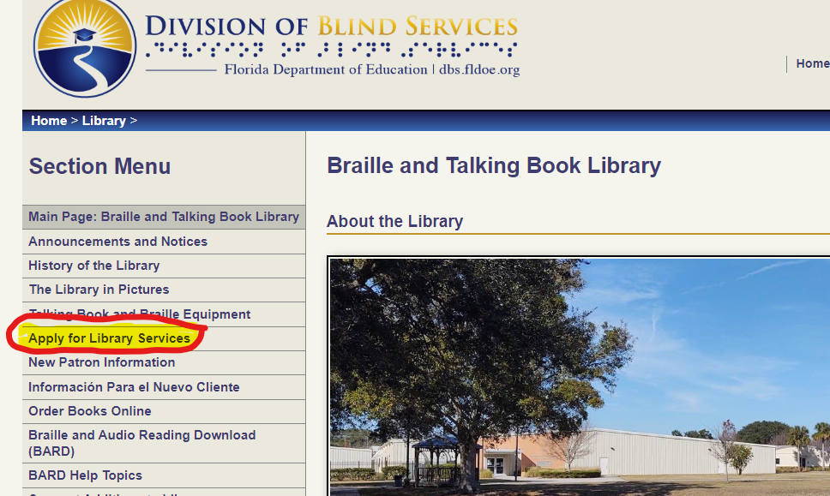
Signing People Up:
Easy Application Process
Librarians can certify!
Visit our website at https://dbs.fldoe.org/Library/apply.html

Slide 14
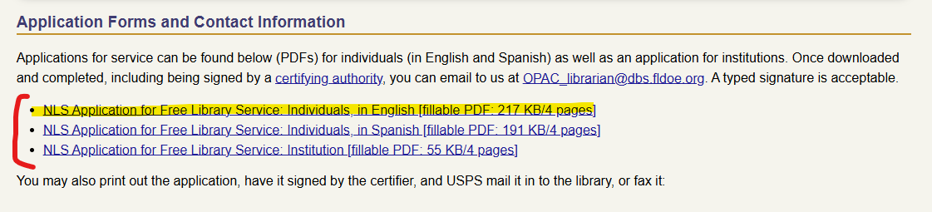
Instructions for a Certifying Authority:
Download the application (PDF file) to a folder on your computer.
Fill out the form with the potential patron.

Slide 15
Instructions for a Certifying Authority (cont.):
Page One:
Eligibility
1. An individual who is blind or has a visual impairment that makes them unable to comfortably read print books.
2. An individual who has a perceptual or reading disability.
3. An individual who has a physical disability that makes it hard to hold or manipulate a book or to focus or move the eyes as needed to read a print book.

Slide 16
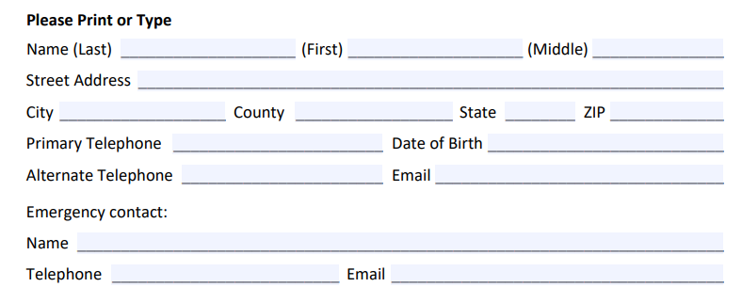
Instructions for a Certifying Authority (cont.):
Page Two:
Patron Contact Information
Parental Acknowledgement
Veteran’s Preference

Slide 17
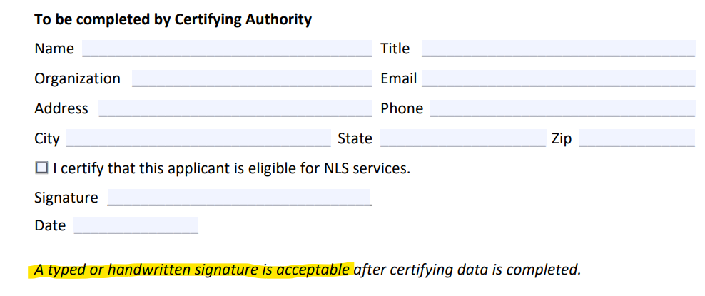
Instructions for a Certifying Authority (cont.):
Certification:
Page Three: Completely fill in all fields.

Slide 18
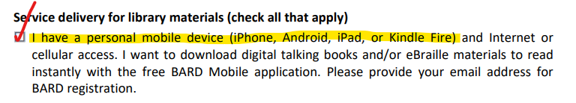
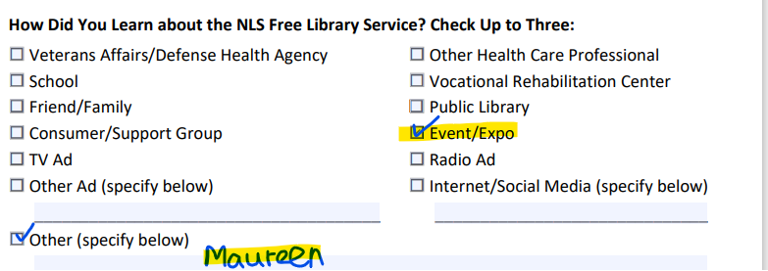
Instructions for a Certifying Authority (cont.):
Page Four:
How do they want to get their books delivered?
  Mobile Device? Or by mail?
How did they hear about the service?
  Check “Event/Expo”, and please write in “Maureen”.

Slide 19
Submit Application:
Save the PDF and attach it in an email to:
OPAC_librarian@dbs.fldoe.org
Success!! Thank you for your help!
The application will be reviewed and entered in our system within 2-3 business days!

Slide 20
Equipment

Slide 21
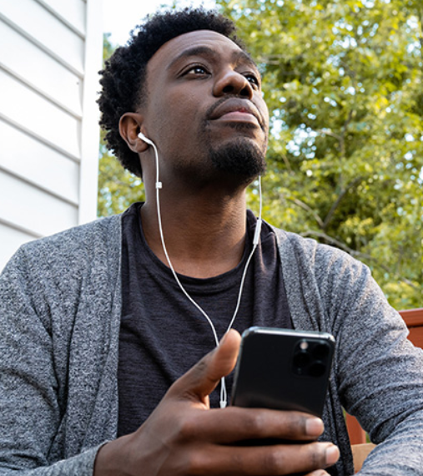
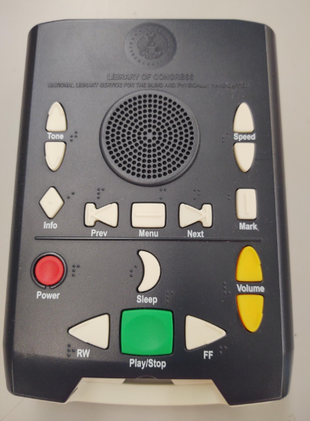
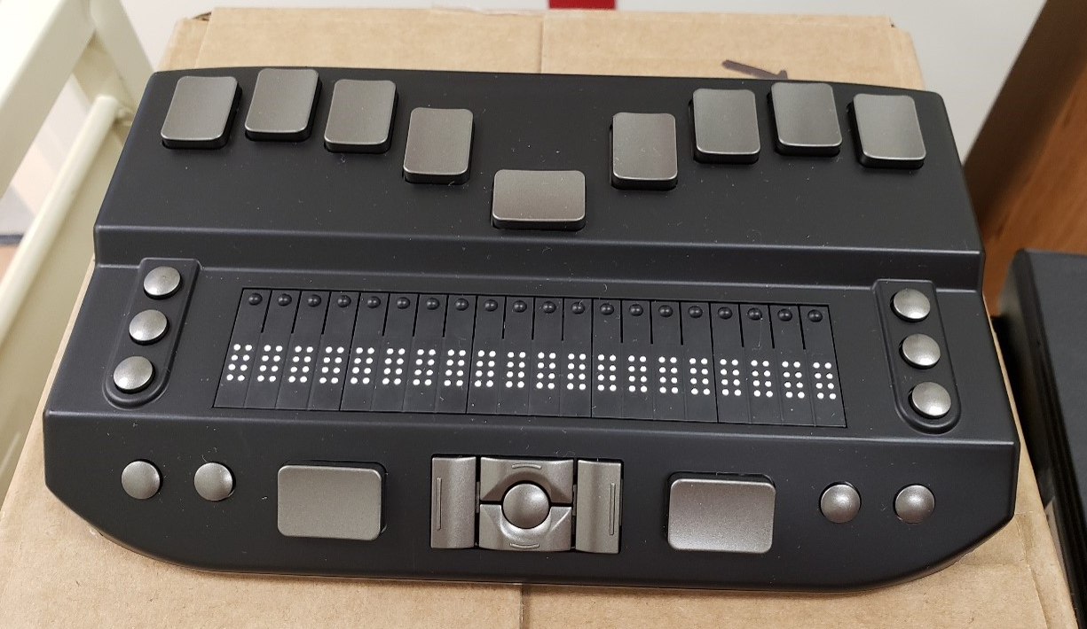
How We Deliver:
Through personal wireless device
Free players (Braille refreshable display and talking book players)

Slide 22
BARD

Slide 23

National Library Service for the Blind and Print Disabled, Library of Congress (NLS) provides
Braille and Audio Reading Download (BARD) Service:
Books, Magazines, Catalog
Flexibility and Accessibility
Settings for notifications
We will be able to sign you up with a BARD demo account. You will be able to see the whole book collection, download a few titles to a wireless device, and see all available magazines.

Slide 24
Display Materials

Slide 25
What do you have for displays?
Postcards 6” x 8 ½”: Focus Groups of Aging, BARD/Currency Readers, General Program, Reading Disability, Students, Veterans
Info Sheets: two-sided, one-page, full color informative handouts that are easy to give out at events.
Braille Alphabet Cards: full alphabet and numbers, with matching raised braille dots.
Applications: we will include library addressed return envelopes
Braille Fun Coloring Sheets
We will send you a starter pack with a selection with all of them!

Slide 26
Thank You!
Maureen Dorosinski, Library Program Specialist
Maureen.Dorosinski@dbs.fldoe.org

