Slide 1

What is CSLP?
We’re a non-profit formed in 1987 by a group of public libraries that wanted to share resources around summer reading programming.
We have 40 states/island nations involved in doing the work and making the decisions.
We are fueled and shaped by our members and volunteers.
Any profit from the sale of summer reading items goes right back into our organization.
Notes:
Who are we? Why summer reading?

Slide 2
CSLP began in 1987 when 10 Minnesota library systems teamed up to create a shared summer program for children - complete with a theme, artwork and incentives. The model spread quickly, and today CSLP continues to grow while staying true to its core principle: librarians sharing ideas, expertise and costs to bring every community a vibrant summer reading program.

Slide 3
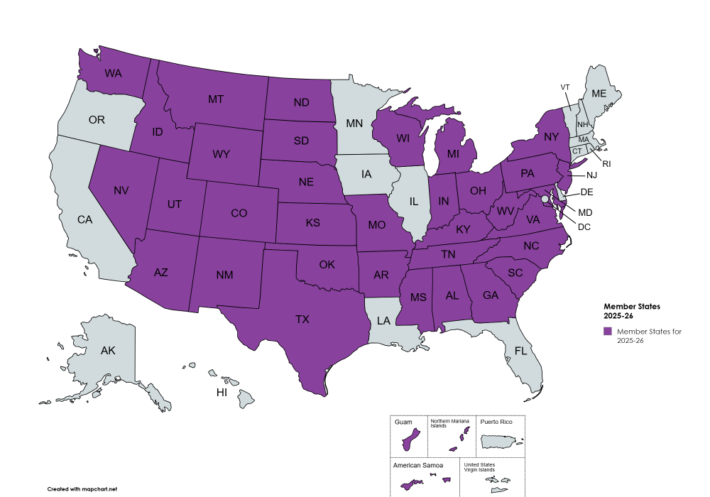
Notes:
https://www.cslpreads.org/join-cslp/ or https://shop.cslpreads.org/product/2026-unearth-a-story-membership-and-online-manual-access/ to purchase 2026 membership.

Slide 4
Why Unearth a Story™?
The slogan, Unearth a Story™ was chosen by member states to align with the theme of dinosaurs/paleontology/archaeology in a way that invites layered interpretation.
Whether readers are digging into a good book, uncovering hidden histories, or exploring the past, the slogan underscores the joy of discovery that reading brings. It also emphasizes that every person and every community has stories waiting to be found and shared—through books, programs, and local knowledge.
Member states collectively vote for future themes and also vote on slogans that involve the chosen themes.

Slide 5
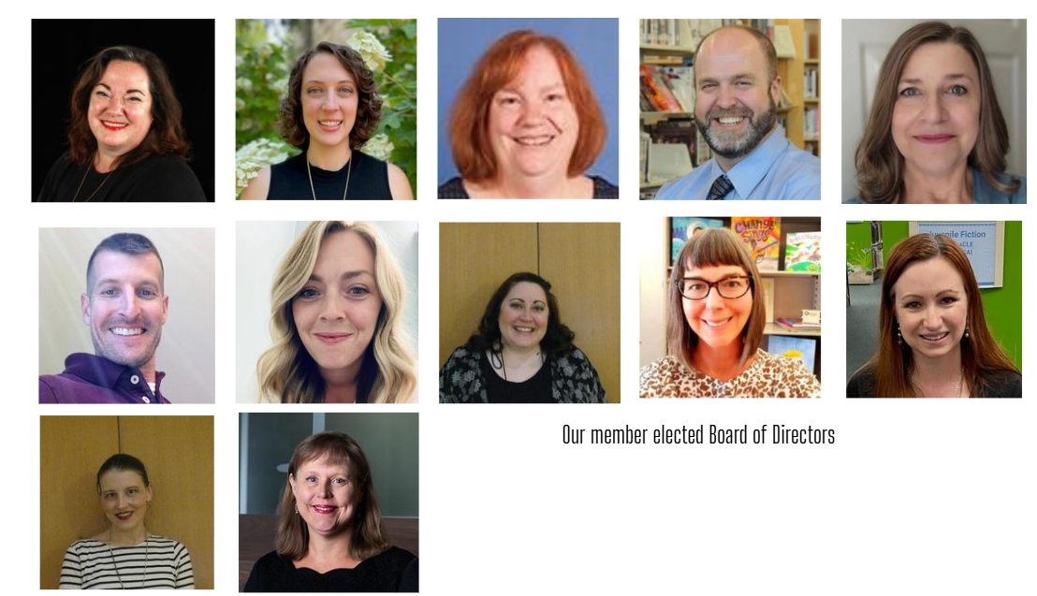
Notes:
https://www.cslpreads.org/about/board-of-directors/ - Kate Greene Smith is our outgoing President and Abby Chumin is our incoming President for 2026. Both have already done a ton of work on behalf of CSLP and we appreciate their leadership.

Slide 6
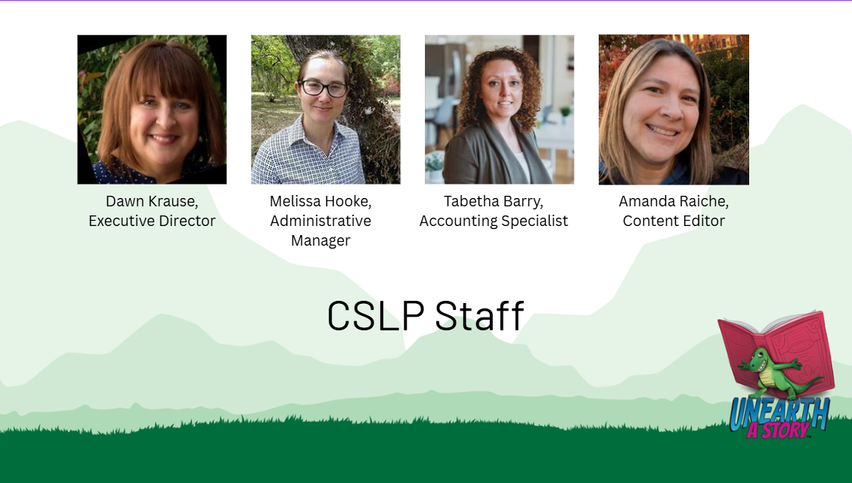
Notes:
Our contact info is here: https://www.cslpreads.org/our-staff/

Slide 7
How do I get access to CSLP content?
Email abak@loc.gov for code
You can also get the code from your state library youth consultant if your state is already a part of CSLP
The code includes access to the entire program manual, artwork, book lists, and more!

Slide 8
Bridging the Gap
NLS and CSLP are in the process of forming a formal partnership in 2026
This means all talking book libraries can access the manual and all CSLP resources
CSLP will announce this partnership and highlight NLS as a service that will be using CSLP content
State reps will be alerted to this and will be told about talking book libraries (yay, outreach!)

Slide 9
NLS Resources
Patron facing website: https://www.loc.gov/nls/services-and-resources/summer-reading/
Network Site (for us): https://www.loc.gov/nls/network/resources/nls-summer-reading/
6 summer reading workshop sessions on summer reading-Alice O’Reilly sent out an email on the collections listserv 1/6
Operations Alert No. 26-06

Slide 10
How do I (Abby) do Summer Reading?
Pick the best dates for your area (June 1st-July 31st)
To keep patrons engaged, I make a gameboard
Patrons have to turn the gameboard in at end to get prizes
I send 2-3 packets through the mail with crafts, STEM activities that have to do with the CSLP theme
This year is a dino paper plate mask, and DIY air dry clay dinos
I focused on using up craft supplies I have on hand

Slide 11
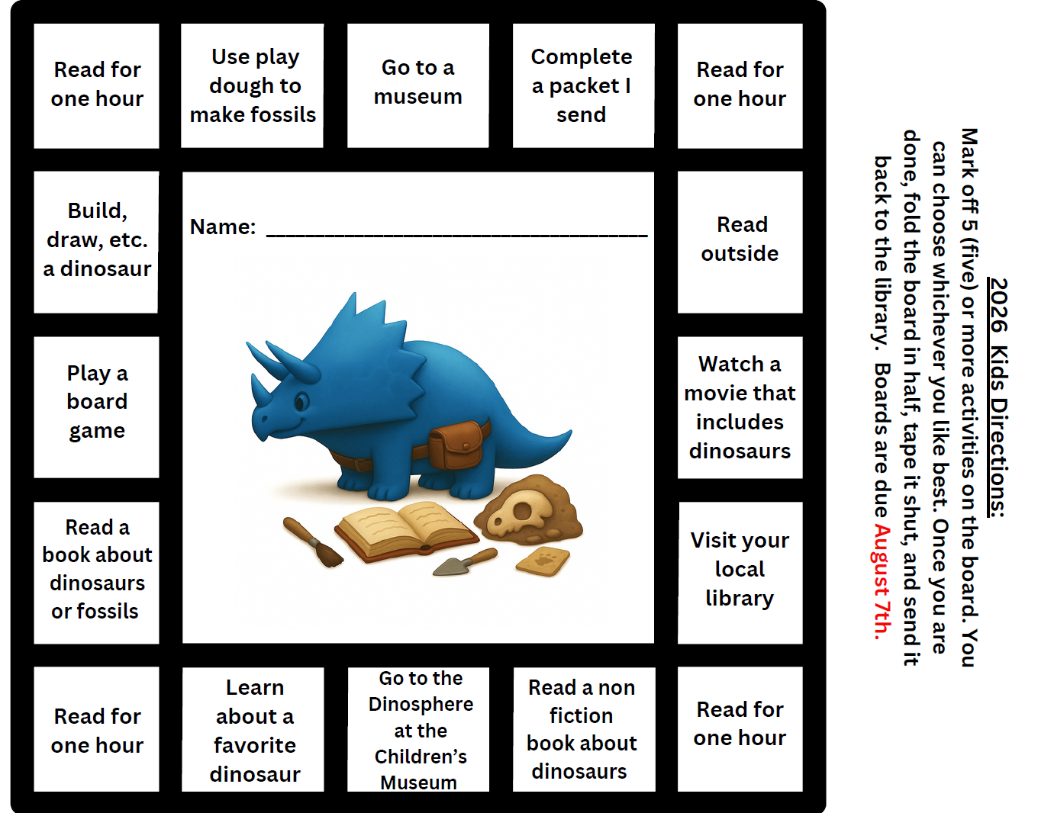

Slide 12
