Slide 1
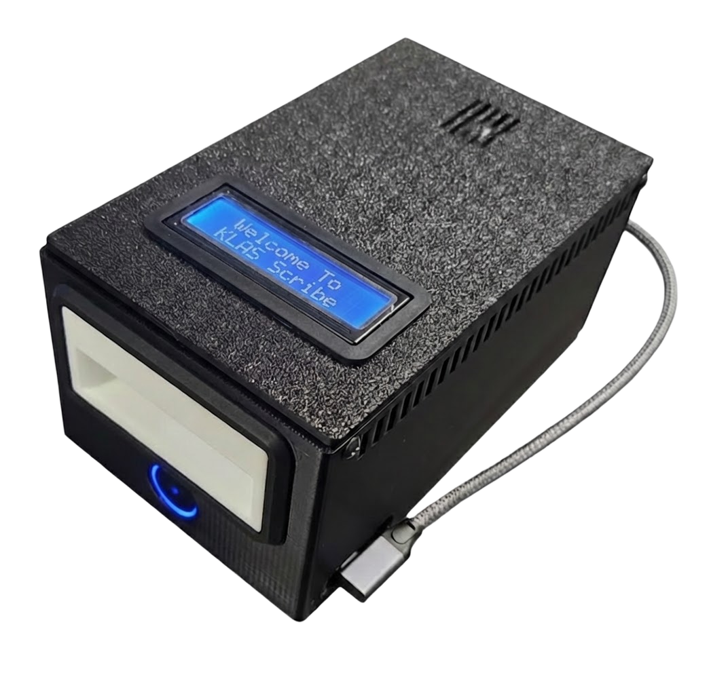
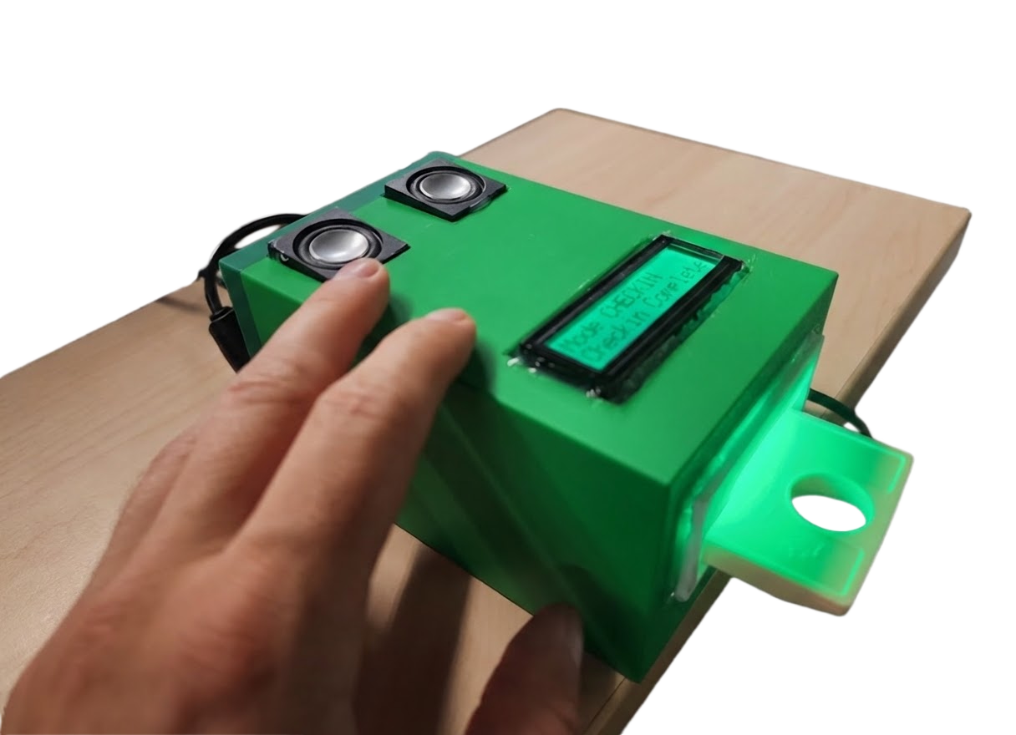
Scribe Micro
Presented By: George Martell
Keystone Systems, Inc

Slide 2
Why make a Scribe Micro
Primary design focus
Portability
Smaller footprint
Simple and easy to operate
Applications
Scribe on the Go for outreach events
Bookmobile sign-ups
Self-service Walk-ins
Front Desk Duplication on Demand requests
Nursing home/VA Hospital patron cartridge refresh
Trusted partners collaboration
Book clubs

Slide 3
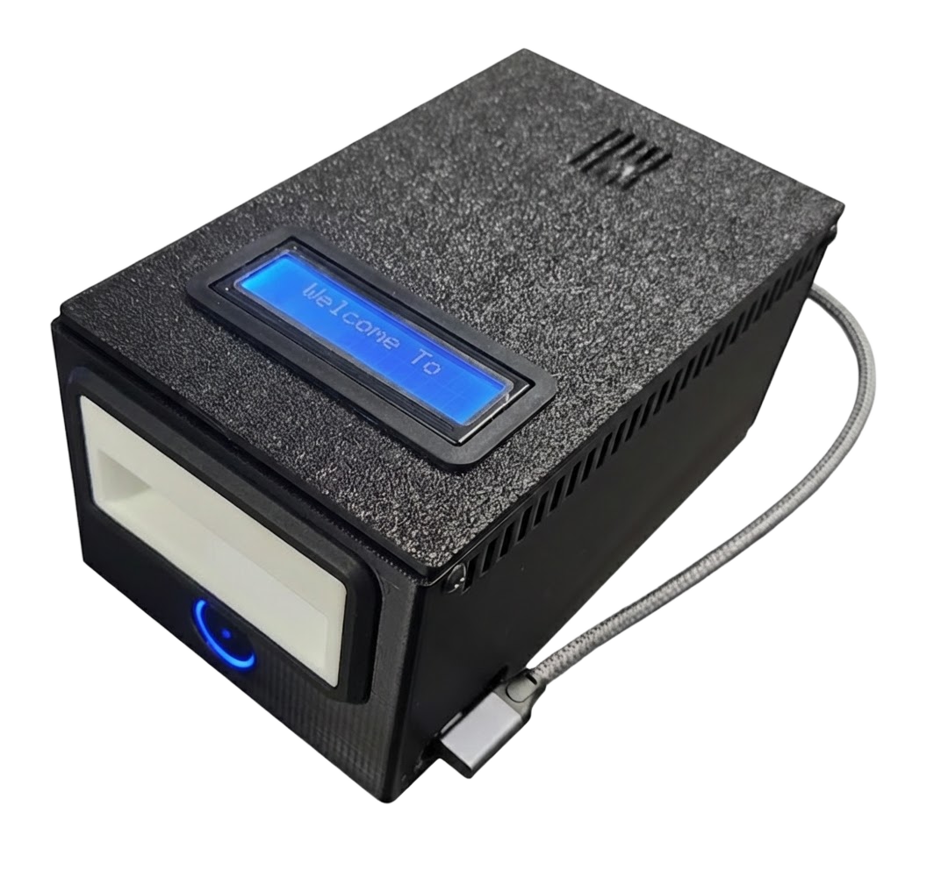
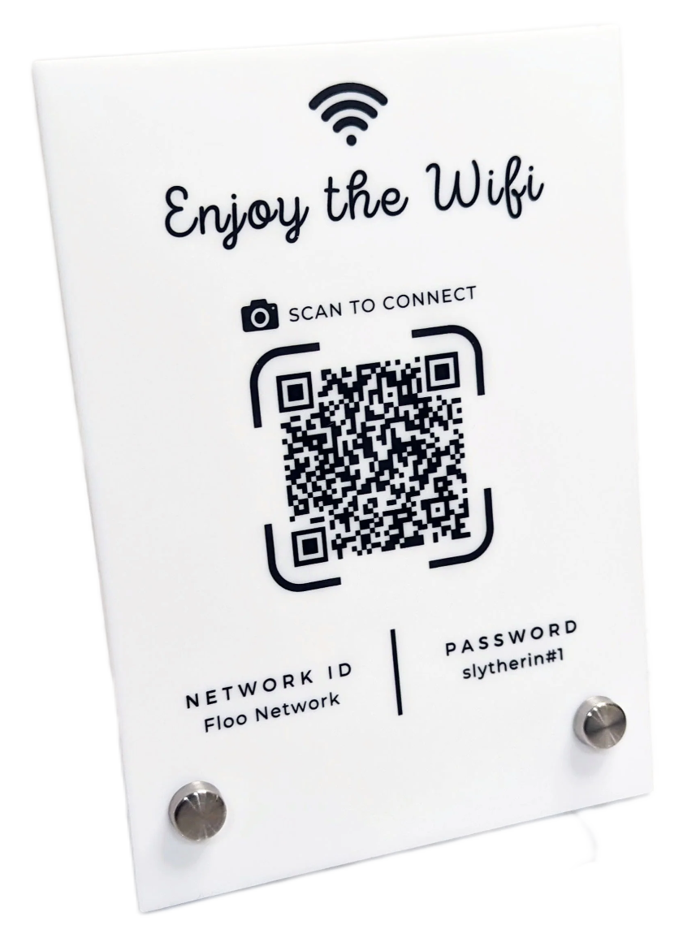
Features
USB Power enables the unit to be powered by either a wall adapter or a portable battery (USB power bank)
Built-in screen displays the mode and status of the device or operation
Built-in scanner reads BOD barcodes and QR codes for configuration and mode change. Codes can be physical or presented from a cell phone screen.
Built-in WiFi can be configured via standard WiFi QR codes
Built-in speakers for talking Scribe functions and sound

Slide 4
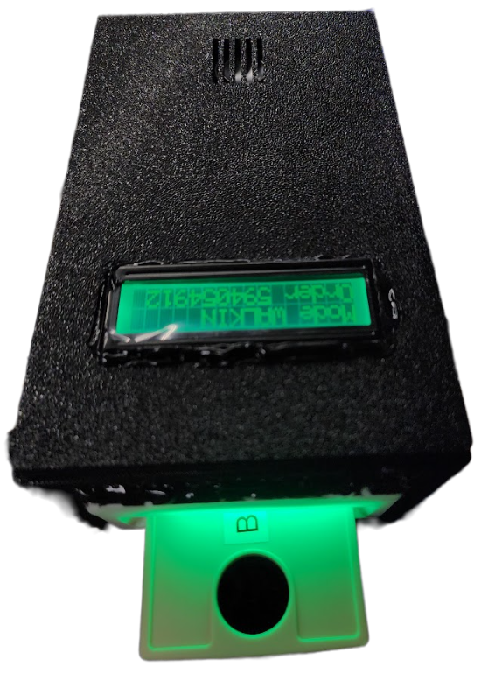
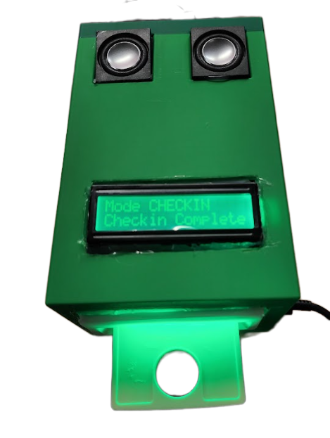
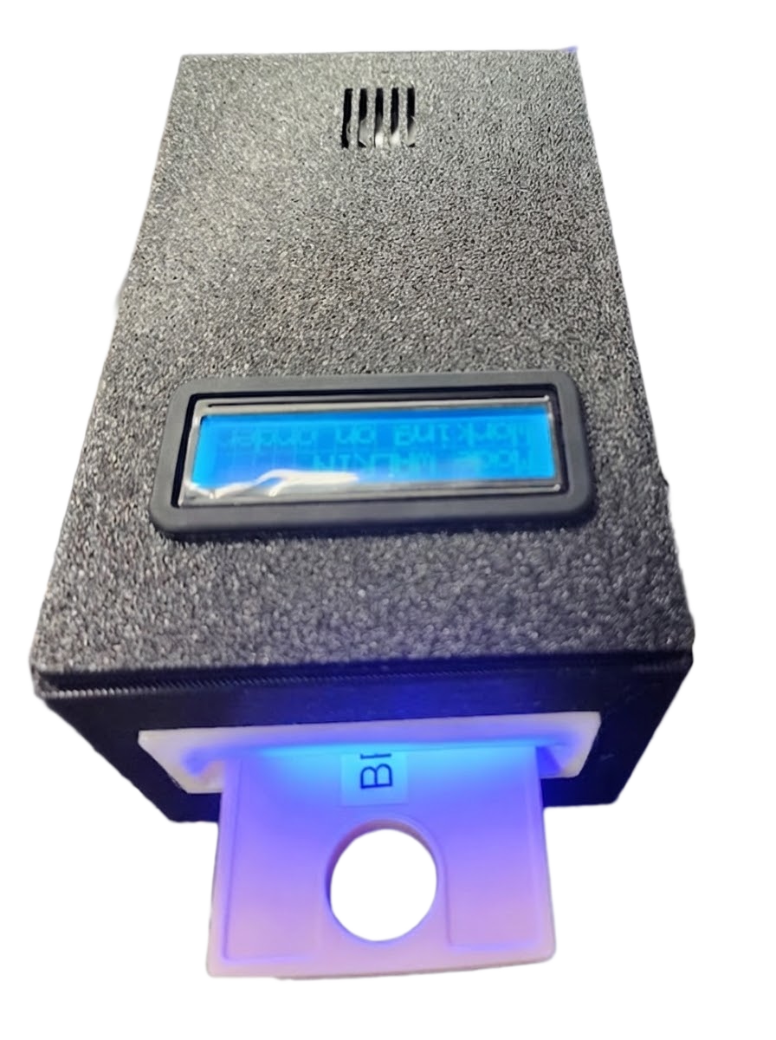
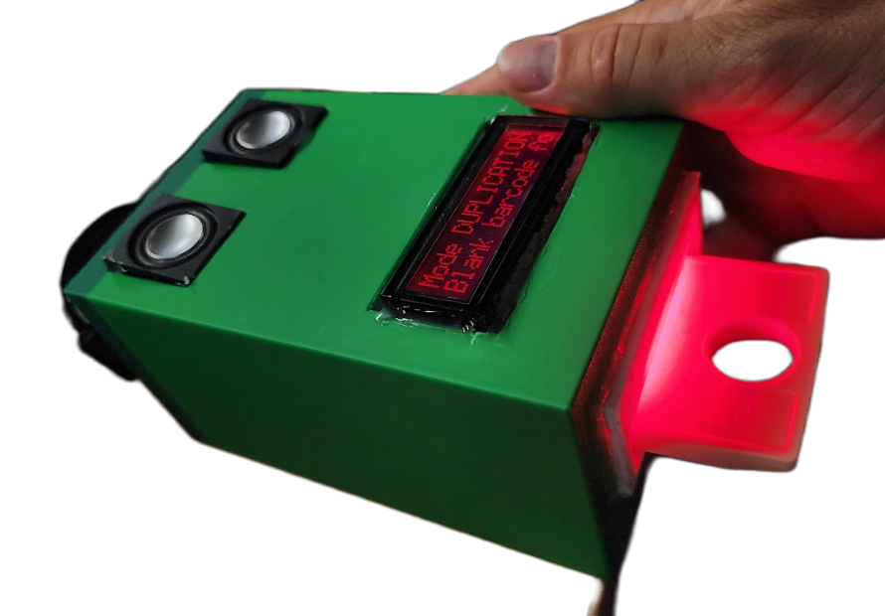
Features
The Cartridge slot and the screen change color to indicate status

Slide 5
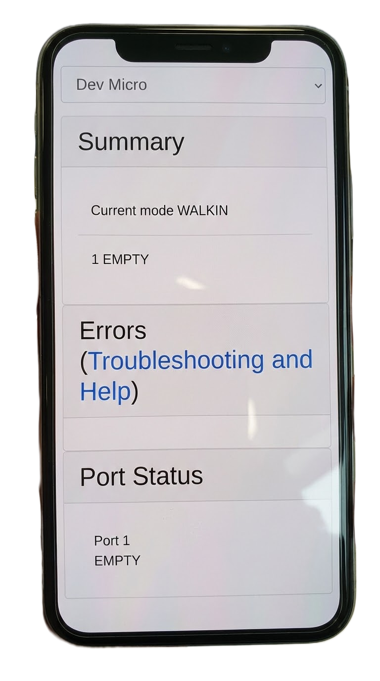
Features
Like other Scribes, the status of the Micro can be viewed in the familiar Web Monitor.
The Scribe Web Monitor can be viewed on a tablet or cell phone web browser (no separate software required).
This can be useful in the field when a desktop isn't readily available.

Slide 6

Anatomy
Speaker for speech and sounds
Mode and status display
Cartridge Slot
Barcode & QR Code Scanner
USB-C
Power Input

Slide 7
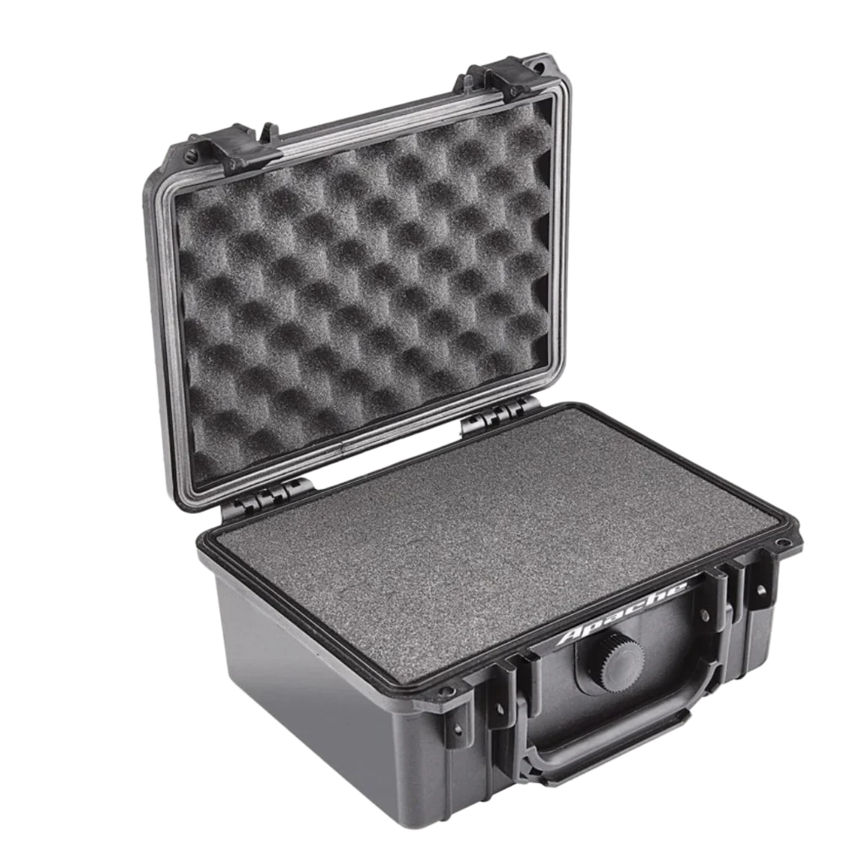
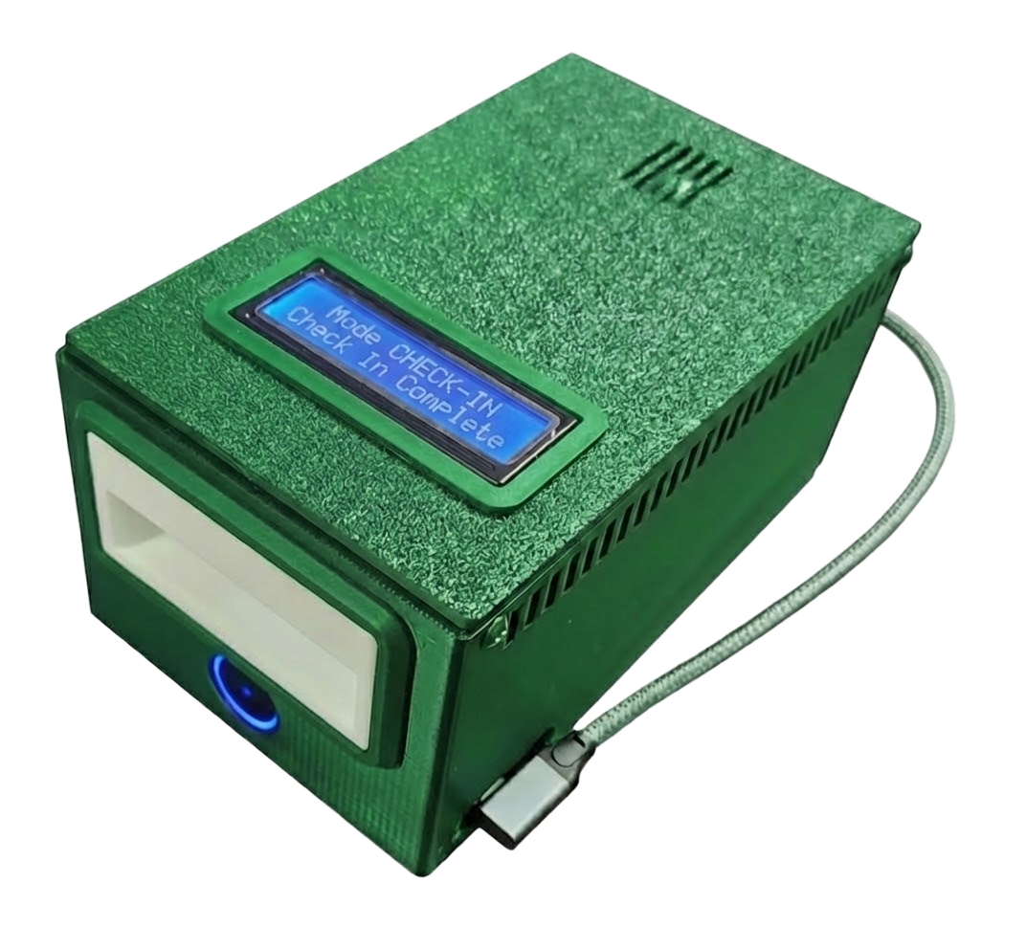
Design Improvements
Ruggedized case design
Small Touch Screen for mode and status
Optional battery “backpack”
Colors?

