Slide 1
2024 APH KLAS Instructional Resource Center Users’ Meeting
Drea Ewing Callicutt, Director of Marketing, Sales, & Communications
Marion Campbell, Customer Support Specialist

Slide 2
Agenda
Introductions
Keystone Updates
KLAS Users’ Group Officers’ & Committees
KLAS Users’ Conference
KLAS Development Updates
Q&A

Slide 3

Keystone Updates – New KLAS Users
Jewish Braille Institute – New York, NY
Alabama Instructional Resource Center – Talladega, AL

Slide 4
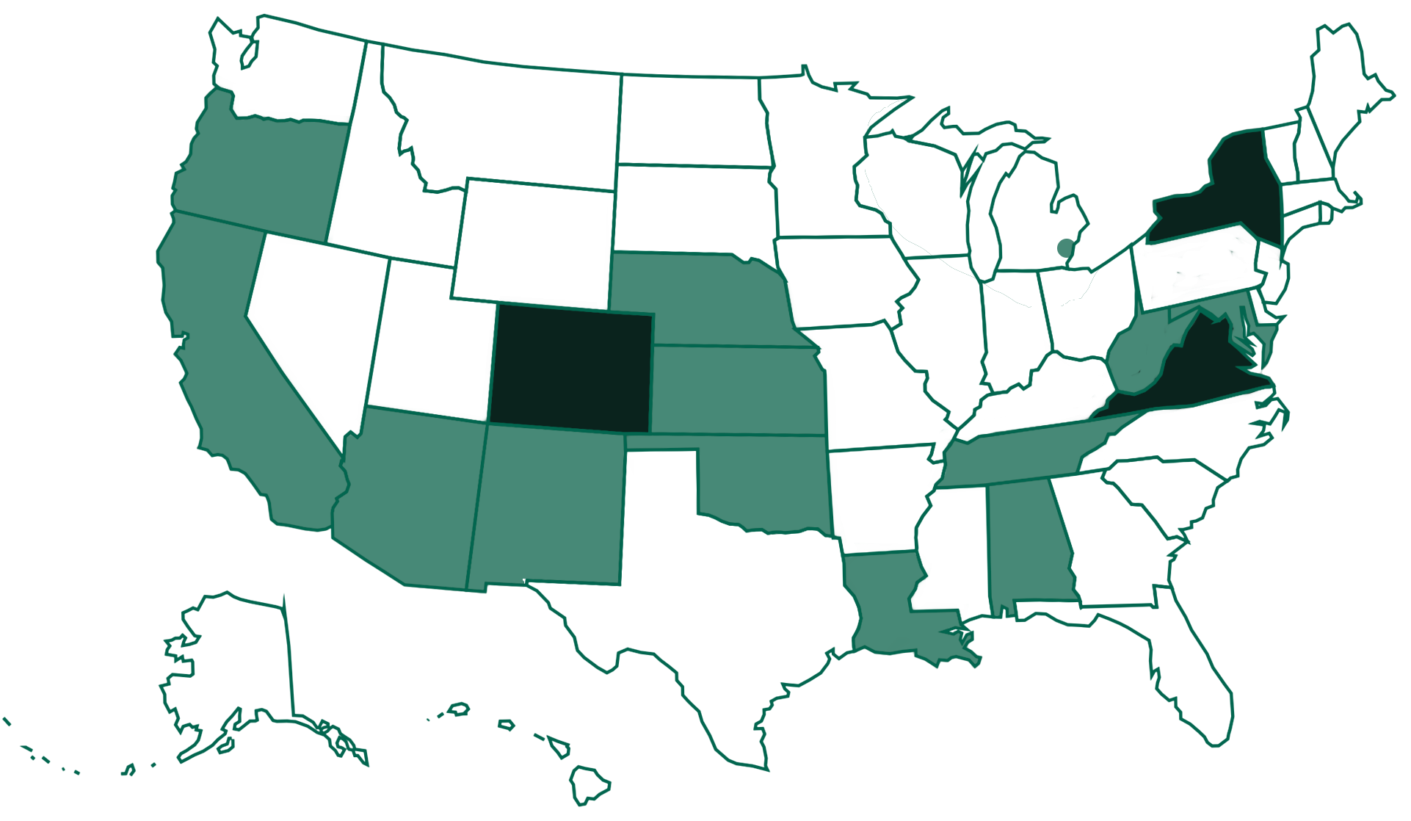
Current KLAS IRC / IMC Installations
Notes:
Instructional Resource and Materials Centers use KLAS to provide service in 16 states. Of these, 3 are self-hosted and 11 are Keystone-hosted. Dark green indicates self-hosted installations, while states in light green are Keystone-hosted.

Slide 5
klasusers.com
Forums
Blog Posts
Release Lists
Webinar Recordings
Customer Specific Training Recordings
KLAS Training Manuals
Info on Upcoming Events & Training Opportunities

Slide 6
Other Communication Channels
KLASUsers listserv
KLASUsers IRC listserv
Weekly Wrap-up
Keystone Social Media
Facebook
Twitter
LinkedIn

Slide 7
Online KLAS Administrator Training
4-day intensive, small group, training led by Keystone staff
Deep dive into KLAS’ Admin features & functions
Next IRC session = November 18-21, 2024

Slide 8
KLAS Users’ Group
Officers
Committees
Maureen Dorosinski, President
Traci Timmons, Past President
Josh Easter, Vice President
Sara Zapotocky, Secretary
KLAS Development Advisory Committee
Jesse McGarity, Chair
Program Committee
Jesse McGarity, Chair
Logistics Committee
Maureen Dorosinski, Chair

Slide 9
KLAS Users’ Group Meetings
KLAS Development Advisory Committee
Serves as an advisory role to Keystone on new features being developed for future releases of KLAS.
Meets once per month, apply to serve for two years

Slide 10
KLAS Users’ Group Committees
Program Committee
Logistics Committee
Online programs each month; during years of Mini Conference, once per quarter.
Meets once per month, new members always welcome
Accommodations, transportation, gifts, speakers, incentives for conference.
Meets once per month, new members always welcome

Slide 11

2025 KLAS Users’ Conference
Dates: March 17-20, 2025
Location: Indianapolis, IN
Theme: Driving Innovation & Inclusion in Libraries: Start Your Engines!
www.klasusers.com/uc2025

Slide 12
2025 KLAS Users’ Conference
Hotel
Conference Site
Embassy Suites by Hilton Indianapolis Downtown
$133/ night + tax (or prevailing gov. rate)
Wifi, breakfast & Evening reception included
Indiana State Library
Walking distance from hotel
All conference sessions will be held here
Talking Book & Braille Library housed in State Library building

Slide 13
2025 KLAS Users’ Conference Registration Deadlines & Costs
Virtual
In-Person
Virtual Early-bird (before December 18, 2024) = $85 with Early-bird discount
Virtual Attendee (after December 18, 2024) = $100 per attendee
In-Person Early-bird (before December 18, 2024) = $200 with Early-bird discount
In-Person (December 18, 2024 - February 16, 2025) = $250 per attendee
In-Person Late (after February 16, 2025) = $300 with late fee

Slide 14
KLAS Users’ Group Meetings
National Library Service for the Blind & Print Disabled National & Regional Conferences
American Printing House for the Blind Annual Meeting

Slide 15
Keystone Services Updates
2023 SSAE Certification Completed
Migrated ALL hosted customers to private micro VMs
Switch revealed a major resource inefficiency
Performance fix had other consequences which have been addressed

Slide 16
KLAS Development Updates
Password Rules Enhancement
Invoicing / Braille Production
APH Integration
Create Shipper / Tracking numbers
Assign and Shipping Wizard
Patron Query Issues
Catalog Updates
WebOrder / Census updates

Slide 17
Password Rules Enhancement
Allows KLAS to enforce rules on password complexity
Password length
a capital letter
a lowercase letter
a number
Notes:
Additionally, passwords can be set to expire on a certain schedule (ex: every 90 days)

Slide 18
Invoicing Braille Production
Create Invoice added to Mat Request
Invoice and payment tabs in Mat Request
New field in invoice Line Detail
New Invoice print tokens
Auto Credits

Slide 19
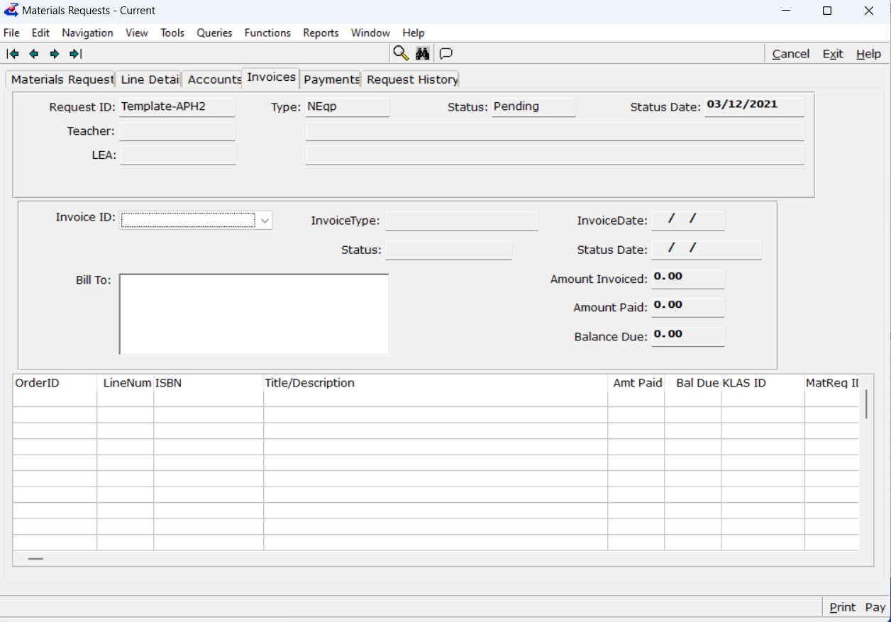
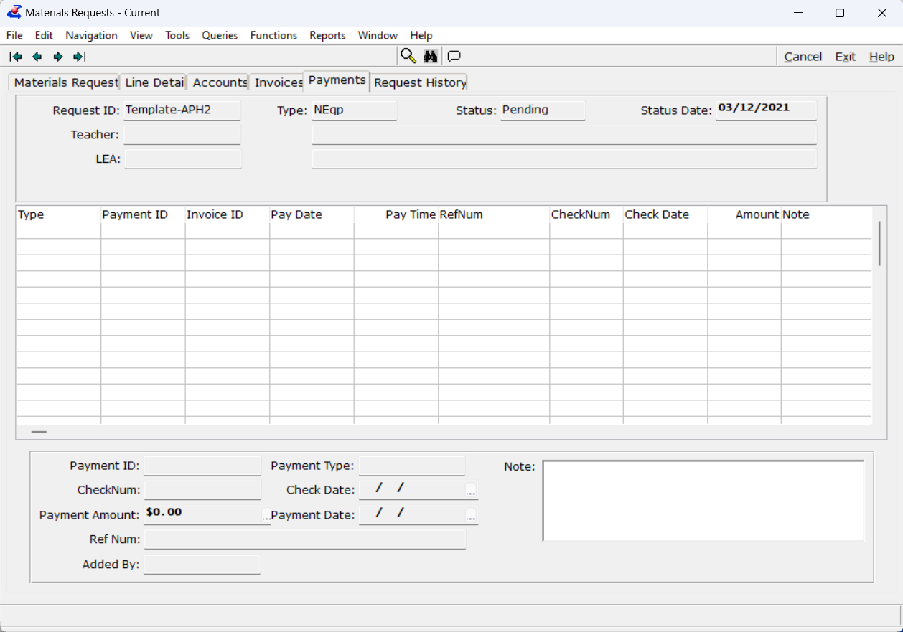
New tabs in the Mat Request module: Invoice and Payment

Slide 20
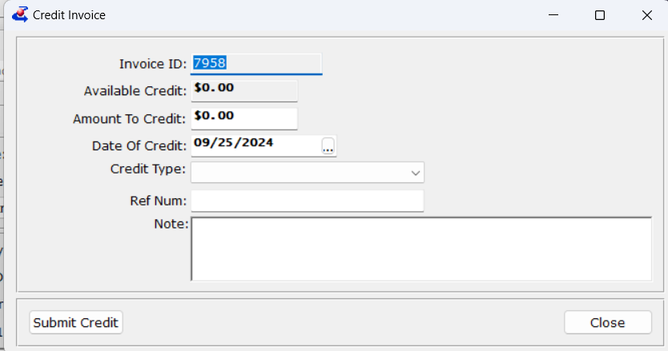
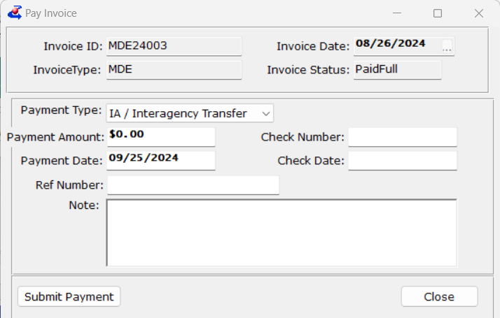
New fields in Invoices (credit type and payment type)
Credit Invoice
Pay invoice

Slide 21
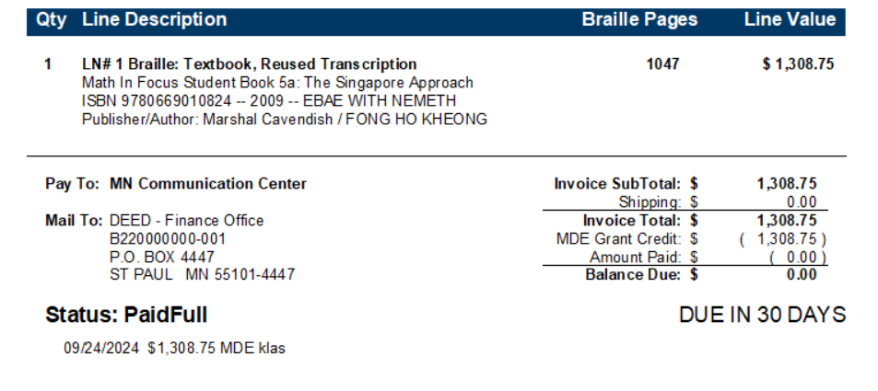
Invoice print tokens
ALL Bibrec Fields
Created by
Created date
Status of payments
Payment type and userID

Slide 22
APH Integration
Currently only OKES is on APH Integration
We can only integrate with APH for free matter items anything with Shipping cost they cannot calculate the shipping cost with the integration at this time.
Lots of fixes to error messaging and streamlining of this process
Who’s NEXT?

Slide 23
Create Shipper
One screen for shipping, not a wizard
AT friendly with barcodes
Has tracking numbers; create your own or have KLAS create one.
Future development is to integrate with USPS.
Tracking numbers can be put on emails & packing slips.

Slide 24
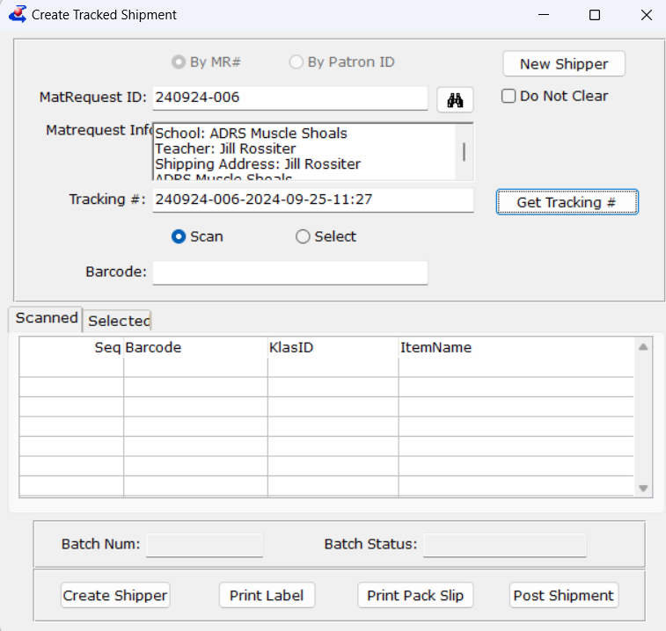
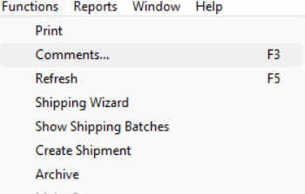
Create shipper
Found in Material Request under the Functions menu

Slide 25
Shipping Wizard/Assigning Materials
CNSM items are looking at all shelves not getting stuck on the first shelf with any items
CNSM item will ship the correct quantity
Show shipping batches fixed (did not show all assigned items for a bit)

Slide 26
Patron Query and Find
Server updates to speed up performance broke some Find functions.
All Patron look-ups have now been fixed
Last to be fixed was Re-Assign in patron Items.
KLAS 7.8.12 -7.8.15

Slide 27
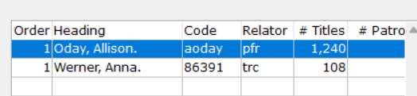
Relator added to series and author
Allow for Proofreaders and Transcribers to be put on transcribed books
More information on Authors or narrators

Slide 28
Census updates
Updated Census to include IDEA students
Removed IEP date as a error is IEP date data collected
Date certified must be the same as the date entered
Still working on website over-write issues

Slide 29
User Submitted Discussion Topics
From Pepper, OK:
Find & Replace function when updating contact information
Improve navigation of WebOrder / WebOPAC.

Slide 30
User Submitted Discussion Topics
GO-TO option by Mat Request -> Line Details Tab -> KLAS ID field to open title record (except Temp Titles).
GO-TO option on Materials Request -> Main Tab beside Teacher / School / Student to open patron record.
From Allen, TN:
GO-TO option beside Material Requests -> Line Details Tab -> PO field to open PO.

Slide 31
Q&A

