Slide 1
APH 2022: KLAS IRC / IMC Users’ Meeting
October 4, 2022

Slide 2
Keystone Staff Presenters
Andrea Ewing Callicutt, Director of Marketing Sales & Communications
Marion Campbell, Customer Support Specialist
Katy Patrick, Technical Writer
James Burts, Chief Executive Officer
Kyle Honeycutt, Manager of Software Development

Slide 3
Agenda
Keystone Updates & Current Customers
KLAS Users’ Community, Training & Events
Keystone Services
New KLAS IRC Features
Upcoming Development
Questions & Discussion

Slide 4
Keystone Updates

Slide 5
Keystone Updates
Keystone staff beginning to return to office in a hybrid model
Same Faces, New Titles
James Burts, Chief Executive Officer
Mitake Holloman Burts, Chief Product Development Officer
Andrea Ewing Callicutt, Director of Marketing, Sales & Communications

Slide 6


Keystone Updates
Hellos
George Martell, Software Development Specialist
Katharina Stevens, Customer Support Specialist

Slide 7
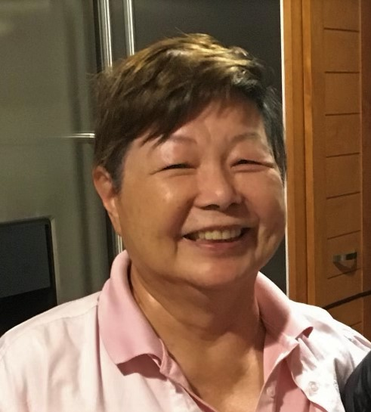
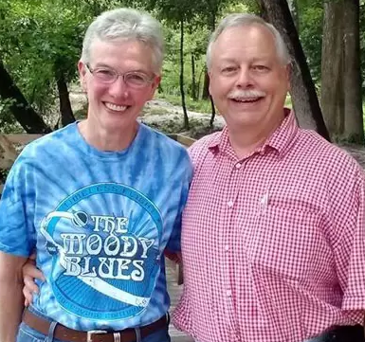
Keystone Updates
Goodbyes
Kay Holloman, Co-founder & Former CEO – Passed Away November 2021
Brian White, Software Development, Project Lead - Retired April 2022

Slide 8
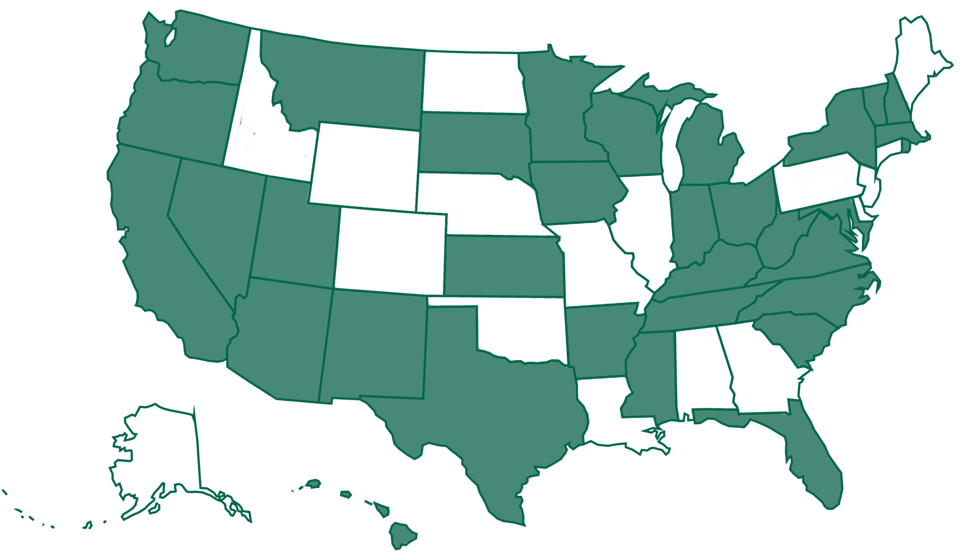
Current iCanConnect Customers
Notes:
KLAS / NDBEDP – National Deaf-Blind Equipment Distribution Program (iCanConnect) - A map with 32 states marked green to show that they use KLAS.

Slide 9
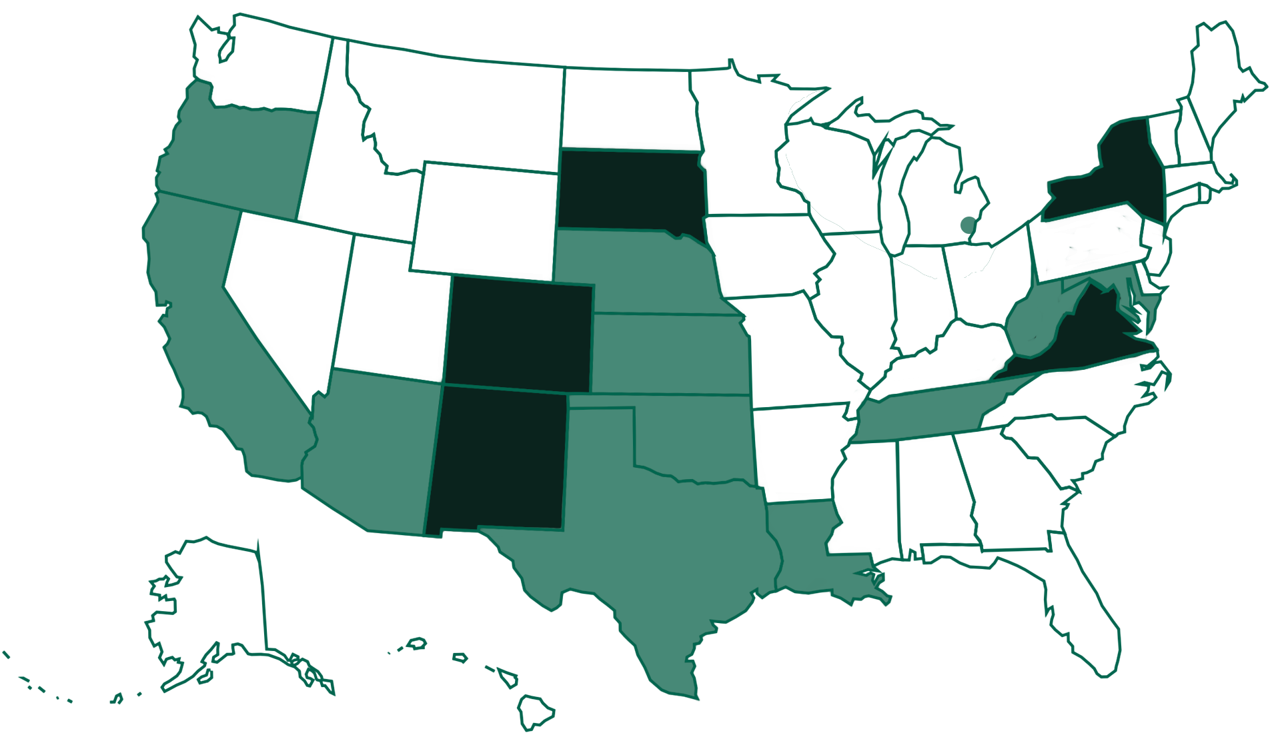
Current IRC / IMC Customers
Notes:
Current IRC KLAS Installations
Self-hosted: New York, Virginia, South Dakota, Colorado, New Mexico
Keystone Hosted: Maryland, West Virginia, Tennessee, Louisiana, Nebraska, Kansas, Oklahoma, Texas, Arizona, Oregon, California, Oakland County (MI)

Slide 10
KLAS Users’ Community

Slide 11
KLAS Users’ Community
KLASUsers.com
Knowledge Base, Latest News, & Discussion Forum
Tag list & search functionality to aid navigation
KLASUsers e-list & KLAS IRC Users’ e-list
Users Group committees are recruiting:
KLAS Users Program Committee
KLAS Users Logistics Committee
KLAS Development Advisory Committee (KDAC)

Slide 12
KDAC
KLAS Development Advisory Committee
Serves an advisory role to Keystone on new features being developed for future releases of KLAS.
Meets 1x/month
Representatives from LBPD, IRC, & Organization / School Libraries
2021 & 2022 Surveys

Slide 13
KDAC IRC Members
Christina Quitana - Arizona Instructional Resource Center (Instructional Resource Centers)
Pepper Watson - Oklahoma Accessible Instructional Materials Center (member at large)

Slide 14
KLAS Users’ Training & Events
Keystone webinars
User-led webinars & roundtables
KLAS Users’ Conference
KLAS 2022 Online Mini-Conference
KLAS UC 2023 - July 17-20, 2023 at Tennessee School for the Blind in Nashville
Online KLAS Administrator Training
IRC – need 2 to commit then will schedule

Slide 15
Keystone Services

Slide 16

Database Hosting
Beginning in February 2020, Keystone’s database hosting moved to Amazon AWS servers.
How does this benefit your organization?
Multiple zones across the US (in VA, OH, CA, OR)
Amazon security practices, plus our own efforts
Encryption of file storage
IT groups are often more comfortable with AWS
This Photo by Unknown Author is licensed under CC BY-SA
Notes:
Since KLAS UC 2021 – for preview updates, please review the conference New Features presentation: https://klasusers.com/knowledge-base/2021-klas-users-conference-presentations-handouts

Slide 17
Database Hosting
Database Backups
Backups stored in multiple AWS zones
Encrypted Backups also stored outside of AWS, on Google
System restore
Scripted automated restore of systems
Previously, restoring a system took hours
All customers can be restored in less than 30 minutes

Slide 18

SSAE Audit
SSAE Audit = an independent review of our IT procedures to ensure we’re meeting security standards
Successfully completed 2022 audit
Audit report available for your IT group to review

Slide 19
New KLAS IRC Features

Slide 20
New KLAS IRC Features
Catalogue
Merge Headings can now run in Batch Manager
Catalog Find tool now handling diacritics appropriately
Add/Remove Headings bug fixed (again)

Slide 21
New KLAS IRC Features
Catalogue
Bug fixes for dropped headings
New titles with multiple headings added before save
Older records on MARC update
Heading Selection tool updated
Keyword filter
Additional information displayed
Relator field for Authors and Narrators

Slide 22
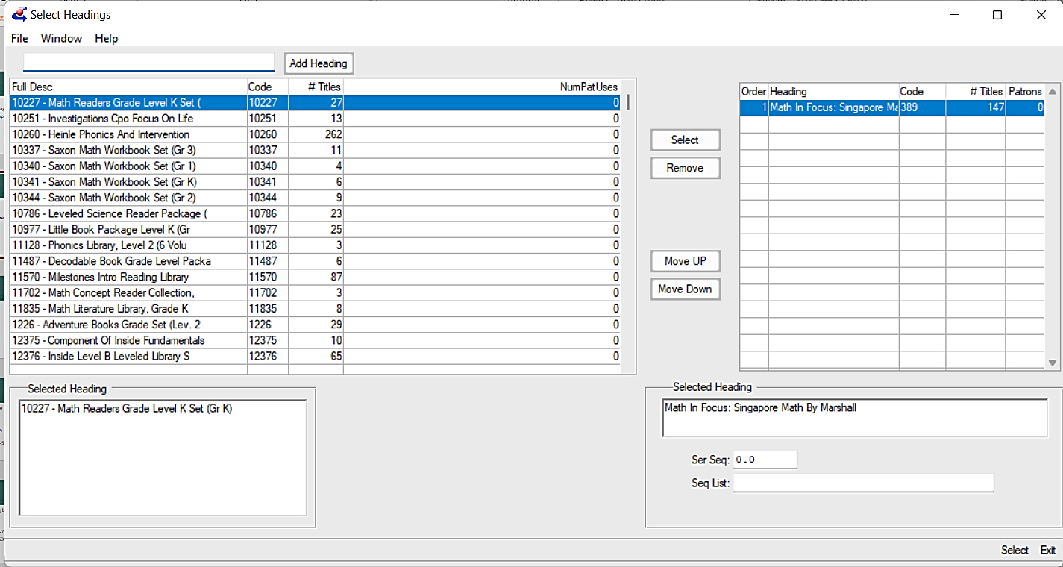

Slide 23
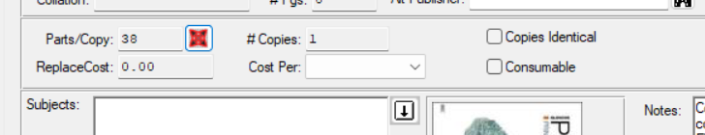
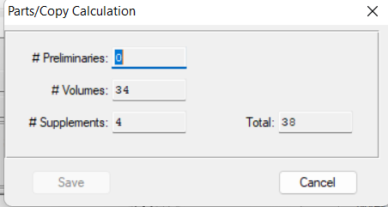
New KLAS IRC Features
Catalogue
Catalogue num/parts displaying correctly

Slide 24
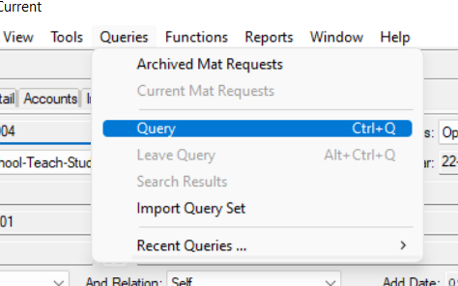
New KLAS IRC Features
Material Request
Fixes to Material Request Query menu

Slide 25
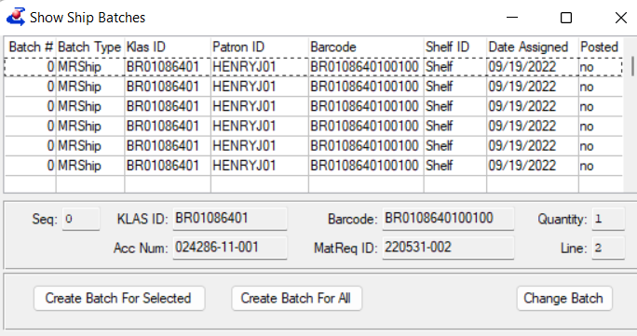
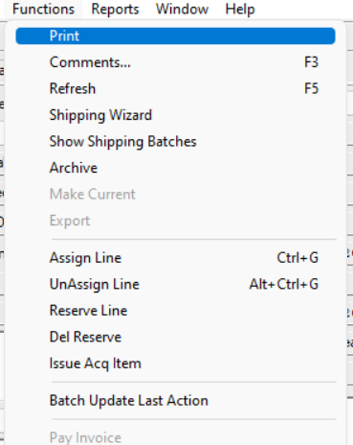
New KLAS IRC Features
Material Request
Show Shipping batches error in creating batches fixed

Slide 26
New KLAS IRC Features
Material Request - Reports
Cost Summary by Patron Report
Allows you to find the amount spent by each patron if the cost is entered on the Material Request
Material Request Listing Report
New fields shown: Ship Date, QTY shipped, & QTY ordered

Slide 27
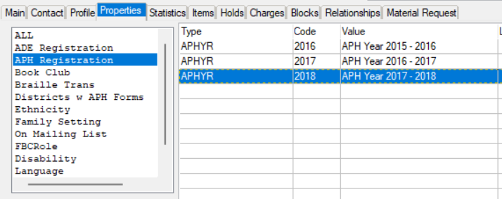
New KLAS IRC Features
Patron
Patron Inventory notice updates
Preference for APH registration available

Slide 28
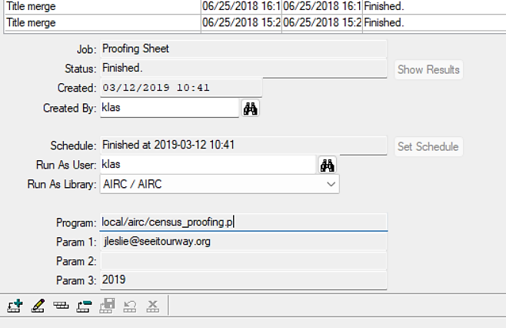
New KLAS IRC Features
Patron
Export census data into APH-ready format (Batch Manager)

Slide 29
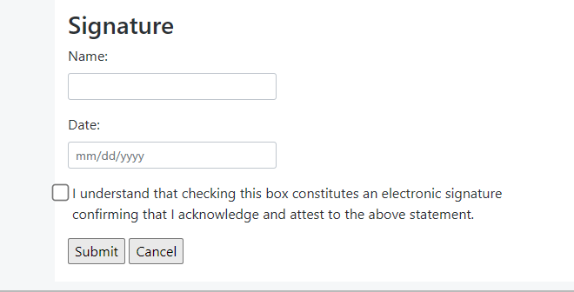
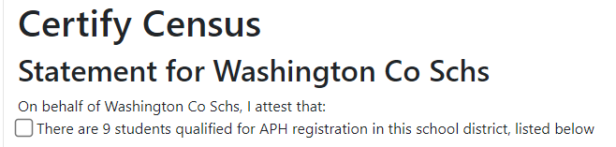
New KLAS IRC Features
Web Order
Fixed Web Order download links
Finalize Census Program fixed to validate the year being finalized in Web Order

Slide 30
Feature Highlight
Meet the Batch Manager
Expands the functions and reports you can do
Offers specialized functionality, including scheduling
Examples: Merge KLASID, Circ by Subject with MR lines, & Email Login
Many reports can “Run as Batch Job” to be scheduled for later

Slide 31
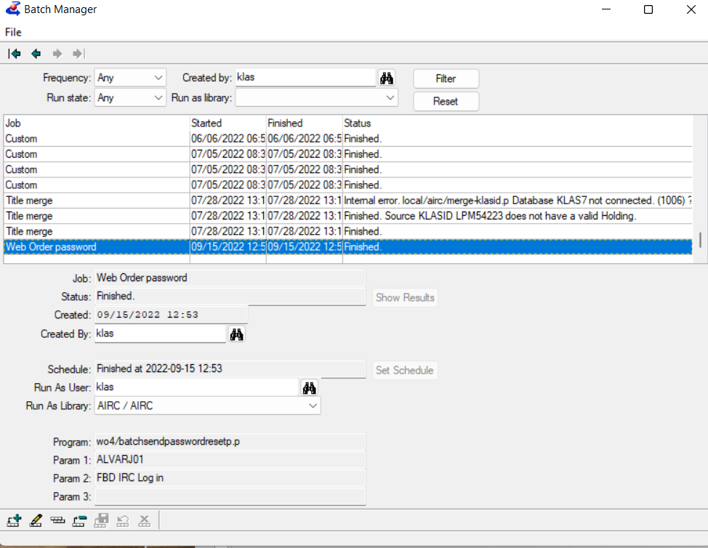
List of all jobs, including finished & upcoming
Schedule
Program & Parameters
Notes:
Needs IRC screenshot, but is this a better approach?

Slide 32
Upcoming Development

Slide 33
APH Ordering API
Demo
Notes:
Insert current status and/or screenshot(s) and/or demo here

Slide 34
Upcoming Development
Continued APH Integration development
Still working out credentials with APH
First Beta site up in a month or two
General release hopefully a month after that
Catalog Integration & Vendor Catalog Integration

Slide 35
Upcoming Development
APH Census Updates
Any changes mandated by APH (new fields, etc.)
Get local procedures (including the export) integrated into KLAS baseline
New screens to run export and other features
Possible - way for teachers to return the completed pdf
Possible - updates to Census Notice
Notes:
Return Completed Census Notice – Do we need to provide a way for teachers to securely upload completed Census Notice pdfs? Potentially upload via WebOrder? Note: email is not secure!
Census Notice – Does this need to be an editable PDF?

Slide 36
Upcoming Development
Tool to remove Graduated/Withdrawn student info from database
Integration of tracking into Shipping Wizard
USPS free matter, other tracking APIs (Ex: FedEx, UPS, etc.)
Windows 11 support

