Slide 1
KLAS Mini-Conference: Keystone Updates
May 3, 2022

Slide 2
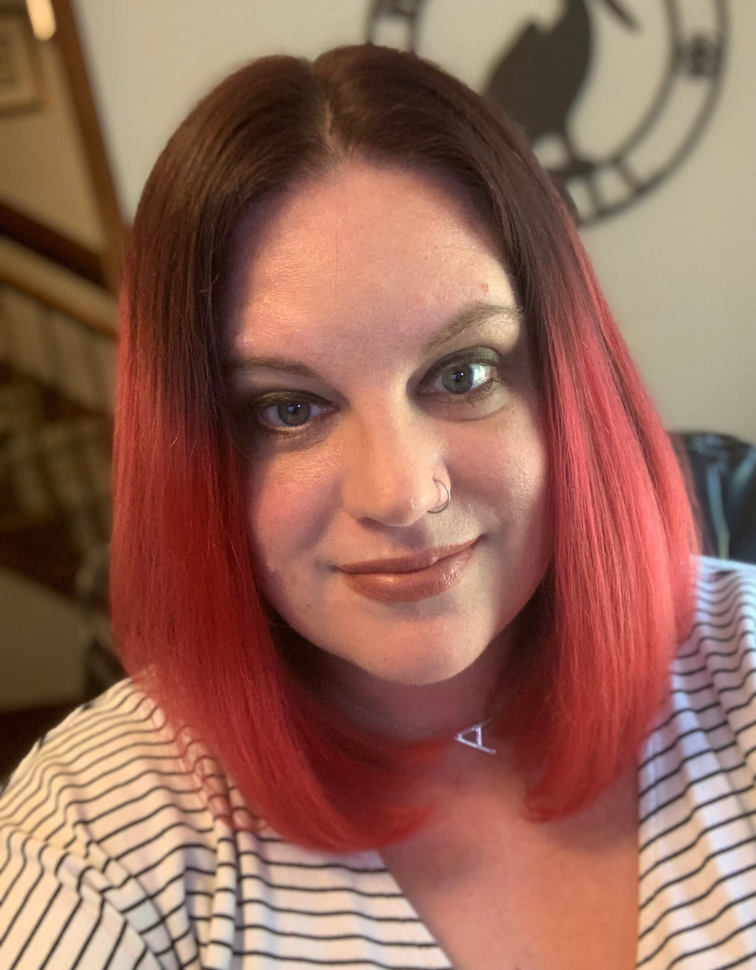
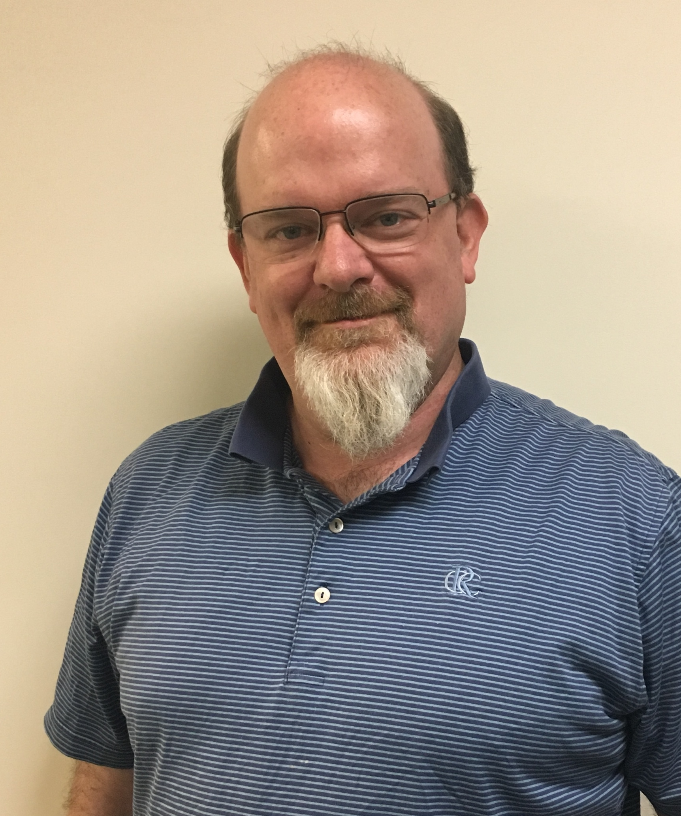
Keystone Staff Presenters
James Burts, Chief Executive Officer
Andrea Ewing Callicutt, Director of Marketing, Sales & Communications

Slide 3
Agenda
Keystone Updates
Current Customers
KLAS Users’ Community, Training & Events
Keystone Services Updates
Ongoing & Upcoming Development
Questions & Discussion

Slide 4
Keystone Updates

Slide 5
Keystone Updates
Keystone staff still working remotely
Hope to soon return to office in a hybrid model
Actively hiring new Customer Support Specialist
Same Faces, New Titles
James Burts, Chief Executive Officer
Mitake Holloman Burts, Chief Product Development Officer
Andrea Ewing Callicutt, Director of Marketing, Sales & Communications

Slide 6

Keystone Updates
Hello
George Martell, Software Development Specialist
Goodbyes
Kay Holloman, Co-founder & Former CEO – Passed Away November 2021
Brian White, Software Development, Project Lead – Retired April 2022

Slide 7
Current KLAS Customers

Slide 8
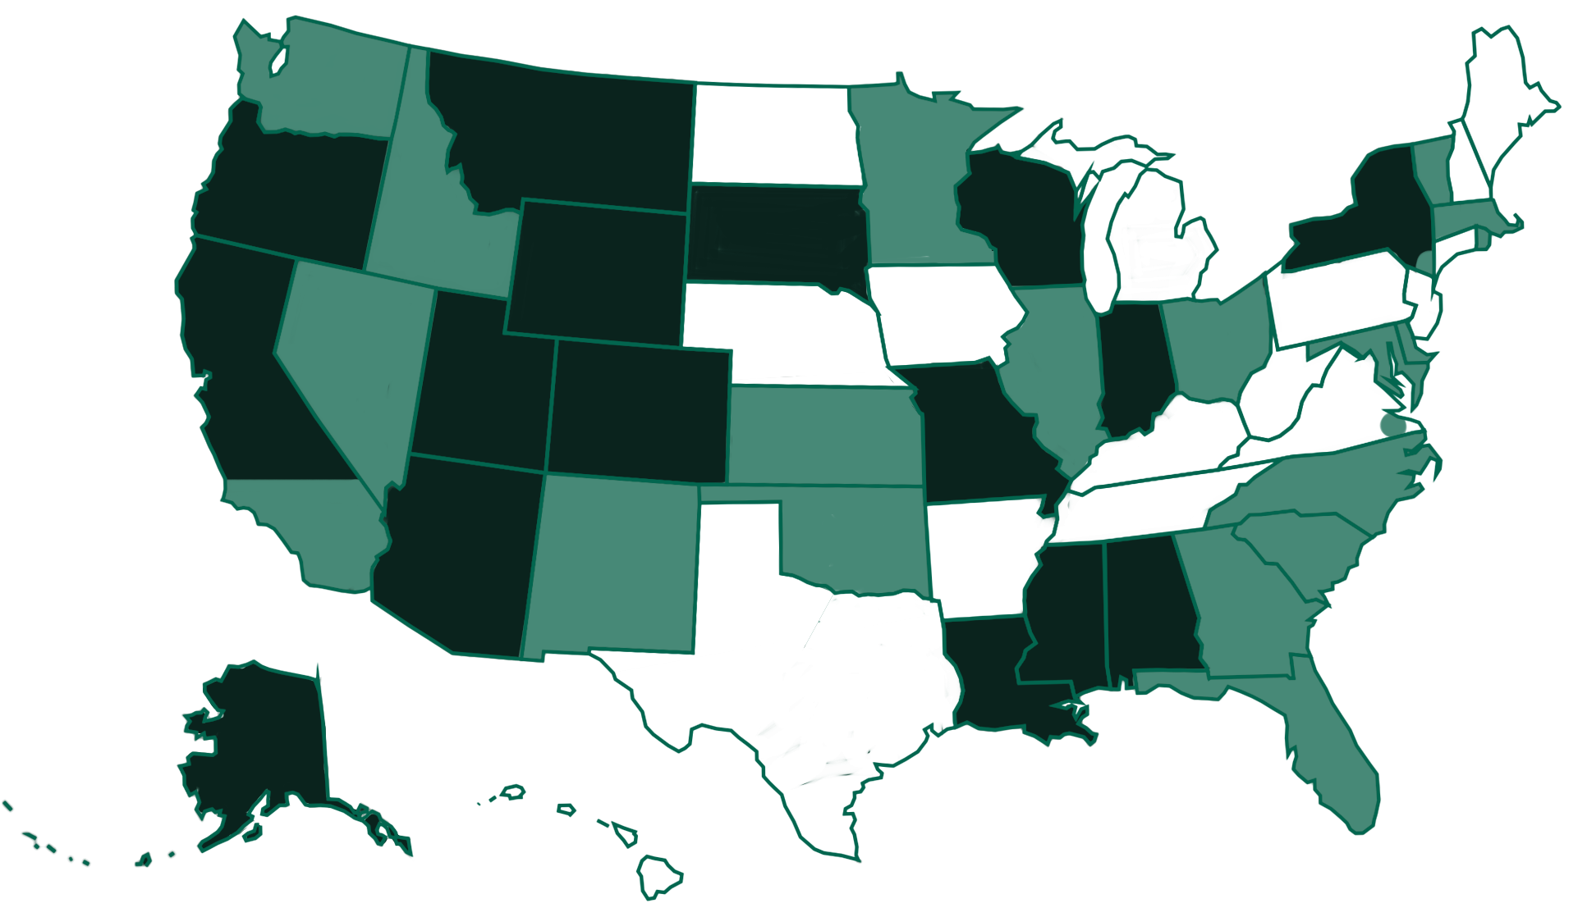
Current LBPD Customers
Notes:
A map with 33 states plus the Virginia Beach area marked green to show that they use KLAS. Of these, 15 states are dark green to indicate self-hosted installations, while 21 states are light green to indicate that they are Keystone-hosted.

Slide 9
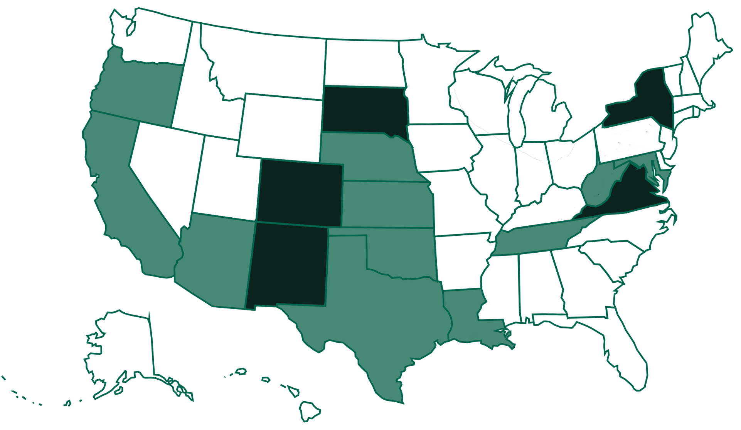
Current IRC Customers
Notes:
Current IRC KLAS Installations
Self-hosted: New York, Virginia, South Dakota, Colorado, New Mexico
Keystone Hosted: Maryland, West Virginia, Tennessee, Louisiana, Nebraska, Kansas, Oklahoma, Texas, Arizona, Oregon, California

Slide 10
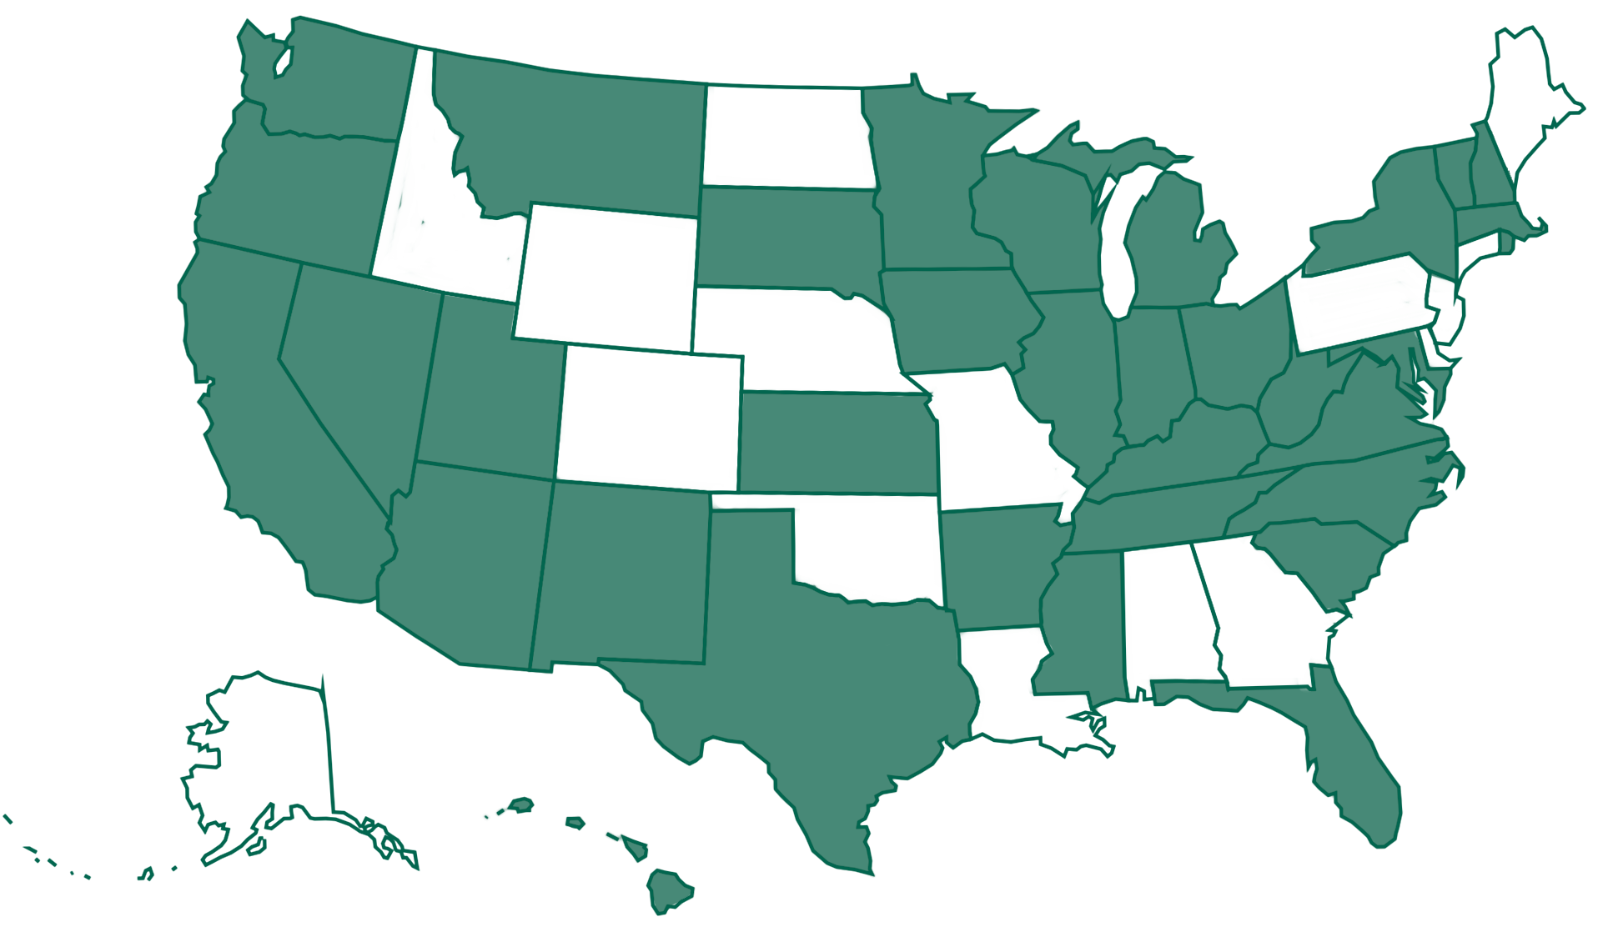
Current iCanConnect Customers
Notes:
KLAS / NDBEDP – National Deaf-Blind Equipment Distribution Program (iCanConnect) - A map with 33 states marked green to show that they use KLAS.

Slide 11
KLAS Users’ Community, Training & Events

Slide 12
KLAS Users’ Community
KLASUsers.com
Knowledge Base, Latest News, & Discussion Forum
Added tag list & search functionality to aid navigation
KLASUsers e-list & KLAS IRC Users’ e-list
Users Group committees:
KLAS Users Program Committee - recruiting
KLAS Users Logistics Committee - recruiting
KLAS Development Advisory Committee (KDAC)

Slide 13
KDAC
KLAS Development Advisory Committee
Serves an advisory role to Keystone on new features being developed for future releases of KLAS.
Meets 1x/month
Representatives from LBPD, IRC, & Organization / School Libraries
2021 & 2022 Surveys
Notes:
“KLAS Development Advisory Committee (KDAC) serves an advisory role to Keystone on new features being developed for future releases of KLAS.”

Slide 14
KDAC Members
Sam Lundberg - New Mexico Talking Book Library (small Talking Book Library), KDAC Chair
Tony Bucci - Arizona Talking Book Library, KLAS Users' Group Officer Liaison
Shawn Lemieux - New York State Talking Book & Braille Library (large Talking Book Library), KDAC Secretary
Dianne Keadle - South Carolina Talking Book Services (mid-sized Talking Book Library)
Ricardo Cisneros - San Francisco Public Library - Talking Books and Braille Center (subregional Talking Book Library)
Donald Salvato - Xavier Society for the Blind (schools and special organizations)
Christina Quitana - Arizona Instructional Resource Center (Instructional Resource Centers)
Crystal Grimes - Oregon Talking Book & Braille Library (member at large)
Dan Malosh - Minnesota Braille and Talking Book Library (member at large)
Pepper Watson - Oklahoma Accessible Instructional Materials Center (member at large)

Slide 15
KLAS Users’ Training & Events
Keystone webinars
User-led webinars & roundtables
KLAS Users’ Conference
2021 - first fully-online & largest attendance ever
2023 at Tennessee School for the Blind in Nashville
Online KLAS Administrator Training
LBPD - September 12-15
IRC – need 2 to commit then will schedule

Slide 16
Keystone Services

Slide 17

Database Hosting
Beginning in February 2020, Keystone’s database hosting moved to Amazon AWS servers.
How does this benefit libraries?
Multiple zones across the US (in VA, OH, CA, OR)
Amazon security practices, plus our own efforts
Encryption of file storage
IT groups are much more comfortable with AWS
This Photo by Unknown Author is licensed under CC BY-SA
Notes:
Since KLAS UC 2021 – for preview updates, please review the conference New Features presentation: https://klasusers.com/knowledge-base/2021-klas-users-conference-presentations-handouts

Slide 18
Database Hosting
Database Backups
Backups stored in multiple AWS zones
Encrypted Backups also stored outside of AWS, on Google
System restore
Scripted automated restore of systems
Previously, restoring a system took hours
Now, all customers can be restored in less than 30 minutes

Slide 19

SSAE Audit
SSAE Audit = an independent review of our IT procedures to ensure we’re meeting security standards
Successfully completed 2021 audit
Audit report available for your IT group to review
2022 audit has started

Slide 20
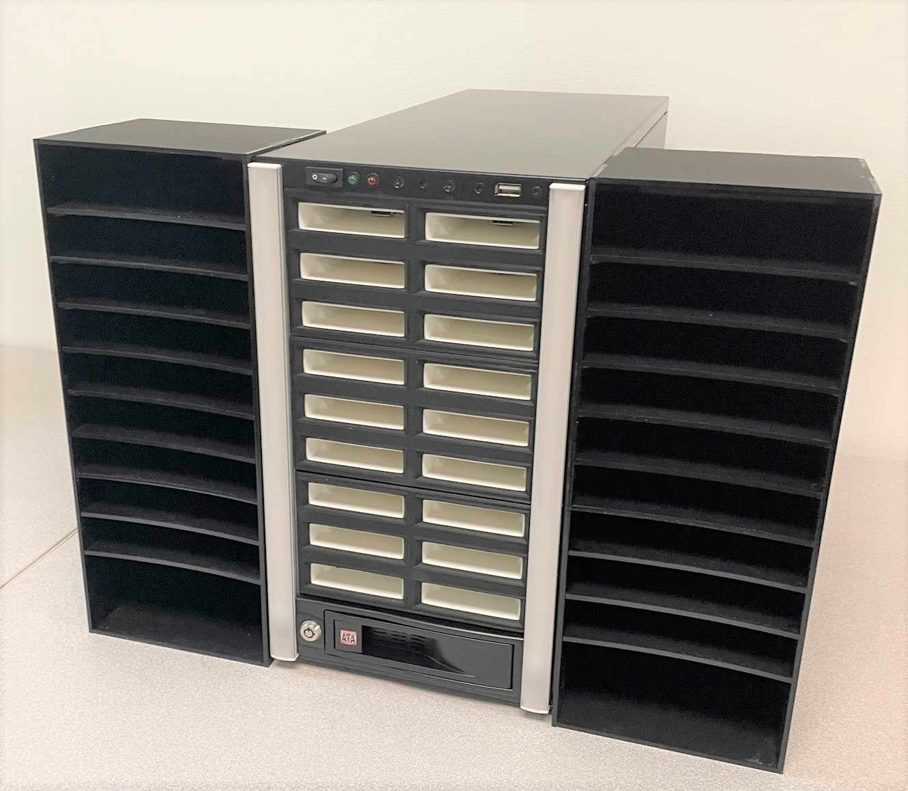
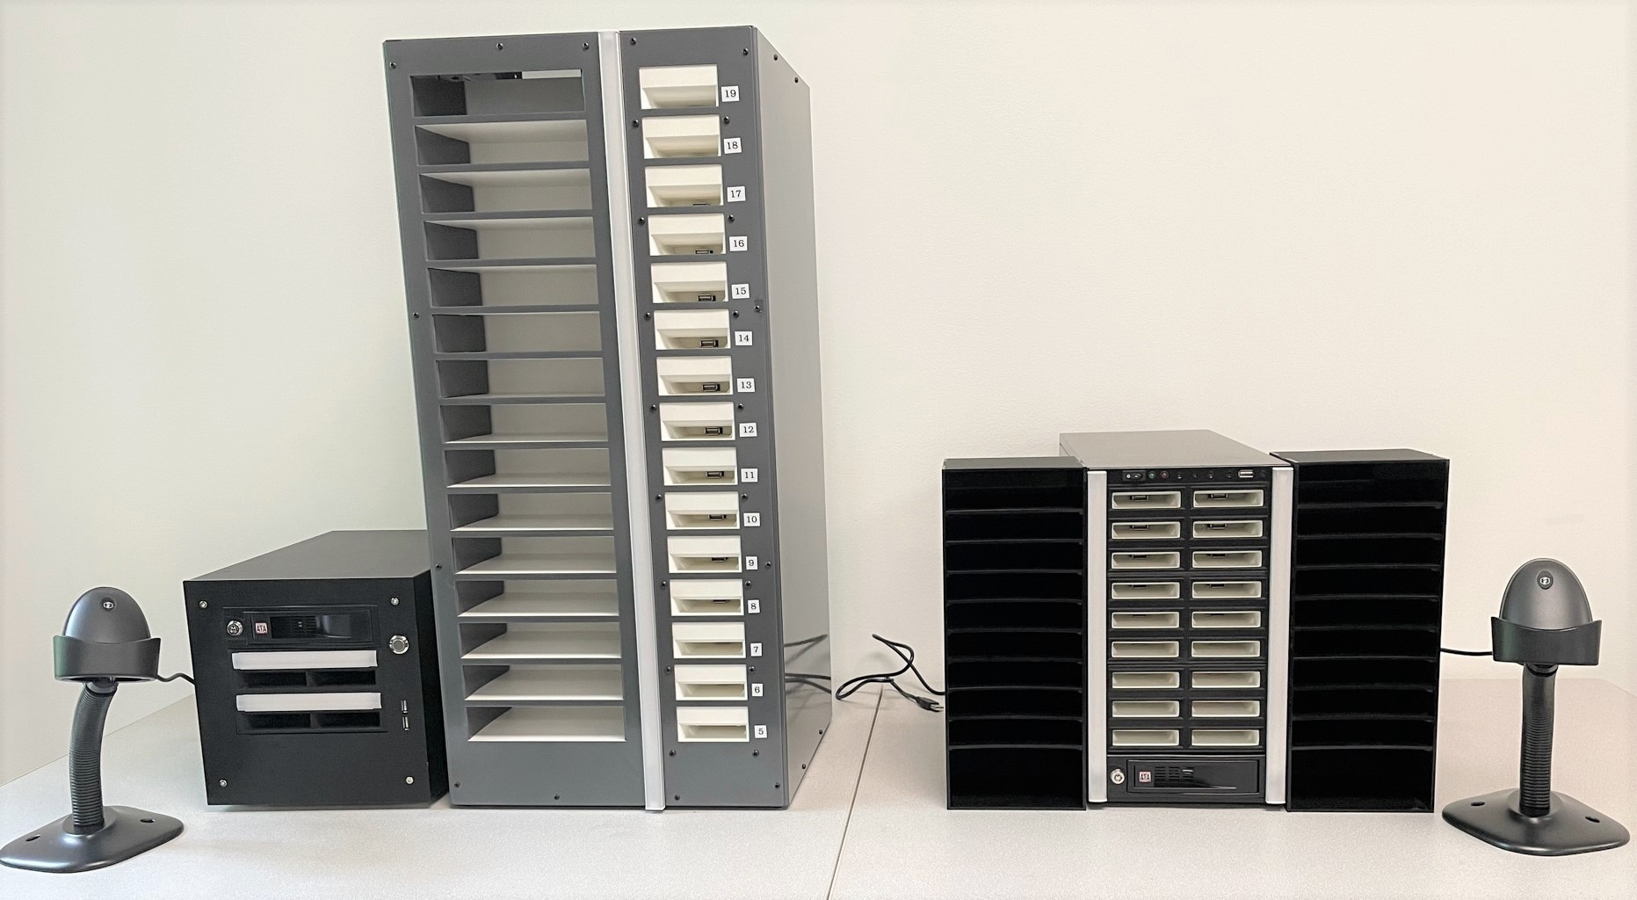
Scribe 2.0
Redesigned equipment for KLAS’ Scribe duplication on demand system
Reached agreement with NLS to unlock white cartridges for duplication

Slide 21
Scribe Installations
Alabama
Arizona
Braille Institute of America (CA)
California
Florida
Idaho
Illinois
Louisiana
Maryland
New Mexico
North Carolina
Perkins Library (MA)
South Dakota
Vermont
Xavier Society (NY)
Notes:
Listed in order of setup

Slide 22
KLAS + Gutenberg Installations
Andrew Heiskell Library (NYPL)
Colorado
Delaware
Georgia
Indiana
Kansas
Minnesota
Montana
Nevada
New York State
Ohio
Oklahoma
Oregon
San Francisco
South Carolina
Utah
Washington
Wisconsin
Wolfner Library (MO)
Notes:
Listed in order of setup

Slide 23
Ongoing & Upcoming Development

Slide 24
WebOPAC v4.0
Accessibility & usability focused redesign
New look, new features
Optimized for both computer and mobile browsers
Will provide a “basic screen” option
Added support for Duplication / Service Queues
Better access to series
Improvements to searching
Optimized for accessibility

Slide 25
API Development
iCanConnect – RLSA
APH
Ordering integration
Submit new orders
Retrieve status of current orders
Catalog integration

Slide 26
KLAS v8
After several years focused on Duplication on Demand development, we will now turn resources towards KLAS v8 with the intent to offer:
Browser-based staff interface for KLAS
Platform independent - expect to run on Windows, MacOS, Linux, etc.
At this point, no specific timeline for availability
We will continue to support KLAS v7 in the interim.

