Slide 1
KLAS IRC Users’ Meeting at
APH 2025
Andrea ewing Callicutt, Director of Marketing Sales & Communications
Marion Campbell, Customer Support Specialist

Slide 2
Agenda
Keystone Staff
Keystone Customers
Keystone Services Updates
KLAS Development Updates
KLAS Users’ Resources

Slide 3
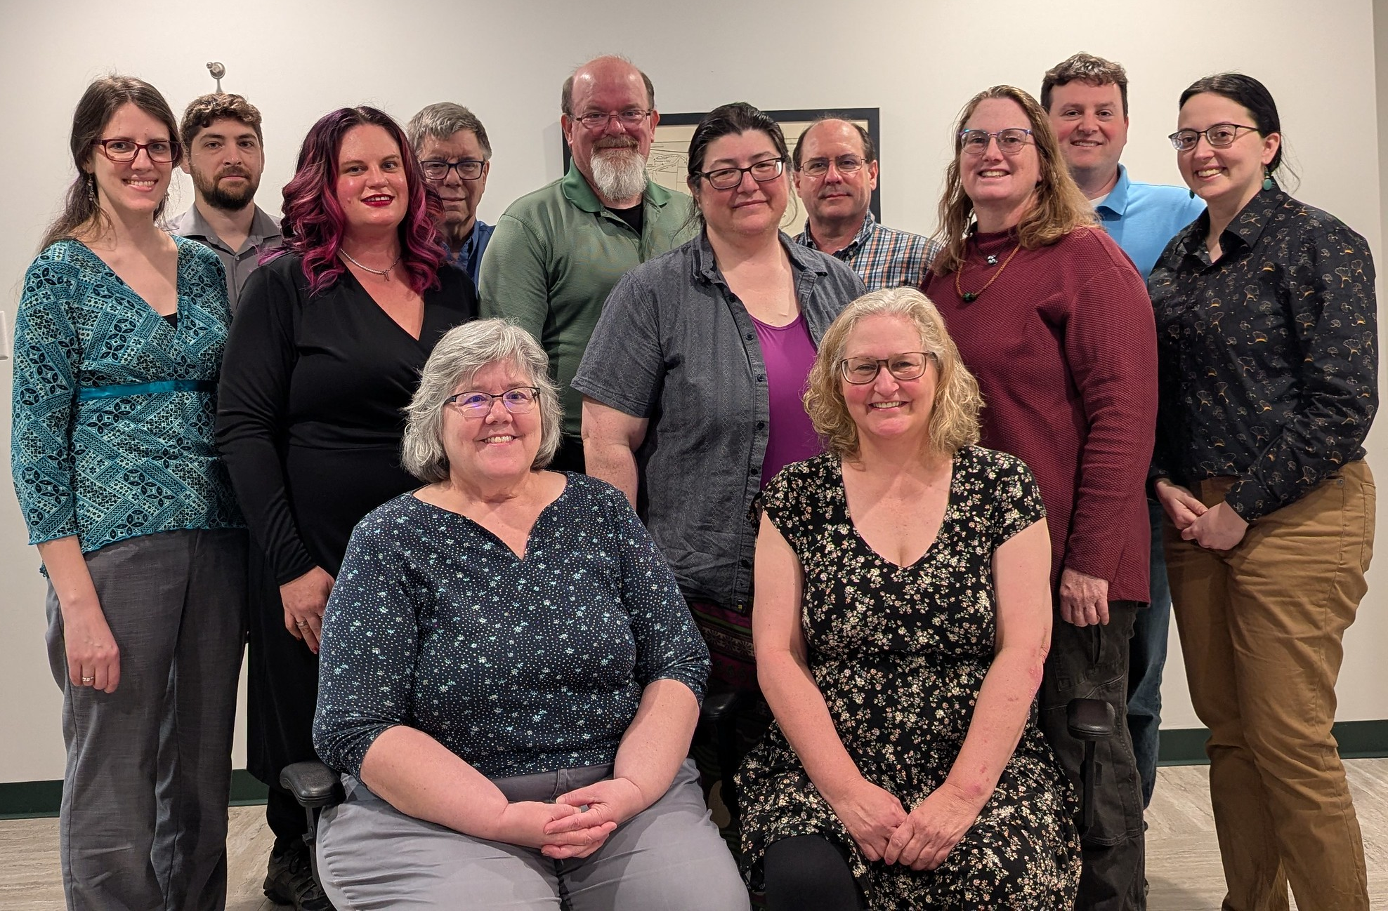
Keystone Staff
Customer Support
Development
Systems Admin / IT
Sales
& Administration

Slide 4
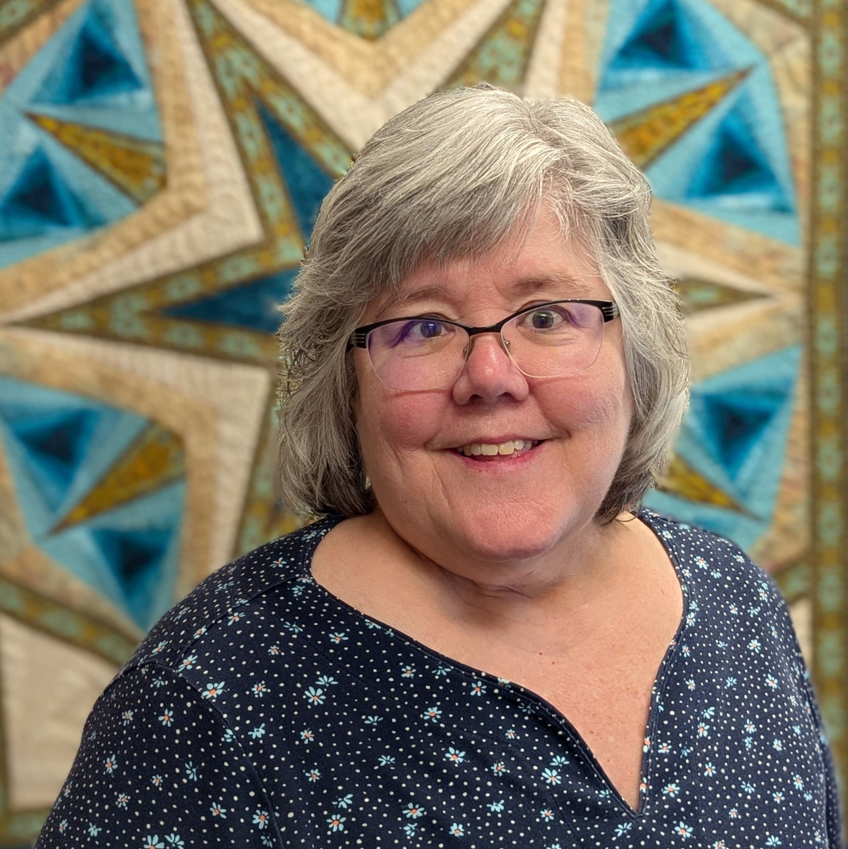
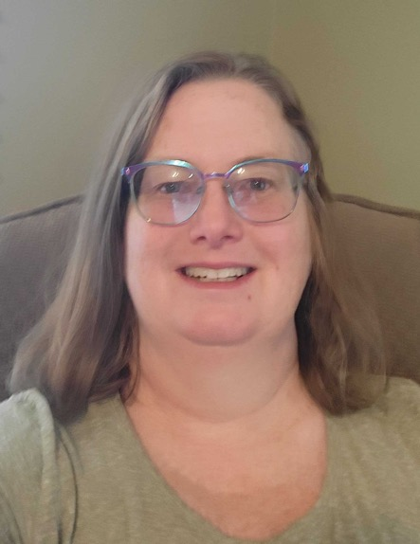
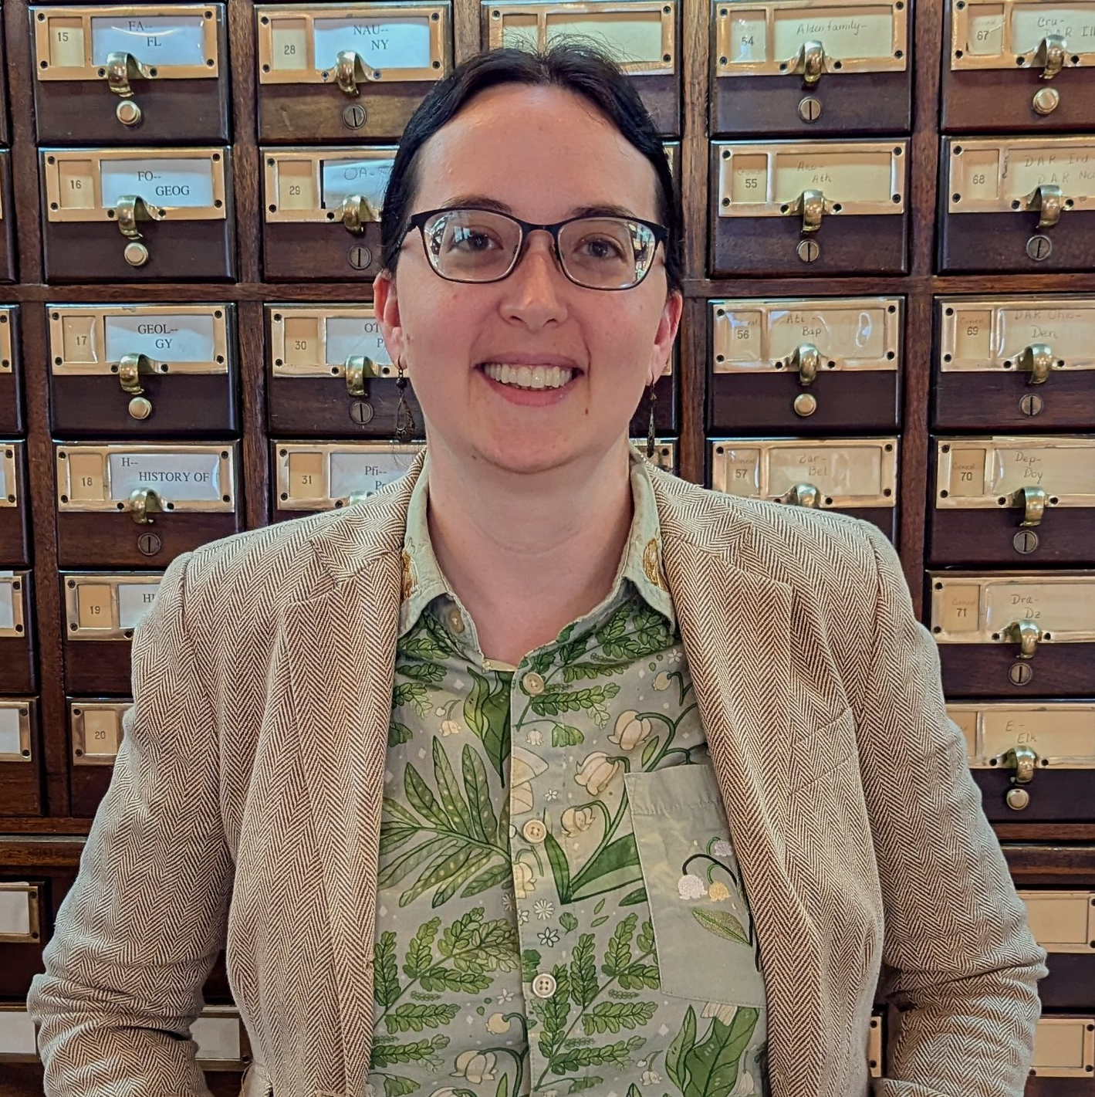
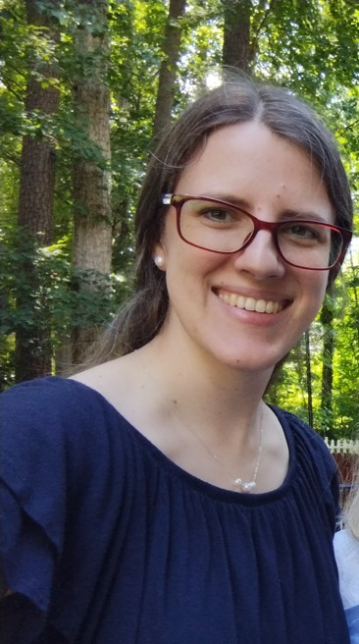
Customer Support
Nancy Honeycutt,
Manager,
Customer Support
Katy Patrick,
Technical Writer
Marion Campbell,
Customer Support Specialist
Katharina Stevens,
Customer Support Specialist

Slide 5




Development
George Martell,
Software Development
Specialist
Mitake Burts,
Chief Product
Development Officer
Kyle Honeycutt,
Manager,
Software Development
John Carpenter,
Software Development
Specialist

Slide 6


Systems Administration / IT
Mark Gardner, Manger,
Systems & Networking
Lee Higley, Lead Consultant,
Information Technology

Slide 7
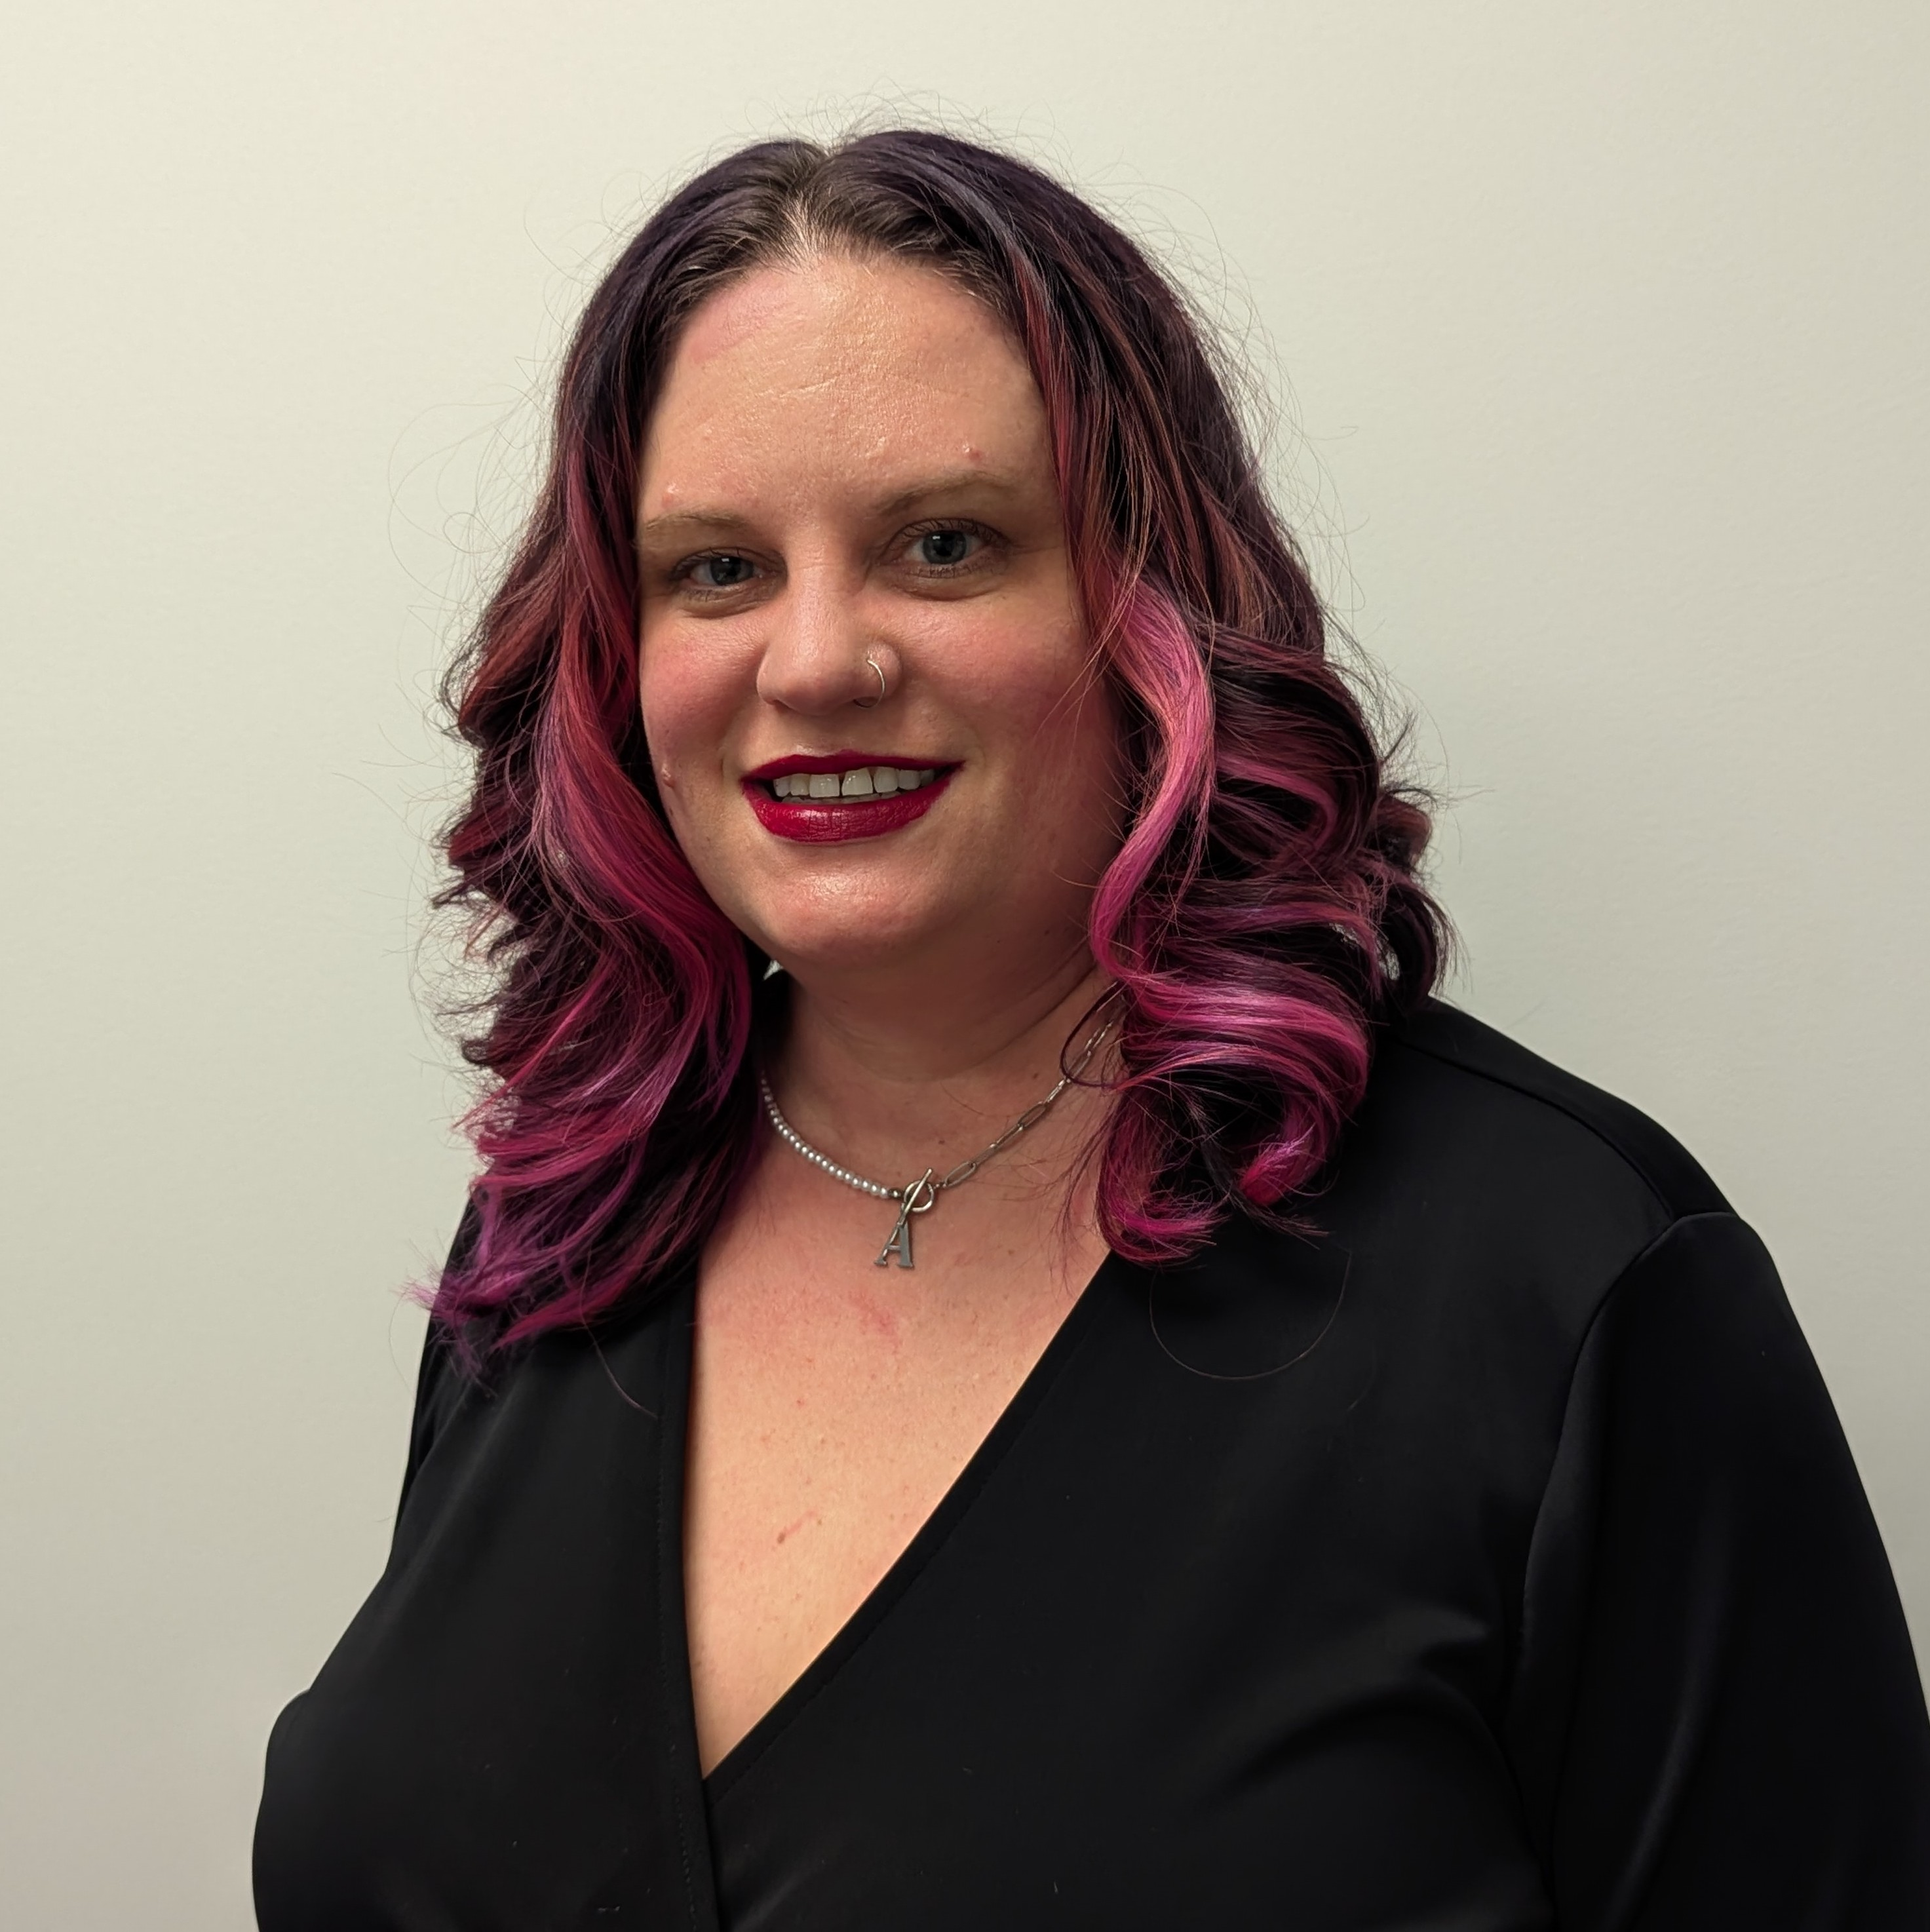
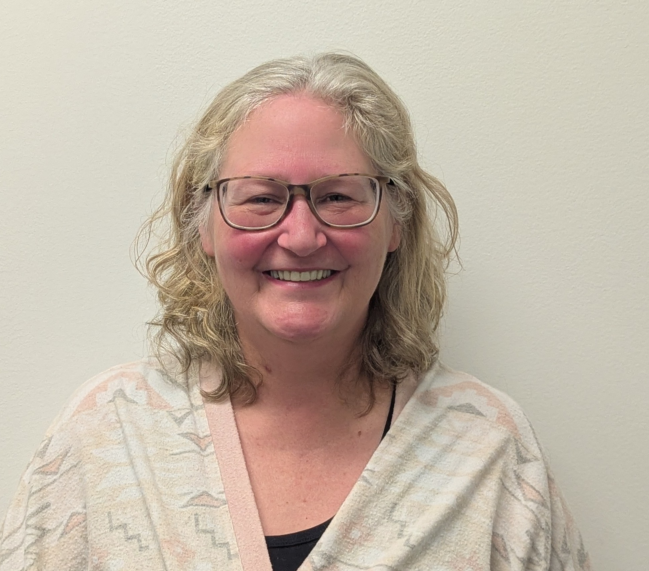

Sales / Administration
Tracey Fye, Office Manager
Drea Callicutt, Director of Marketing, Sales, & Communications
James Burts, CEO

Slide 8
Keystone Customers
New KLAS Users
Current Library for the Blind & Print Disabled Users
Current Instructional Resource / Materials Center Users

Slide 9
New KLAS Users
Now Live!
  Minnesota State Services for the Blind (SSB), Minnesota Department of Employment & Economic Development
  Michigan Braille and Talking Book Library
  Kentucky Instructional Resource Center

Slide 10
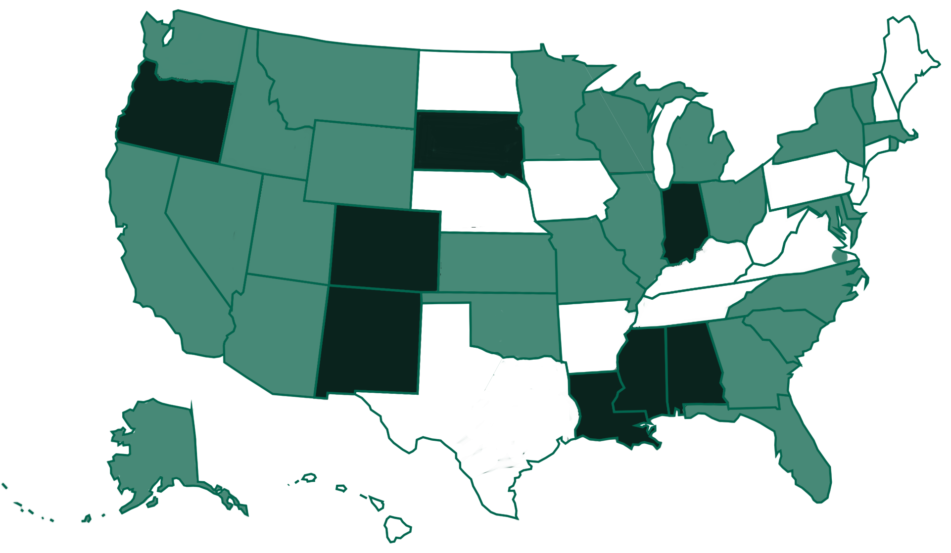
Current KLAS LBPD Installations
Notes:
Light green are Keystone hosted. Dark green are self-hosted.

Slide 11
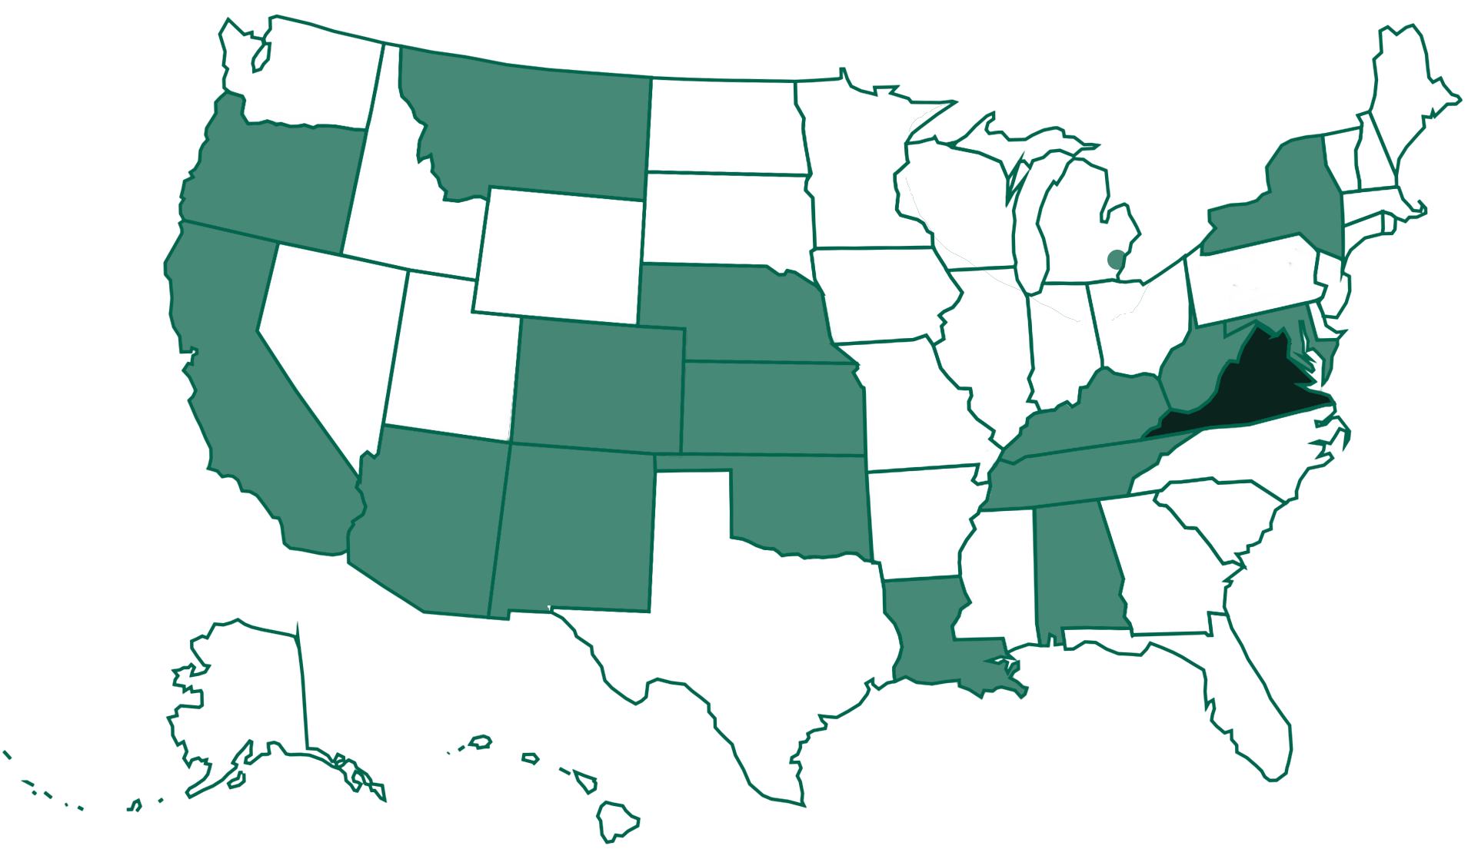
Current KLAS IRC / IMC Installations
Notes:
Light green are Keystone hosted. Dark green are self hosted.

Slide 12

Keystone Services Updates
Hosting:
  2024 SSAE Certification
  Completed

Slide 13
KLAS Users’ Resources:
KLASUsers.com
  Email ks7@klas.com to request an account
  Forums, Release Lists, MARC Records, Training Recordings, How-Tos, User Manuals, etc.
KLAS Users’ & IRC User listserv
  Email ks7@klas.com to be subscribed
KLAS Users’ Conference & MiniConference
  May 2026 – free, online MiniConference
  2027 – Hybrid Users’ Conference in Worcester, MA

Slide 14
KLAS Users’ Resources:
Ongoing webinars & roundtables
  Monthly during MiniConference year
  Quarterly during Hybrid Conference year
Keystone’s Social Media
  Facebook & LinkedIn
Online IRC / IMC KLAS Administrator Training
  November 3-6, 2025
  2026 dates TBD
KLAS Users’ Group Meetings at NLS & APH

Slide 15
KLAS Users’ Group
New Officers as of 8/1/2025
  Josh Easter, President, South Dakota Braille & Talking Book Library
  James Gleason, Vice President, Perkins Library
  Maureen Dorosinski, Immediate Past President, Florida Braille & Talking Book Libraries
  AnnaMarie Theiss, Secretary, Alabama Instructional Resource Center
Committees
  KLAS Development Advisory Committee (KDAC)
  Logistics Committee
  Program Committee

Slide 16
KLAS Updates: Release Lists 7.8.22-30
Order of how we will go over these:
  KLAS General
  Catalog
  Material Request
  Acquisitions
    Orders, Receive, Invoices
  Reports
    Updated, New
  Web Order
    Patron, Orders, Census

Slide 17
KLAS General Updates
Code update: Codes in Code maintenance now allow up to 15 characters.
  NOTE: Some browses & drop downs may cut off description due to this.
Library Maintenance: Emails addresses can have up to 60 characters.

Slide 18
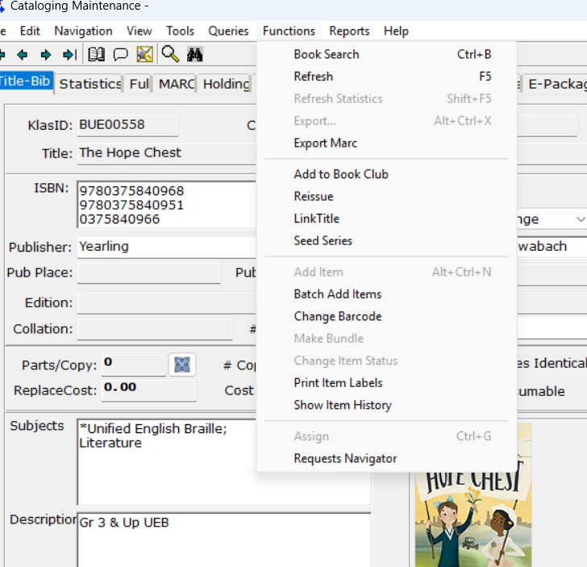
Catalog Updates
Performance improvements
Item History is in the Functions menu (accessibility)
Can place a Reserve on a Temp Title and still check the book out
Batch Add Items generates barcodes for prelims and supplements correctly

Slide 19
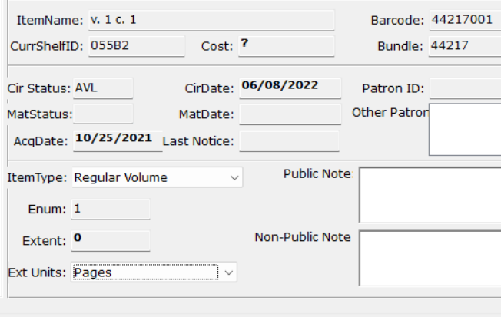
Catalog cont.
Enum on Items tab now visible
  Can update volume number as well if item is a prelim or supplement

Slide 20
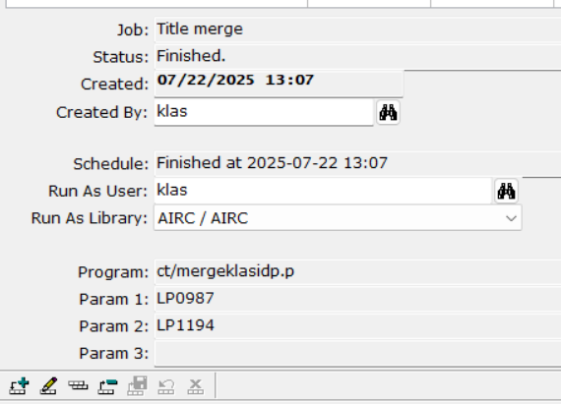
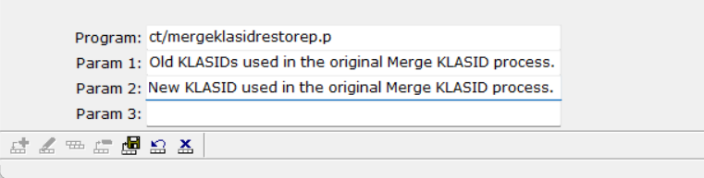
Catalog cont.
Merge Title program in Batch Manager
Restore Merged Title program for Batch Manager

Slide 21
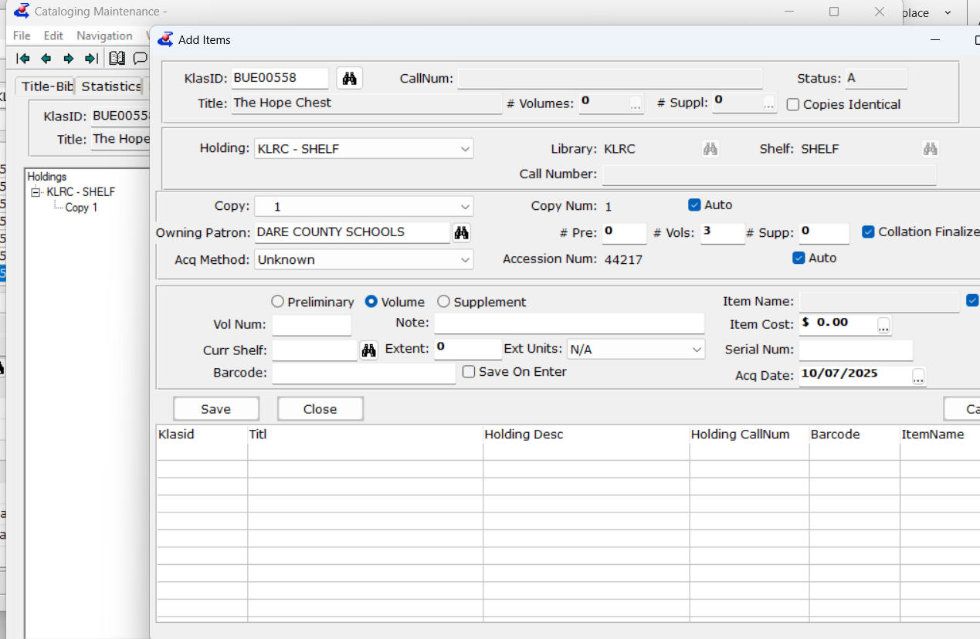
Catalog cont.
Add Items now defaults to currently selected copy
Fixed bug in Add Items and Receive that did not default library and shelf

Slide 22
Material Request Updates
Consumable items in a deleted Holding will not Assign to a Mat Request
Emails fixed for events such as Print Copy Requested
Can set action line status to close request after SHC
Packing slip update allows carriage return in notes
Mat Request Query allows queries on Public Note, Non-Public Note, and Unit Cost
Sub-detail can now be added to Mat Request browse

Slide 23
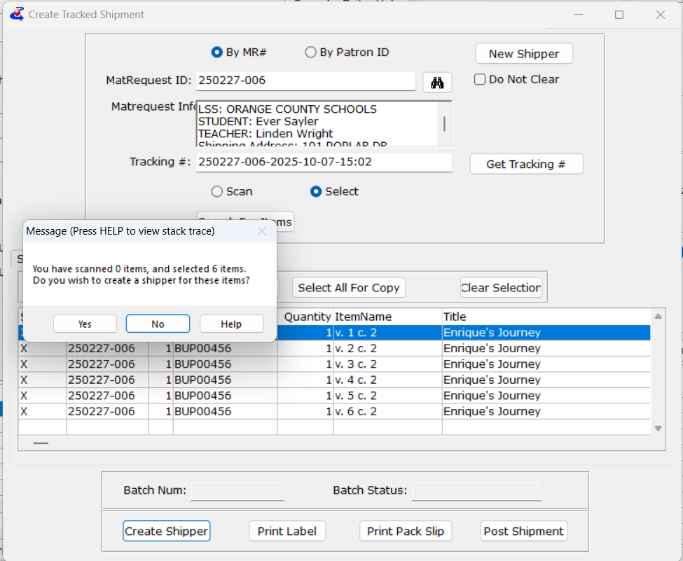
Material Request cont.
Create shipper updated messages about posting and creating a batch (accessibility)

Slide 24
Acquisitions: Orders
Can’t create multiple POs for same Mat Request line anymore
New tokens in Print Order, including Num Parts
EOTs and EOT assistants can use Set as On Order feature to sync KLAS orders with APH
  Start by emailing both Anthony Phillips at APH and ks7@klas.com

Slide 25
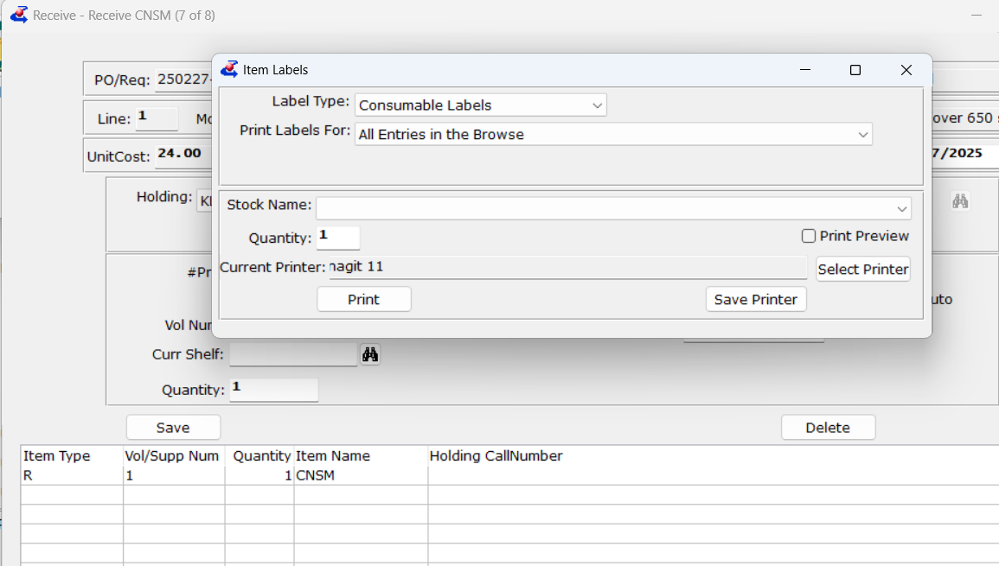
Acquisitions: Receive
Print label now defaults to correct type of label for consumable or tracked items

Slide 26
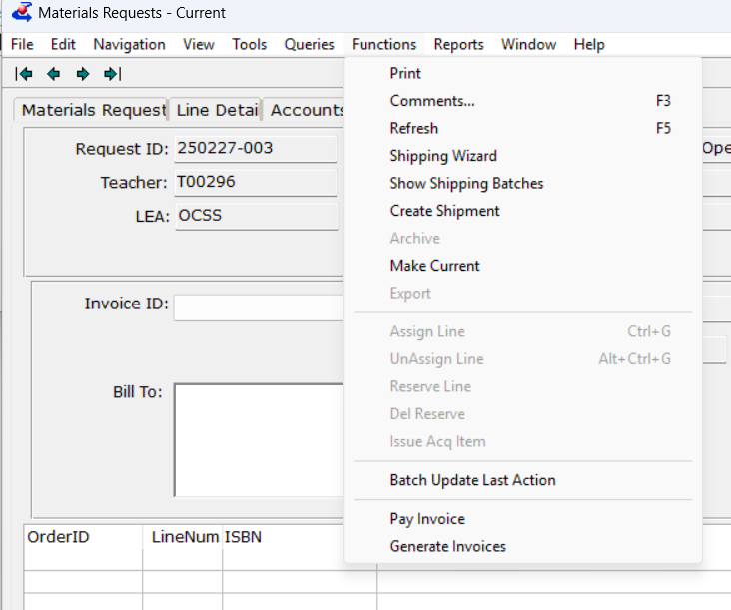
Acquisitions: Invoice
Generate invoice from Mat Request now available
Invoice line can display Sub-detail using invoice line types
Print invoice allows selection of multiple billing addresses

Slide 27
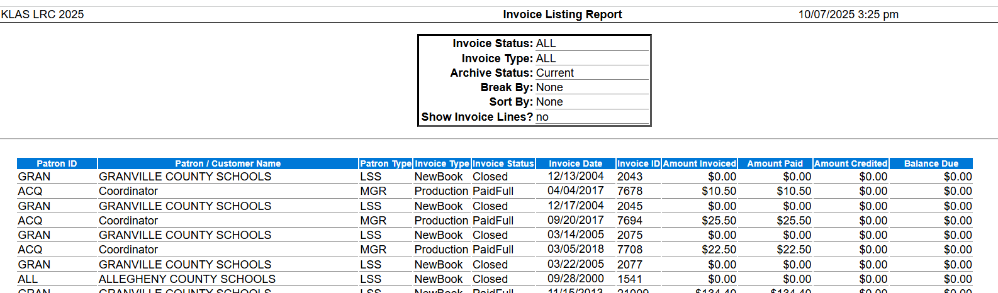
Reports: Updated
Invoice Listing Report includes amount paid, amount credited, total and subtotal fields

Slide 28
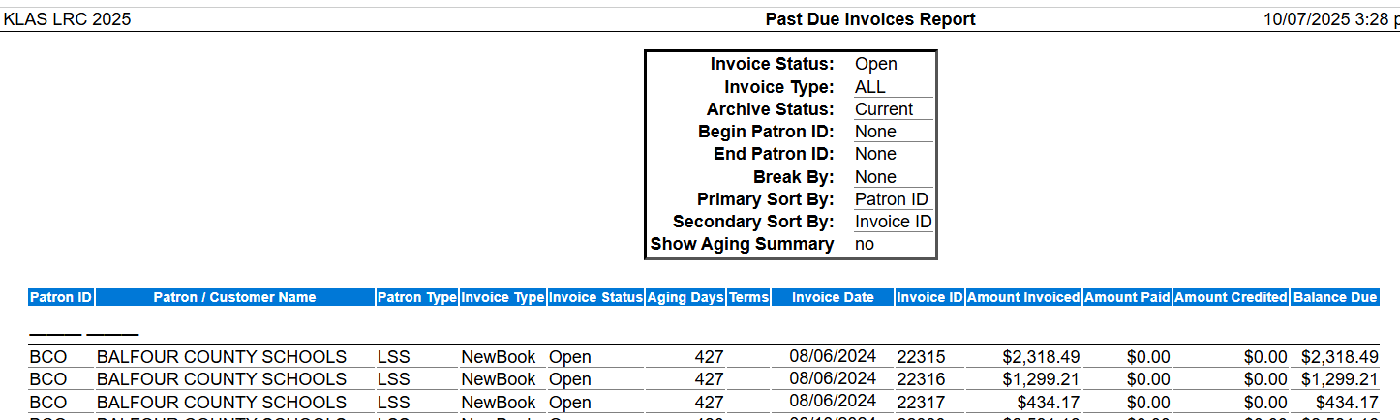
Reports: Updated
Past Due invoices contains criteria for a given patron or patron range

Slide 29
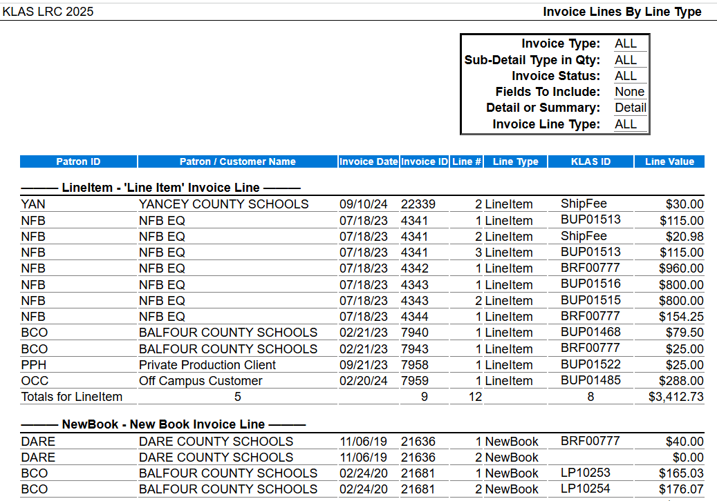
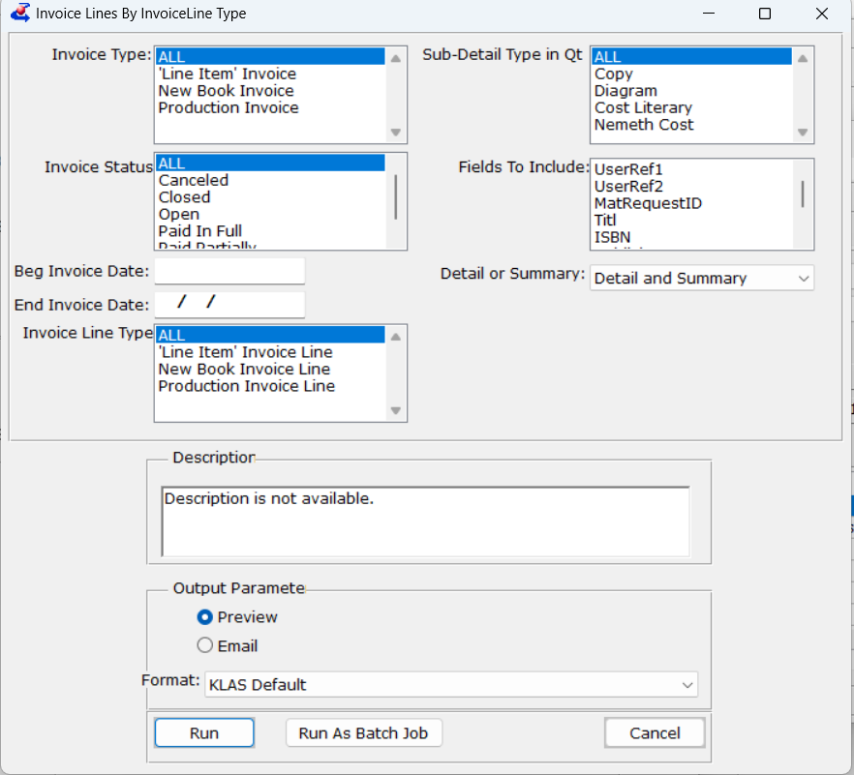
Reports: New - Invoiced lines by line type

Slide 30
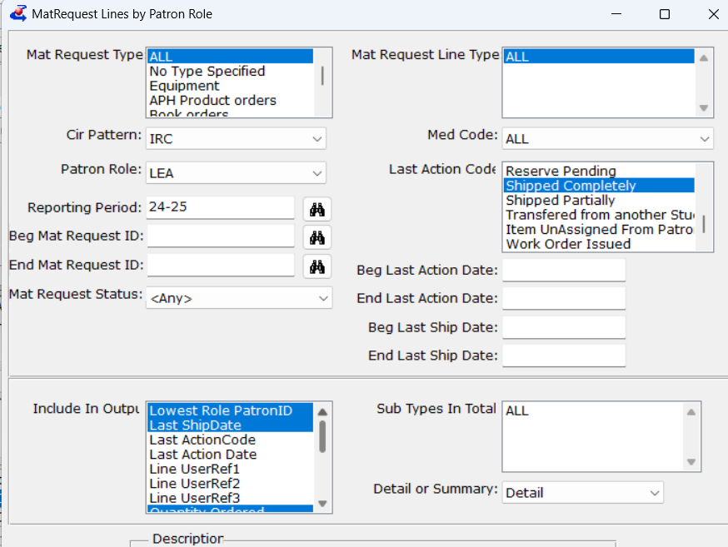
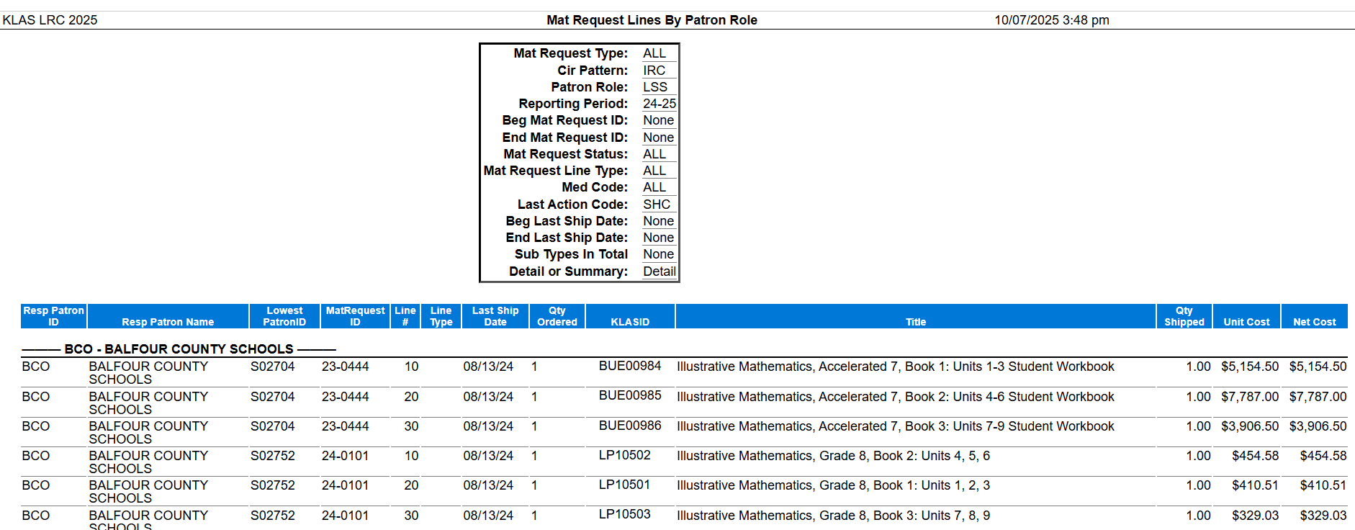
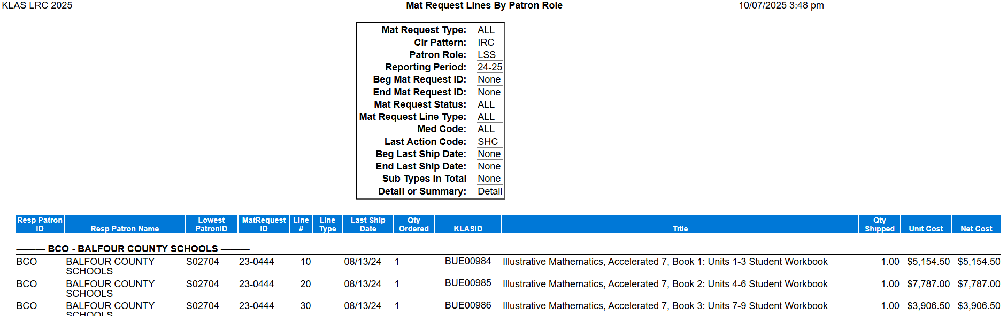
Reports: MR - Line by patron type
Replaces Students Served report that I ran

Slide 31
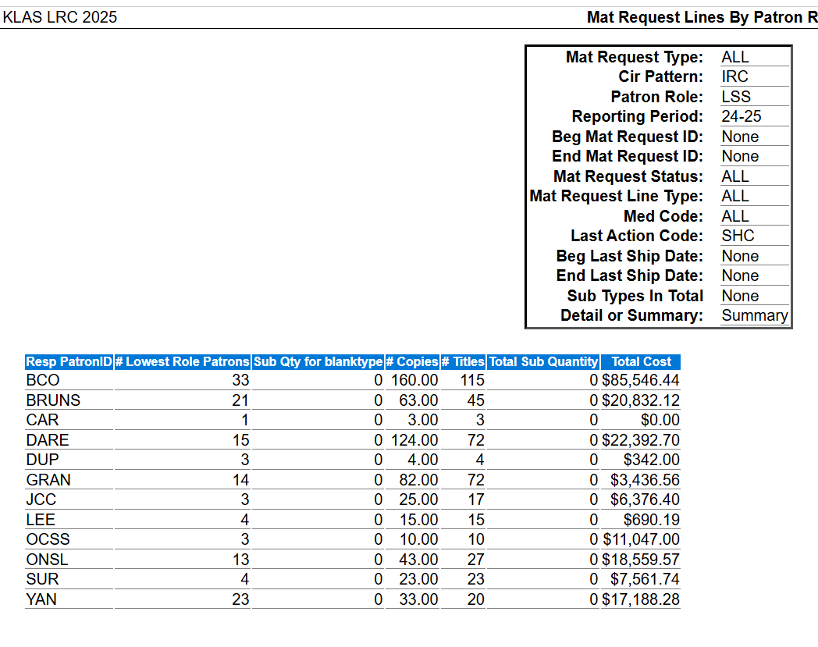
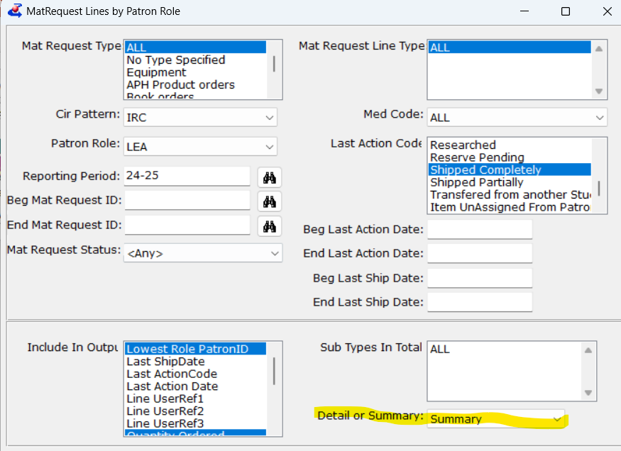
Reports: MR - Line by patron type Summary

Slide 32
KLAS Development (Upcoming)
Single-Sign-On and/or 2 Factor Authentication
  via KeyCloak
  Optional
Security improvements
  In the KLAS application
  In the WebOPAC
WebOPAC Accessibility improvements
USPS intelligent mail API

Slide 33
Questions???

