Slide 1
End of Year Reporting
September 23, 2025
Circulation Summary Spreadsheet
New NLS Active Patron Report
Referral Source and Inactive Reason
Batch Patron Status Review

Slide 2
Circulation Summary Spreadsheet
Expertly compiled from your circulation statistics
Readership:
  Count of Patrons (non-deleted or deleted this year PIMMS IDs) Served
  Count of how many received qualifying activity:
    Audio - Book or Mag
    Hard Copy Braille - Book or Mag
    E-Braille - Book
    Network Library Collection (includes Serials)
    New this year: Serials, BARD Activity
  “NNNN” patrons who didn’t receive from any column
  Individuals vs Institutions breakout

Slide 3
Circulation Summary Spreadsheet
Circulation:
  Circulation by category
    Talking Book on Cartridge
    Hard Copy Braille Book
    E-Braille Book on Cartridge
    Magazines On Cartridge
    Cartridges
  Circulation by prefix / cartridge / serial / language
  Popular titles (Overall, Braille, adding Foreign Language)

Slide 4
New NLS Active Patron Report
Standardized version of the spreadsheet statistics
Parameters for NLS-Only (PIMMS ID) or All
Parameter for timeframe
Juvenile patron count (18 vs “classic” R&C 13)
ETA: Mid-October
“Classic” R&C report will remain available.
“Active Patron” definition blog post

Slide 5
Last Served Date
Tracked, consumable, electronic circs all update
  Make sure you load your BARD statistics
Monograph & Serial
Exception: Pub / Publication Serial Type
  Use for routine Newsletters
  Keeps inactive patrons from lingering under the radar
  Circulations are still counted towards Network-produced material
Current data, not historical: run the stats you want at the end of the period, don’t try to recreate them later

Slide 6
Referral Source and Inactive Reason
Stored on the Preferences tab
Query Recipe basics:
  Patron Type – Begins – P (for individual only)
  Main Status – Equals – A (for currently Active)
  Library ID – Equals – (your branch)
  Registration Date – Is Between – (this year?) OR
  Advanced tab – Patron – Status Start Date – Is Between
Key ingredient (Advanced tab):
  Query against Preference: NLSRef or NLSInact OR
  Main tab Referral Code
  Query by Code or Value

Slide 7
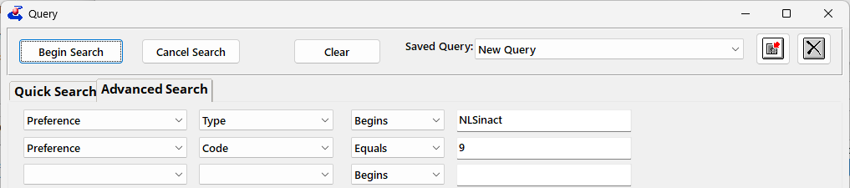
Example Queries: Inactive Reason
Preference – Type – Begins – NLSinact
Preference – Code – Equals - #
or to combine several codes:
Preference - Code – In – #,#,#

Slide 8

Example Queries: Inactive Reason
Prefer to just go off the full description listed on the tab? That works, too!
Preference – Type – Begins – NLSinact
Preference – Value – Begins – (description)

Slide 9
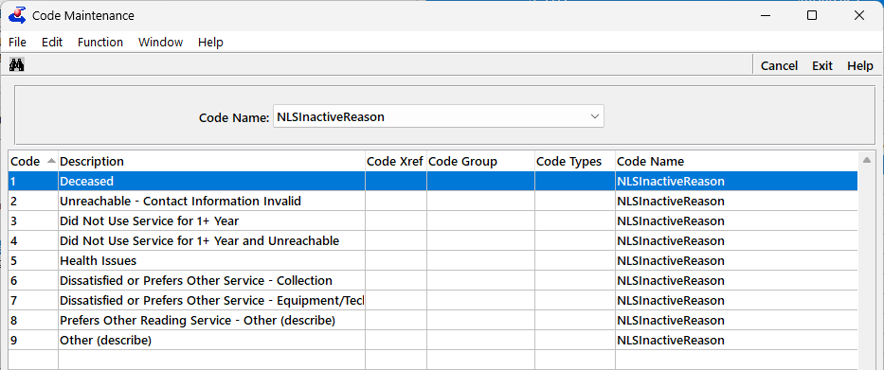
Inactive codes
What codes do I query against?
View – Administration – Code Maintenance (but do not edit)

Slide 10
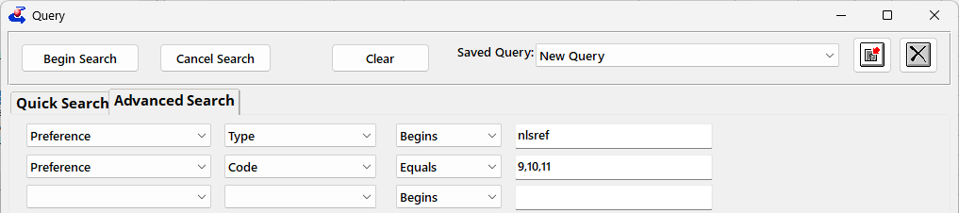
Example Queries: NLS Referral
Preference – Type – Begins – NLSref
Preference – Code – Equals - #
or to combine several codes:
Preference - Code – In – #,#,#

Slide 11
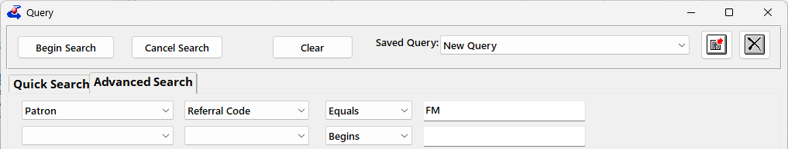
Example Queries: Local Referral
Additional referral sources can be tracked under 1 NLS Referral Code. To query against these:
Patron – Referral Code – Equals – (code from the Main Tab, or the ReferalSource codefile)

Slide 12
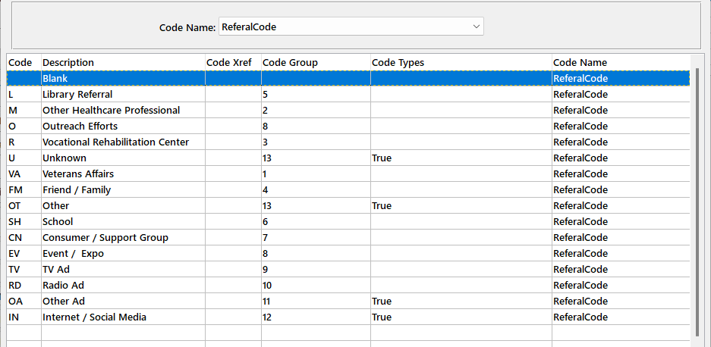
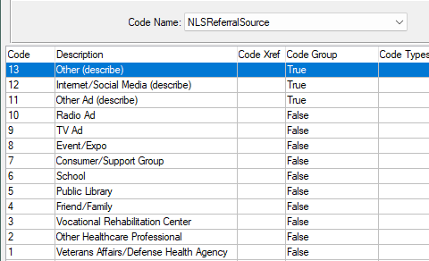
Referral Source Codes

Slide 13
Batch Patron Status Review
Keep your Patron module clean
  No need to scroll through Suspended / long inactive results in Find
  Quicker Queries
  More accurate counts and statistics
Got behind? Now is the time to catch up!
  New definitions & new report = new counts across the board
  New definitions less sensitive to batch maintenance
BPSR Instruction on KLASusers.com

