Slide 1
New Features
7.7.53-7.7.58

Slide 2

Katy Patrick
Technical Writer, Keystone Systems

Slide 3
Overview
KLAS Core
WebOrder & IRC
Catalog & Equipment
Patron
Nightly Configuration
Duplication

Slide 4
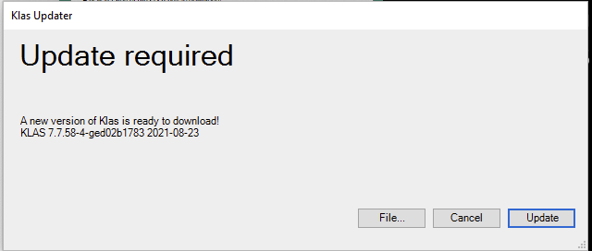
KLAS Client
Client startup less likely to need alternate Activation Keys
Updater can now resume interrupted downloads
Notes:
Users that need a separate Activation Key to manage Host Verification due to their network’s SSL interception should now be able to connect from home or office using the same Activation Key / KLAS installation. For more info: RL 7.7.53, Issue #KLAS-2567

Slide 5
KLAS Core
Program created to delete old, completed Batch Jobs
Scheduled reports no longer drop the selected parameters when edited in the Batch Manager
Standard program for emailing a message and/or attachment created, for use by other KLAS functions and programs
Accelerator Keys restored in Report front end
Notes:
Accelerator keys have been added back to the Report front end, allowing users to skip to the Preview/Email radio set and Run/Cancel buttons using the keyboard. Alt+ underlined letter will activate the button or radio set option.

Slide 6
WebOrder
WebOrder
Various accessibility improvements
Improved screen reader labels for buttons
Menu “hamburger” button correctly reports open/closed status
Add Patron / Consumer setting Library correctly

Slide 7
IRC / IMC
Continued improvements to REST interface
“return” parameter allows for a comma-separated list of additional information to return.
MR Lines can be updated individually.
Shipping Wizard buttons now have proper labelling for screen Readers

Slide 8
IRC/IMC
Upcoming:
Fix for blank Batch Type bug (we hope).
Revert Patron Language cleanup that was supposed to be LBPD-only.
APH Integration update:
APH uses WooCommerce, which has a well-established API that we already have some experience with.

Slide 9
Catalog
Character limit increased for Author and Narrator fields; long lists should no longer get cut off
Double-clicking an entry on the Ship Batch Review screen now opens the related Patron record, with the Item or Order selected

Slide 10
Equipment
Character limit increased for the Barcode field
Restore Deleted Model function added

Slide 11
Patron
New Patron Query fields:
Patron Blocks
WebOPAC Maintenance
Patron Inventory Notice can now display when a related patron is Blocked
Items Sent Notice can now include Inactive relationships if specified
Notes:
Because of how this data is stored or calculated, the new fields cannot be the only criteria used to build the query, and they will result in the query being slower than usual.

Slide 12
Patron
Exclusions can no longer be added for improper preference types
Ex: Patron Language
Existing invalid Exclusions were removed

Slide 13
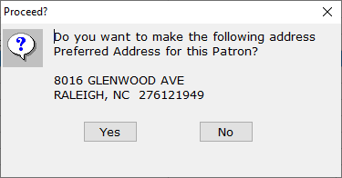
Optional prompt to automatically make a new address the default for shipping
Can enable for select Contact SubTypes (e.g. Primary, Temporary).
First address added to a record still becomes the default Ship address; no prompt needed.
Pops up after the Address Verification screen.
Notes:
Add Notes Now if you want to wait for the process to complete, fine for small Query Sets. Add Notes Later to put the job in the Batch Manager, better for large Query Sets.

Slide 14
Reading History Opt-Out
Permanently anonymizes the patron’s HasHads, moving them to a “straw patron” record: DELPAT
Anonymous record with same Library ID and Patron Type will be used for all Opt-Outs; created automatically if needed.
You keep the stats, the patron gets their privacy.
Remember that it will “break” Autoselect for that patron.
Initial roll-out: basic functionality for items only
Upcoming release:
Several UI improvements.
Duplication Orders also moved / anonymized.

Slide 15
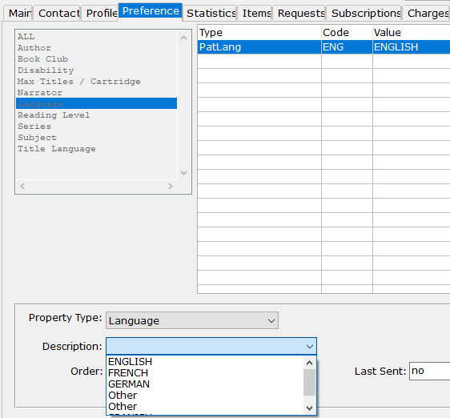
Patron
Patron Language codes no longer imported from PIMMS automatically
Additional languages can be added to your list as needed
Don’t miss the recent Key Notes Blog post on improving foreign language service!
Notes:
Blog post: https://klasusers.com/klas-news/key-notes/improving-foreign-language-service

Slide 16
Nightly Configuration
New Configuration Options!
Customize which Nightly Programs are used for each ServeType. Possible examples:
OnDemand (Dup) – Reserve, Series
Magazine Only – Reserve
Nightly List Only – Reserve, Series, Request, Author
(*Reserve and Series programs affect Duplication only)

Slide 17
Nightly Configuration
More specific overrides less specific
Individual
PatronType
Library
Customize Program settings and options for a specific PatronType
Possible examples:
IN / Nursing Homes – more Author selections, no HH check, more Subject Exclusion checks
PI / Incarcerated Patron – no Subject selections, Subject Exclusion checks on everything
Notes:
PatronType customizations will be applied regardless of library branch.

Slide 18
Duplication
Select Reserve types can be “pushed”
Serials, WebOPAC Rushes, BookClubs
If title is Duplication-Ready, it will now be pushed immediately, instead of waiting for Nightly.
Improvements for Duplication in additional media
NSCutoff calculation no longer considers the Cartridge, only the Order.

Slide 19
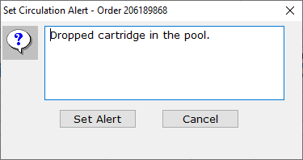
Circulation Alerts (for both Scribe and Gutenberg!)
Functions Menu – Duplication Orders – Set Circulation Alert
On Check-In, Alert will display on the Scribe or Gutenberg
Notes:
An order must be In Circulation for an Alert to be added.
On the Scribe, a red error light will display, and additional info will be shown on the Scribe Monitor webpage.

Slide 20
Duplication – Quality of Life “stuff”
Order Number added to the Patron Find for easy troubleshooting
Quick Request now returns correct error if KLAS ID is not found or is invalid

Slide 21
Duplication – Quality of Life “stuff”
Upcoming:
Fix for the Assignment confirmation pop-up for patrons with multiple Duplication media.
Error messaging for Quick Requested titles that can’t be added from List.

Slide 22
Duplication - Scribe
Walk-in mode update: “Single PCC” mode reworked to be consistent with other Scribe modes
Operating System incompatibility with the Write Protect system has been resolved
New Scribe Minis are being built and deployed again.

Slide 23
Duplication - Gutenberg
Patron names with Prefixes and Suffixes now print correctly on mail cards
eDoc mapping will allow Valid entries to override Withdrawn entries
eDoc mapping now creates additional logging

